Slide 1
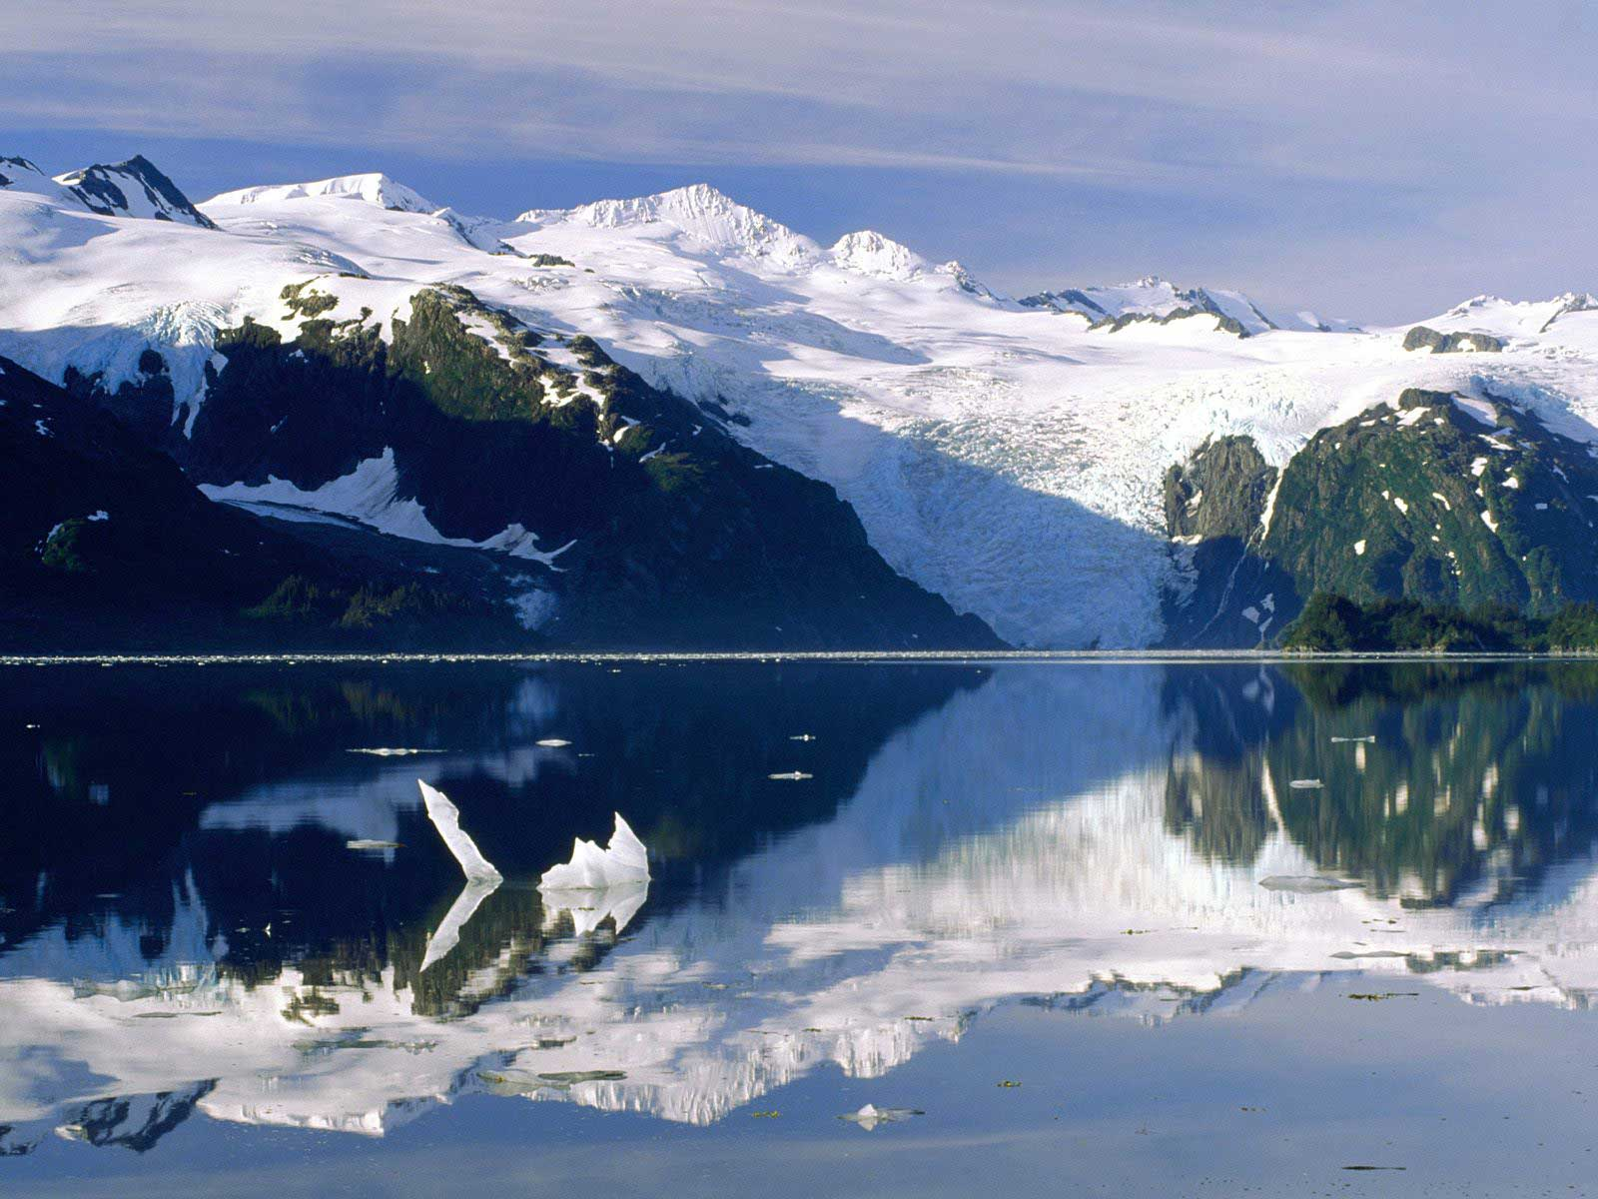
1.1 Populations and Ecosystems
Varinder Singh B.

Slide 2
Learning Objectives
Understand the meanings of a few new, ecological terms.
Understand the mechanics behind an ‘ecosystem’.
Understand what a ‘niche’ is.

Slide 3
Success Criteria
Relate the words to real-life ecosystems.

Slide 4
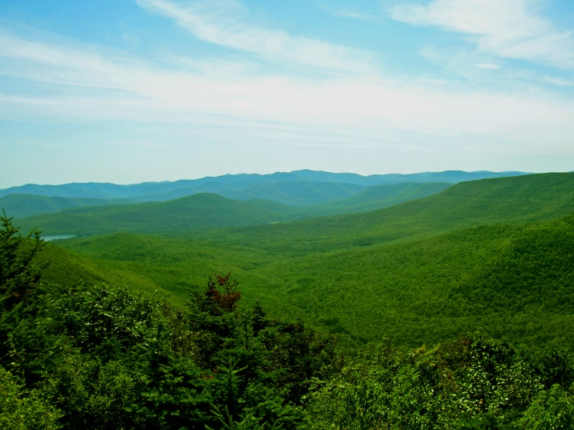
Ecology – The Study Of...
Ecology is about studying relationships between organisms and their environment.
ENVIRONMENT
The conditions surrounding an organism. The environment can be split into living and non-living components.
Black Bear
Catskill Mountains, NY

Slide 5
Environment
So, Environment = conditions surrounding an organism.
These conditions are either living or non-living.
LIVING = BIOTIC
NON-LIVING = ABIOTIC
Biotic factors can include things such as competition between individuals, predation and disease.
Abiotic factors can include things such as temperature, rainfall and natural disasters.

Slide 6
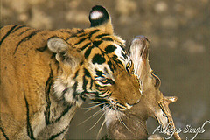
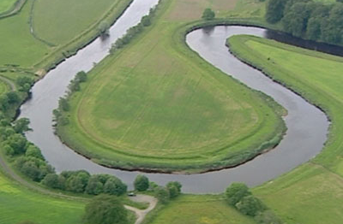
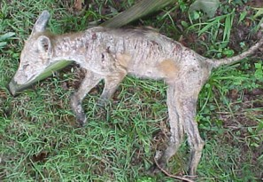
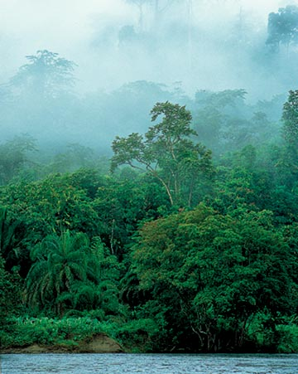
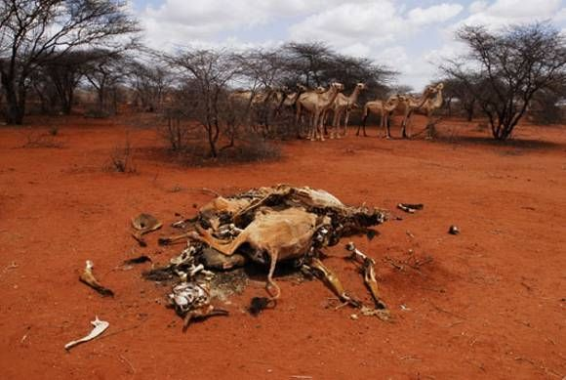
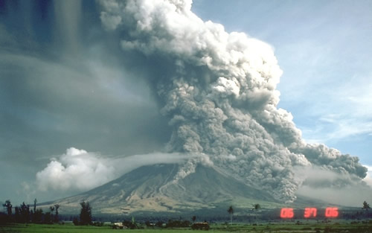
Biotic Factors
Abiotic Factors
Competition
Predation
Disease
Availability of food
Temperature
Rainfall
Light
Natural Disasters
Rivers

Slide 7
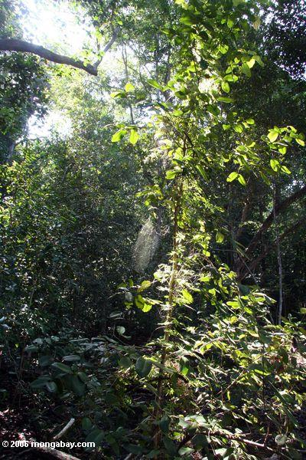
Ecosystem
An ecosystem is the largest level of organisation we study in ecology.
It’s an area in which organisms interact with both the environment and with each other.
<- A Rainforest Ecosystem:
The ecosystem is the entire area and what lives within it.
The environment includes the conditions.
Two Major Things About Ecosystems:
There is an energy flow
Recycling of elements

Slide 8
Energy Flow in an Ecosystem
What is the ultimate source of energy for an ecosystem?
Solar Energy
The flow of energy in an ecosystem is as follows:
Solar Energy Chemical Energy
What kind of organisms are responsible for this flow?
Plants (Photoautotrophs)
Photosynthesis

Slide 9
Energy Flow in an Ecosystem
The previous slide dealt with the overall flow of energy through an ecosystem, and how it originally enters it.
However, there are other organisms involved as well as plants.
Energy is transferred through trophic levels.
Producer → Primary → Secondary → Tertiary
Consumer Consumer Consumer
All energy passing through the ecosystem is eventually returned to it as heat.

Slide 10
Populations
A population is a group of organisms of a SINGLE SPECIES, living in the same area, that breed together.
Groby?
Boundaries of a population are hard to define. For humans it’s pretty easy, but for insects and migratory birds it can be difficult.
log
another log
1km

Slide 11
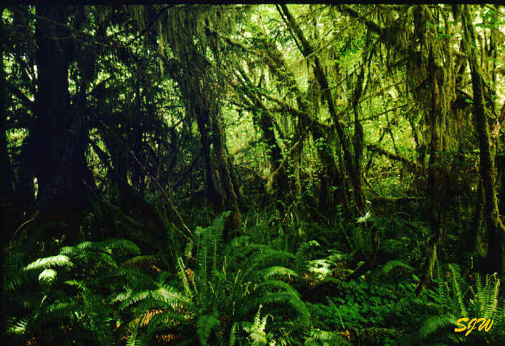
Community
A community is all of the populations in the ecosystem.
The populations in the community will be:
Living together
Interacting with each other
Killing and eating each other
Remember: We’re not just talking about animals. Populations and communities include the plants too.
Bats
Anaconda
Spiders
Ants
Birds
Frogs
Plants

Slide 12
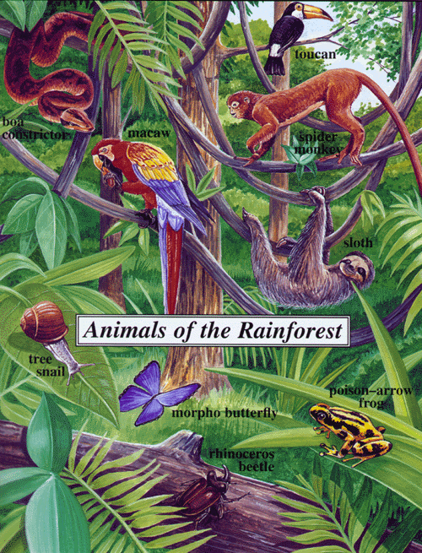
Habitats
Within an ecosystem, there are many areas where organisms can live. These areas are called habitats.
The type of habitat depends on the species.
Mammalian habitats are different from amphibian or bird habitats.
Some habitats overlap.
Microhabitats are small pockets within an ‘ordinary’ habitat.
A python may live on a tree, but the cracks in the bark may be home to woodlice.

Slide 13
Niche
Think of every organism in an ecosystem as having a job there.
The environment dictates how the organism does it’s job.
A NICHE refers to where an organism lives, and what role it plays within the environment.
All of the biotic and abiotic factors of the environment influence the niche.

Slide 14
The ecological niche of an organism depends not only on where it lives but also on what it does. By analogy, it may be said that the habitat is the organism's "address", and the niche is its "profession", biologically speaking.
Odum - Fundamentals of Ecology - W B Saunders 1959
Example:
Oak trees live in oak woodlands. The oak woodland is the habitat. So if you were writing a letter to an oak tree, you would address the letter to:
Sir Deciduous Oak Tree, The Oak Forest, England, U.K.
What do oak trees do? If you can answer that question you know the oak trees "profession" or its ecological niche. Perhaps you think that oak trees just stand there looking pretty and not doing vey much, but think about it.
Oak trees:
absorb sunlight by photosynthesis;
absorb water and mineral salts from the soil;
provide shelter for many animals and other plants;
act as a support for creeping plants;
serve as a source of food for animals;
cover the ground with their dead leaves in the autumn.

