Slide 1
Causes of disease
1.1 Pathogens

Slide 2
Starter
What is health?
A state of complete physical, mental and social well-being.
What is disease?
A description of symptoms which suggest a malfunction of body or mind.
What is a pathogen?
A microorganism that causes disease.

Slide 3
Learning outcomes
Students should understand the following:
Pathogens include bacteria, viruses and fungi.
Disease can result from pathogenic microorganisms penetrating any of an organism’s interfaces with the environment. These interfaces include the digestive
and gas-exchange systems.
Pathogens cause disease by damaging the cells of the host and by producing toxins.

Slide 4
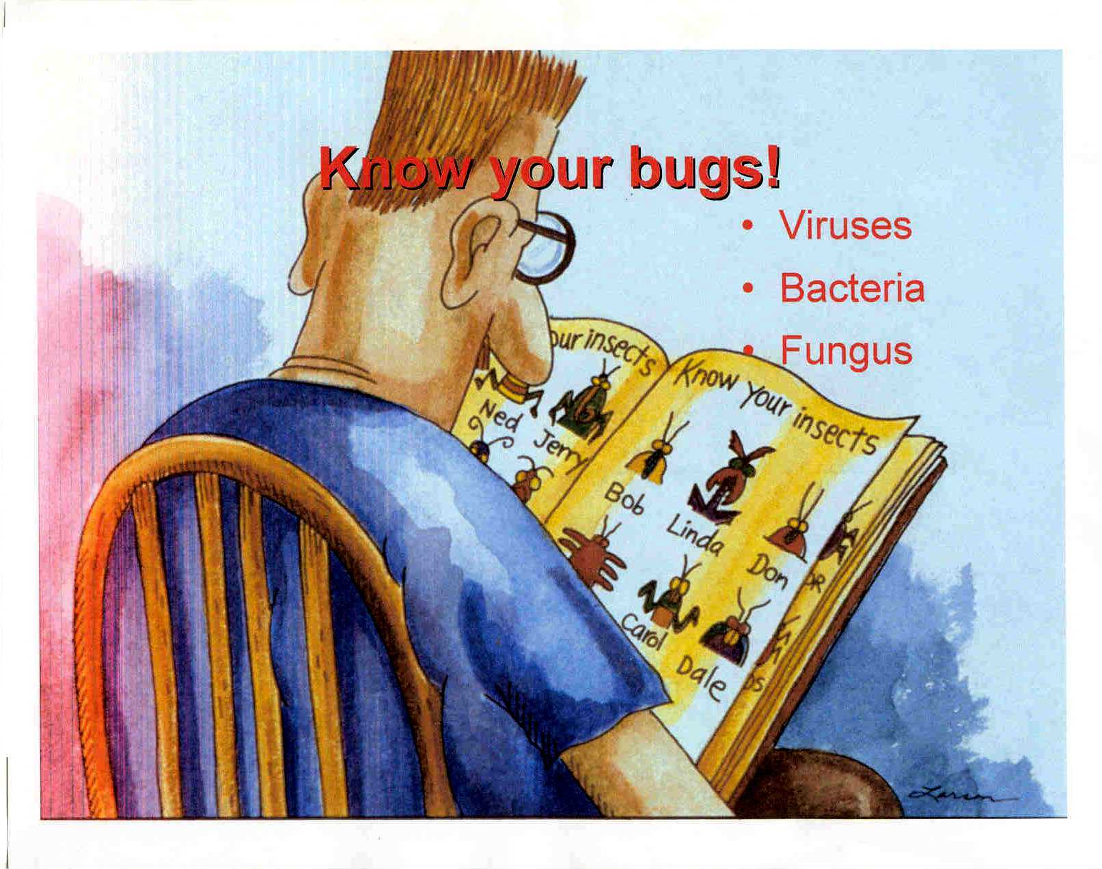
Infectious diseases
Epidemics – widespread outbreaks of disease
Pandemics – epidemics that spread Internationally.
Any microorganism that spreads disease is called a pathogen. There are 3 types:
Bacteria e.g. salmonella, tuberculosis
Virus e.g. Influenza, AIDS, measles
Fungi e.g. athletes foot, thrush

Slide 5
Initial infection
A microorganism must pass the bodies external defences:
Skin – through a cut
Respiratory tract
Digestive system
Urino-gential system
To help prevent entry the body has a number of defences
Mucous layer that covers exchange surfaces
Enzymes
Stomach acid

Slide 6
Why do we feel ill?
Pathogens colonise and reproduce in tissue and body fluids causing:
Physical damage to cell structure
Disruption of cell metabolism and function
Release of toxins
Stimulation of the body’s immune system

Slide 7
After infection
Once pathogens are inside they then attach to the host cell via receptor binding protein molecules (ligands) found in the microbial wall or viral coat.
Pathogens enter by endocytosis or by producing enzymes that breach the host cell membrane. They must then reproduce but this takes time.
The time period between infection and appearance of signs and symptoms is called the incubation period.
It is possible for an infected but otherwise apparently healthy person to pass on an infection – carrier.

Slide 8
Toxins
Many bacterial pathogens produce toxins
Exotoxins – secreted by or leak from bacteria:
Escherichia Coli - exotoxins affect lining of intestines and cause diarrhoea.
Clostridium tetani – exotoxins affect nerve cells resulting in spastic paralysis (lockjaw)
Endotoxins – complex compounds released when bacterial cell dies.
They are picked up by macrophages (type of white blood cell) and cause them to produce proteins that alter the body’s temperature -regulating mechanisms, resulting in a fever. These proteins also cause weakness and aching.

Slide 9
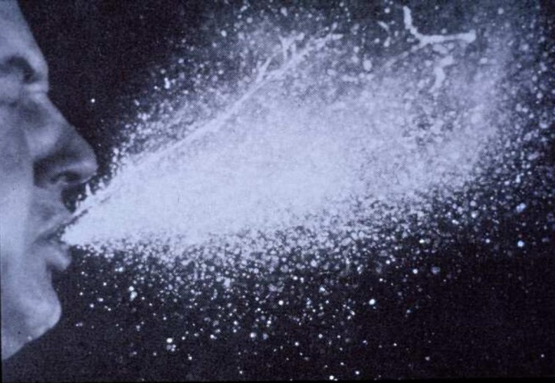
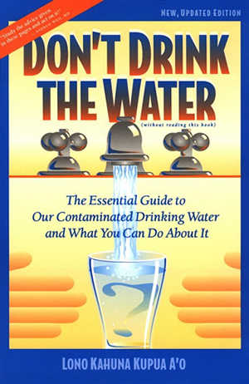
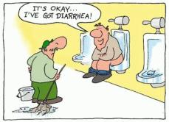
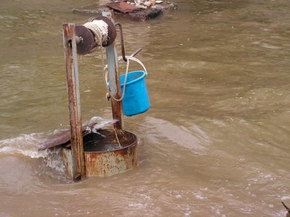
Transmission of pathogens
Pathogens can infect an individual in a number of ways:
Air-borne infection
e.g. chickenpox, influenza, TB
Water-borne infection
e.g. Vibrio cholerae and Escherichia coli

Slide 10
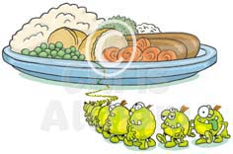
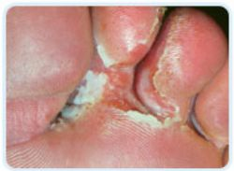
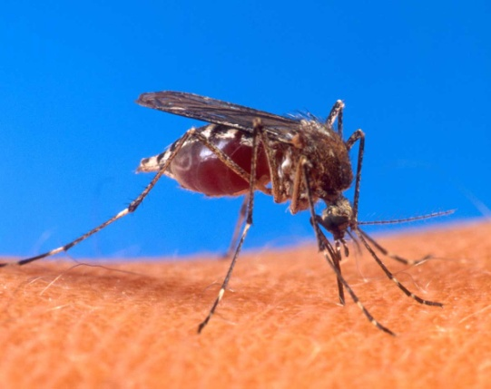
Transmission of pathogens
Food-borne infection
e.g. salmonella and typhoid
Direct contact infection
e.g. athletes foot (fungal)
Sexually transmitted diseases e.g. Syphilis (bacterial) genital herpes, HIV (viral)
Animal vectors
e.g. malaria

Slide 11
Learning outcomes
Students should understand the following:
Pathogens include bacteria, viruses and fungi.
Disease can result from pathogenic microorganisms penetrating any of an organism’s interfaces with the environment. These interfaces include the digestive
and gas-exchange systems.
Pathogens cause disease by damaging the cells of the host and by producing toxins.

