Slide 1
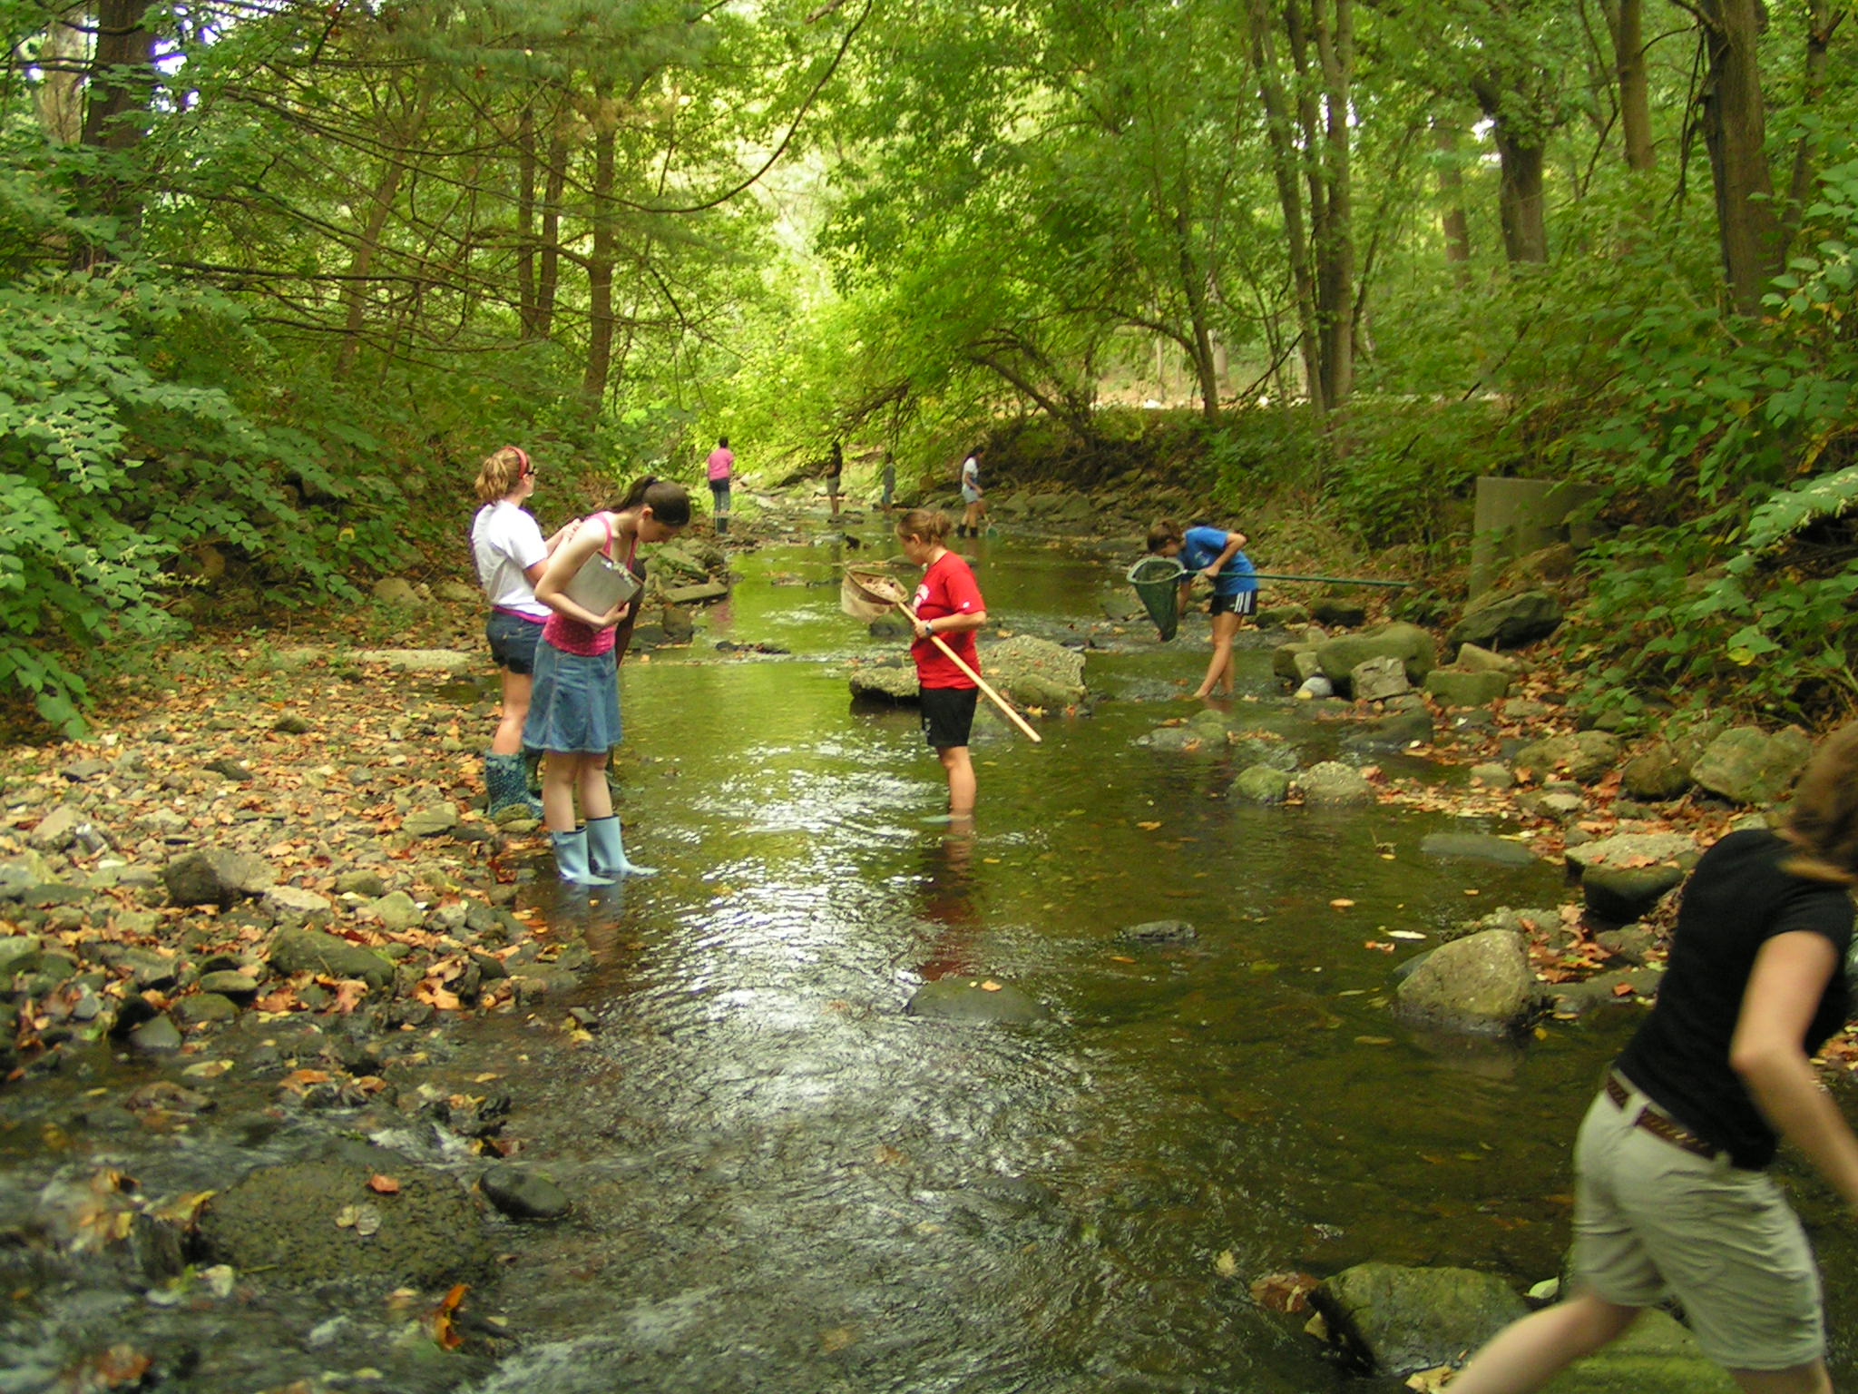
1.2 Investigating Populations

Slide 2
Learning Objectives
Recap yesterday. Elaborate on a few things.
Study the different ecological techniques used to study populations.
Decide on a field trip?

Slide 3
Studying Habitats
When studying a habitat, ecologists will first estimate the populations of the species living there.
The abundance of each species can never be known exactly, but sampling can give reasonably accurate estimates.
Why would it be wrong to try to count every individual of a population?
So small samples are studied at random locations, and then scaled up to fit the entire habitat.
There are of course, a range of ecological techniques at an ecologist’s disposal.

Slide 4
Introducing Sampling Techniques
The approach to sampling can be in one of two ways:
1. Random
2. Systematic
Random Sampling:
This is usually employed when trying to eliminate bias. Two numbered axis can be laid out over the sample area. Generation of random numbers provides co-ordinates for areas to study.
Systematic Sampling:
A similar grid is laid over the entire area, but samples are taken at regular intervals. Time-consuming... But more reliable?
These two approaches are realised using the following apparatus.
Random grid
island

Slide 5
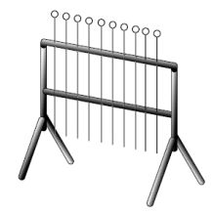
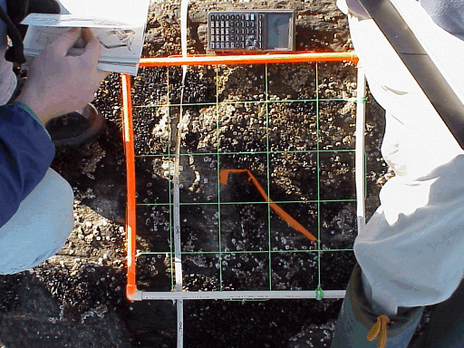
Quadrats
A quadrat is just a fancy square used by biologists/ecologists.
There’s two types of quadrat:
Frame Quadrat
Point Quadrat

Slide 6
More About Quadratting
Three things to consider when using quadrats:
The size of the quadrat:
Depends on the size of species being investigated, or what kind of groups or colonies the species live in.
The number of samples being taken in the area:
The more samples you take in the habitat, the more reliable the results will be... Depends if time is an issue.
The position of each quadrat:
Producing unbiased results within a small time-frame is the best idea. Random sampling would work well.
A problem that arises during quadrat sampling is the clumping of plants. To get around this... We measure the ‘mean density’ or ‘percentage cover’ instead.

Slide 7
Mean Density
You count all the individuals of a single species in a quadrat. Do this for a few quadrats (as painstaking as it may be).
The quadrat must be of a known size.
Plug the numbers into the following formula:
Estimated mean = Total number of induviduals counted
density Number of quadrats x Area of quadrat

Slide 8
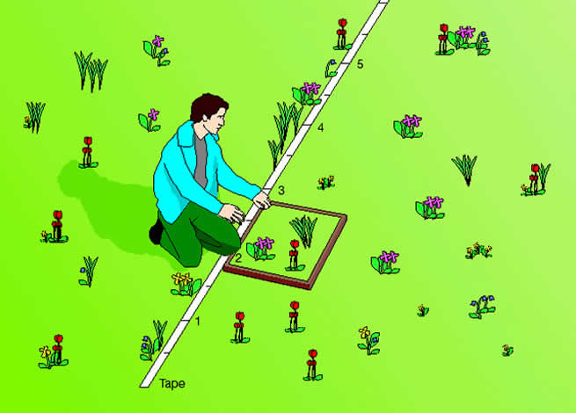
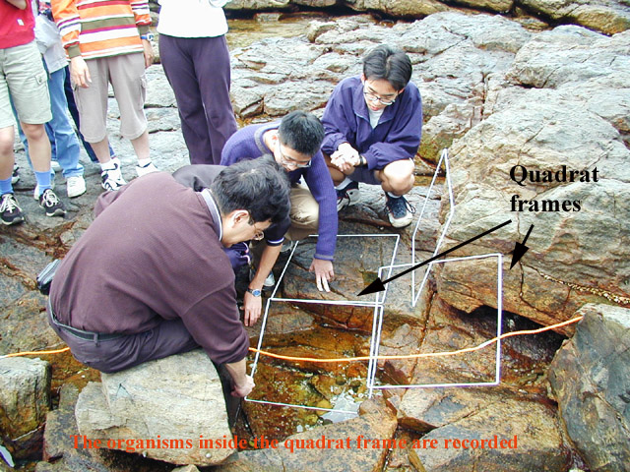
Transects
Transect sampling is more of a systematic technique, but can be adapted to a random technique if required.
See transect sheet.

Slide 9
Mark-Release-Recapture

Slide 10
What about animals?
What we’ve seen up until now is fine for sampling plant populations, but studying animals and insects is trickier.
A set of animals are caught and then marked in some way.
They’re then released back into the community.
After a specified length of time, the community is revisited and the same number or individuals is caught again.
The number of marked individuals is counted.
The population size is calculated:
Estimated pop. = Total number of individuals in the first sample x
size Total number of individuals in the seconds sample
number of marked individuals recaptured

