Slide 1
Variation in Population Size
1.3

Slide 2
Starter
Recap:
Definitions of:
Population?
Abiotic?
Biotic?

Slide 3
Learning Objectives
State what factors determine the size of a population
Describe the abiotic factors that affect the size of a population
Explain how these factors influence population size
Carry out Chi squared tests

Slide 4
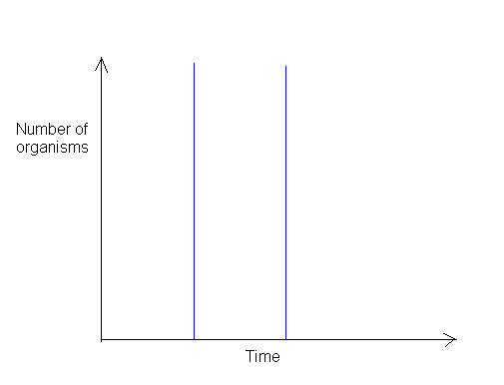
Population Growth Curves
Usually there are 3 phases:
Slow growth as numbers are built up
Rapid growth
Population growth decreases, population is approximately stable. Some variation due to...?
Stable, no growth
Rapid growth
Slow growth

Slide 5
Population Size
Affected by limiting factors
Rapid growth can happen when there are no or few limiting factors e.g. Plants can grow rapidly if sunlight is not limiting
Once more organisms grow and reproduce, nutrients and other factors become limiting, slowing down overall increase in population size
The ultimate population size will be affected by biotic and abiotic factors.

Slide 6
Abiotic Factors
For the following abiotic factors write an explanation about how they would influence the size of a population
Temperature
Light
pH
Water and Humidity

Slide 7
Temperature
Population size will be smaller if the temperature is too far away from the optimum for that species
Enzymes
Too cold: enzymes slow down, metabolic rate decreases so growth is slower
Too hot: enzymes are denatured so population growth is slower
Warm-blooded animals: if the temperature is too far from the optimum a lot of energy is expended trying to maintain normal body temperature, so population growth slows.

Slide 8
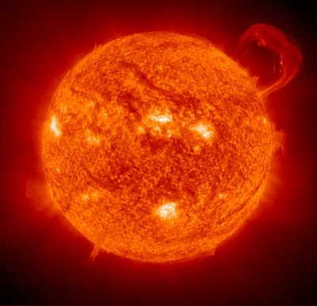
Light
Photosynthesis rates will increase when light intensity increases, this means faster plant growth.
This will have an effect up the food chain, potentially increasing animal population size.

Slide 9
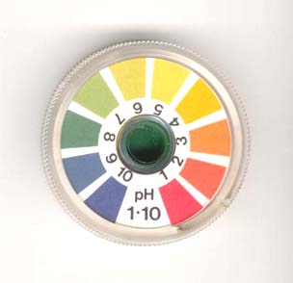
pH
Enzyme activity is affected by pH
Enzymes have an optimum pH at which they will work best
Population sizes will be larger when the conditions are the best pH for enzyme activity

Slide 10
Water and Humidity
Population sizes are often very small if there is little water present (only species such as xerophytes will be able to survive)
Changes in humidity will affect the transpiration rates of plants, thus affecting plant growth.
If the air is dry, only species adapted to this will be present in larger numbers.

Slide 11
Averages
Mean = sum of all values/number of values
Mode = most common value
Median = middle value when all values written out in order
Ecology field study, calculate the mean, median and mode for the data:
Quadrats in the woodland | A | B | C | D | E | F | G
Frequency of meadow brown butterfly | 3 | 22 | 12 | 7 | 12 | 8 | 10

Slide 12
Chi Squared (X²⁾
The Chi-squared test is used to test a null hypothesis.
It allows us to compare our observed results with the expected results and decide whether or not there is a significant difference between them.

Slide 13
When do you use chi squared?
It is a simple test that can only be used if certain criteria are met:
The sample size must be relatively large
The data must fall into discrete categories
Only raw counts and not percentages can be used

Slide 14
Chi-squared (X²) test
Chi = sum of [observed numbers (O) – expected numbers (E)]²
Squared expected numbers (E)
X ² = (O – E)²
E
Σ

Slide 15
Chi-squared test
The number obtained is then read off a chi-squared distribution table to determine whether any deviation from the expected results is significant or not.
Degrees of freedom – number of categories minus one (n-1).

Slide 16
Chi-squared
In the chi-squared test, the critical value is p = 0.05 (5%)
If the probability that the deviation is due to chance is more than p = 0.05 (i.e. a probability of more than 5%), we can reject the null hypothesis that there is no statistically significant difference between the observed and the expected results.
E.g. If your X² value is 54.6 and the significance level at the appropriate degrees of freedom is 9.48 then you would reject the null hypothesis.

Slide 17
Question
Type of Seaweed | Frequency (number of animals on each type of seaweed)
Serrated wrack | 45
Bladder wrack | 38
Egg wrack | 10
Spiral wrack | 5
Other algae | 2
Total | 100
Null Hypothesis: there is no difference between the frequencies of animals over the 5 types of seaweed
Expected Frequency = 100/5 = 20

Slide 18
Question
Seaweed | Observed | Expected | O-E | (O-E)² | (O-E)²/E
S.W. | 45 | 20 | 25 | 625 | 31.3
B.W. | 38 | 20 | 18 | 324 | 16.2
E.W. | 10 | 20 | -10 | 100 | 5
Spiral W. | 5 | 20 | -15 | 225 | 11.3
O.A. | 2 | 20 | -18 | 324 | 16.2
Total | 100 | 100 |  |  | 79.9
Σ
X ² = (O – E)²
E

Slide 19
Question
Our X² value is 79.9
You then look this up in a Critical Value table, using your degrees of freedom (number of categories – 1, so it is 5 – 1 = 4)
The critical value at 5% is 9.48, our value is bigger than this, so we reject the null hypothesis
D.o.F. | Significance Level
 | 0.05 (5%) | 0.02 (2%) | 0.01 (1%)
1 | 3.84 | 5.41 | 6.64
2 | 5.99 | 7.82 | 9.21
3 | 7.82 | 9.84 | 11.34
4 | 9.48 | 11.66 | 13.27

Slide 20
Application Questions
Complete application questions from page 12 of the A2 book

