Slide 1
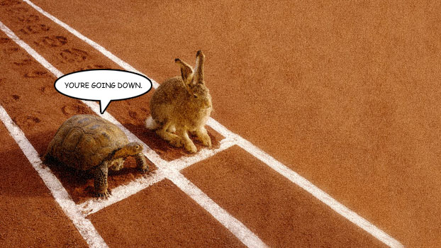
1.4 Competition

Slide 2
Starter Activity: Unscramble these anagrams!
Paulnitpoo
Baithat
Cotbitai
Tobciti
Mumcityno
chine

Slide 3
Learning objectives:
What is intraspecific competition?
What factors do different species compete for?
What is interspecific competition?
How does interspecific competition influence population size?

Slide 4
Success Criteria
All students should be able to give definitions of interspecific competition and intraspecific competition.
All students should be able to complete examination questions on competition

Slide 5
Competition - A Biotic Factor!
Competition is a biotic factor as it involves interactions between organisms.
Where two or more individuals share any resource (e.g. Light, food, space, oxygen) that is insufficient to satisfy all their requirements fully, then competition results.
There are two types of competition:
Intraspecific competition
Interspecific competition

Slide 6
Intraspecific Competition
Intraspecific competition occurs between members of the same species.
As a population grows, (density dependent) competition increases for space (e.g. a patch of soil to grow on or a nesting site) and food.
Population varies about the carrying capacity – an average figure.

Slide 7
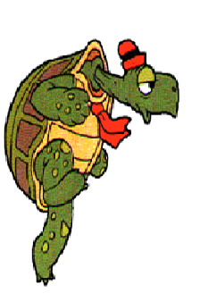
Intraspecific Competition

Slide 8
Intraspecific Competition in Algae
Autumn – shortening days and falling temperatures – reduce photosynthesis and slow enzyme activity – algae die
Algae cells (number/cm³)
120
100
80
60
40
20
0
Winter – little light and low temperatures – slow/prevent photosynthesis and enzyme activity
Spring – longer days, with more light and higher temperatures – allow more photosynthesis and faster enzyme activity
Jan Feb Mar Apr May Jun Jul Aug Sep Oct Nov Dec
Algal growth over a year

Slide 9
Question 1: Suggest and explain how one biotic factor could explain the changes in the population of microscopic algae in the graph on this page between July and September.
Answer: Availability of mineral ion, e.g. Nitrate; becoming limiting factor; due to intra- and interspecific competition for nitrate; so population growth stops and there is a decline in numbers.

Slide 10
Intraspecific Competition in a population of small herbivores
Competition increases, some factor becomes limiting and growth becomes negative
Number of herbivores/hectare
No limiting factors
4.5
4.0
3.5
3.0
2.5
2.0
1.5
1.0
0.5
0
Carrying capacity
Smaller population lowers competition and population grows again
0 2 4 6 8 10 12 14 16
Time (weeks)

Slide 11
Important Information!
There will be variation in phenotypes of a population due to genetic and environmental factors. Mutation, meiosis and sexual reproduction produce genetic variation. Variation means that some are better adapted to their environment.

Slide 12
Interspecific Competition
Interspecific competition is where different species compete for the same resource, at the same trophic level.
Species of plant compete for light; herbivore species compete for the same plant; or carnivore species compete for the same prey.

Slide 13
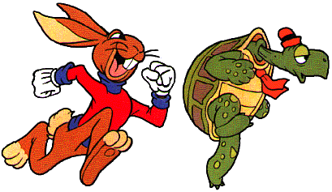
Interspecific Competition

Slide 14
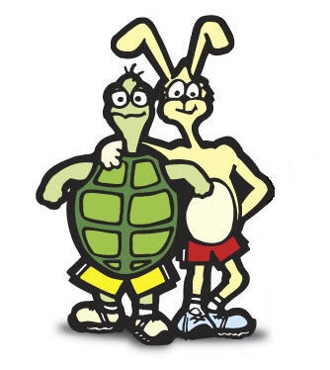
Plenary Activity
Complete the two summary questions (page 14) and the four application questions (page 15) in the student text book.
You have 15 minutes to complete this task!

Slide 15
Predation
Predation – the predator is a limiting factor on growth of the prey population and the prey is a limiting factor on the predator population.
Population curves for herbivore and predator have the same general shape.
The predator’s curve always shows a TIME LAG, compared to the prey.

Slide 16
Intraspecific Competition in a population of small herbivores
Prey population increasing due to small predator population
Large number of predators causes a fall in prey population
Predator population fall after prey population falls
Herbivores/hectare
3.0
2.5
2.0
1.5
1.0
0.5
0
0.5
0.4
0.3
0.2
0.1
0
Predators/hectare
Predator numbers grow as they now have a lot of prey to feed on.
0 2 4 6 8 10 12 14 16
Time (weeks)

