Slide 1
Co-ordination
10.1

Slide 2
Starter
Write down two differences between the hormonal system and nervous system
Nervous system – nerve cells pass electrical impulses along their length and stimulate target cells by neurotransmitters
Hormonal system - chemicals (hormones) that pass in the blood.
Hormonal system – slower, less specific form of communication
Nervous system – rapid response but short-lasting

Slide 3
Learning outcomes
Success criteria
By the end of this lesson I will know that –
Nerve cells pass electrical impulses along their length. They stimulate their target cells by secreting chemical neurotransmitters directly on to them. This results in rapid, short-lived and localised responses.
Mammalian hormones are substances that stimulate their target cells via the blood system. This results in slow, long-lasting and widespread responses.
Histamine and prostaglandins are local chemical mediators released by some mammalian cells and affect only cells in their immediate vicinity.
By the end of this lesson I can
Write down at least 2 differences between hormonal and nervous systems
Complete a comparison between hormonal and nervous systems
Describe to your partner from KS4 why a young shoot will bend towards the light
Complete a diagram describing the role of IAA
Complete application on page 158 – 160 and peer mark

Slide 4
Chemical Mediators
Further type of co-ordination: chemicals released by cells that affect the cells immediately around them
Chemical mediators are released by infected or injured cells and cause arteries and arterioles to dilate
There is a rise in temperature and swelling of the affected area = inflammatory response

Slide 5
Chemical Mediators
Chemical Mediator | Where is it found? | When is it released? | Response? | Result?
Histamine | Stored in certain white blood cells | Released following injuries or in response to an allergen | Dilation of small arteries and arterioles, causing an increased permeability of capillaries | Swelling, redness and itching
Prostaglandins | Found in cell membranes | Following injury | Dilation of small arteries and arterioles, causing an increased permeability of capillaries | Affects blood pressure and neurotransmitters – affecting pain sensation

Slide 6
Task
Complete table of comparison between hormonal and nervous systems

Slide 7
Differences between hormonal and nervous communication
Hormonal communication | Nervous communication
By chemicals called hormones | By nerve impulses. Chemicals are released at synapses
Slow response | Rapid response
Slower transmission | Very rapid transmission
Hormones travel in bloodstream to all parts of the body | Impulses travel along nerve fibres which are fixed pathways to specific parts of the body
Strength of stimulus is determined by a change in hormone concentration | Strength of a stimulus Is determined by a change in the frequency of impulses
Hormones can have a permanent and irreversible effect | Nerve impulses have a temporary and reversible effect

Slide 8
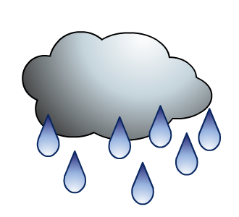
Name the different types of tropisms
Plant responses to stimuli are given specific names:
light
water
gravity
phototropism
hydrotropism
geotropism
Which parts of a plant respond to these different stimuli and why?
Notes:
Teacher notes
Geotropism is also sometimes referred to as gravitropism.

Slide 9
Plant growth factors
Influence plant growth
Made by cells located throughout the plant rather than in a particular organ, like animal hormones
Affect the tissues that release them rather than acting on a distant target organ, like animal hormones.
Produced in small quantities
Effects are close to tissue that produces them
An example is indoleacetic acid (IAA) – causes plants to elongate. This is an auxin.

Slide 10
Plant tropisms
Task – Describe to your partner (from KS4 knowledge) why a young shoot will bend towards the light

Slide 11
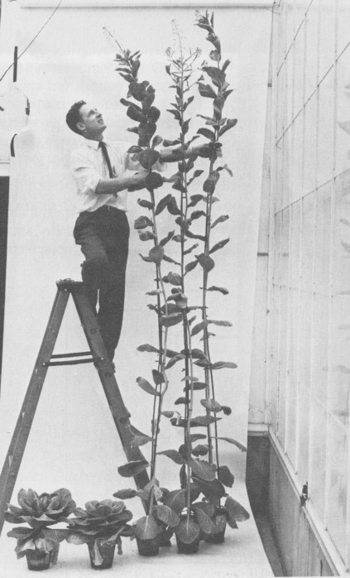
Plant Hormones
The growth and form of a plant is determined by the balance of plant hormones.
A well known example of a plant hormone is AUXIN (IAA).
General points that it is IMPORTANT for you to remember:
IAA is made in the tip.
IAA causes cell elongation in the shady side of plants.

Slide 12
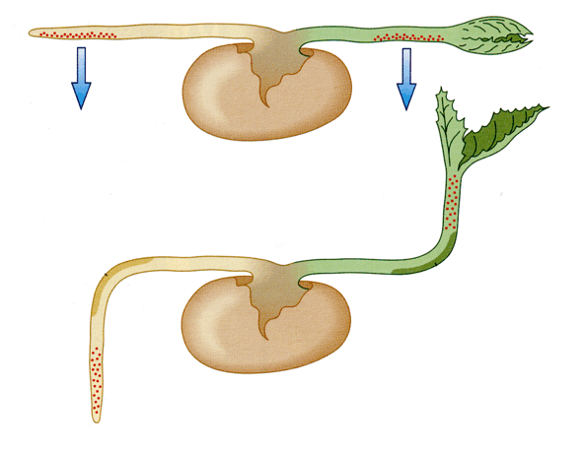
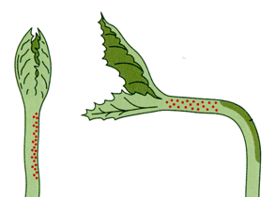
Hormones and Tropisms
ANNOTATE YOUR DIAGRAMS
GEOTROPISM
PHOTOTROPISM
IAA collects on the lower side of root and shoot.
IAA is produced in the tip and light causes it to collect on the shady side of the shoot
Light
High level of IAA slows down growth on lower side of root.
It bends downwards
High level of IAA speeds up growth on lower side of shoot
It bends upwards.
High level of IAA causes cell elongation on the shady side of the shoot.
This side grows faster, so the plant bends towards the light.

Slide 13
Task
Write out explanations of what is happening in the 3 experiments on the sheet. Include detail about IAA and where it is going and why.

Slide 14
Application Questions
Complete IAA application questions on pages 158-160

Slide 15
Learning outcomes
Success criteria
By the end of this lesson I will know that –
Nerve cells pass electrical impulses along their length. They stimulate their target cells by secreting chemical neurotransmitters directly on to them. This results in rapid, short-lived and localised responses.
Mammalian hormones are substances that stimulate their target cells via the blood system. This results in slow, long-lasting and widespread responses.
Histamine and prostaglandins are local chemical mediators released by some mammalian cells and affect only cells in their immediate vicinity.
By the end of this lesson I can
Write down at least 2 differences between hormonal and nervous systems
Complete a comparison between hormonal and nervous systems
Describe to your partner from KS4 why a young shoot will bend towards the light
Complete a diagram describing the role of IAA
Complete application on page 158 – 160 and peer mark

