Slide 1
10. The Variety of Life
10.1 Haemoglobin

Slide 2
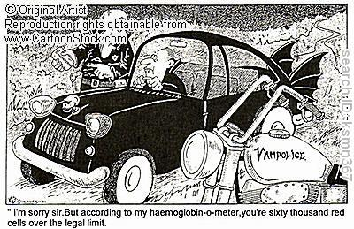
Starter
What is haemoglobin?

Slide 3
Learning Objectives and Success Criteria
Describe the structure of haemoglobin and what its role is
Explain how haemoglobin in different organisms differs
State what loading and unloading of oxygen is
You can complete a table to show how affinity of oxygen changes in different regions of the body
You can make a labelled model of the structure of haemoglobin
You can describe how and why haemoglobin differs in different organisms

Slide 4
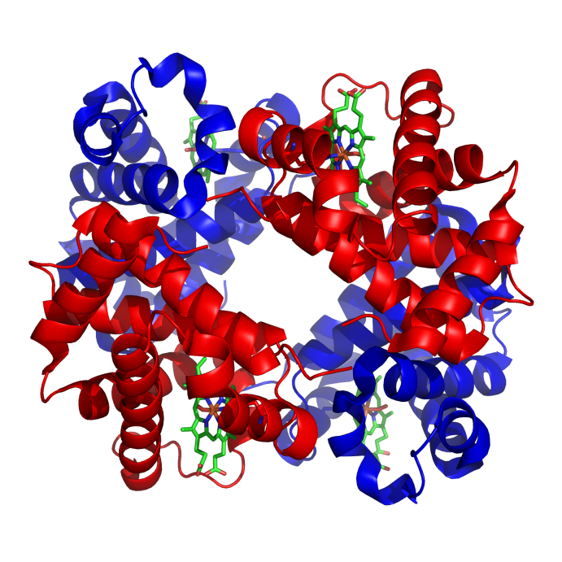
Structure of Haemoglobin Molecules
Primary Structure – 4 polypeptide chains
Secondary Structure – Each polypeptide chain is coiled into a helix
Tertiary Structure – Each chain is folded into a precise shape
Quaternary Structure – 4 chains are linked together to form a ~ spherical molecule.

Slide 5
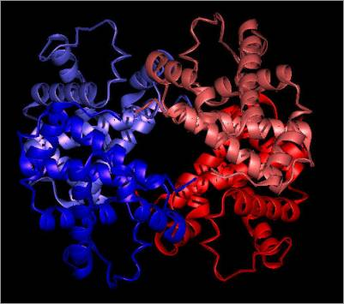
More on Quaternary Structure
Each polypeptide chain has a haem group
A haem group has an iron ion (Fe²⁺)
Each Fe²⁺ can join to an Oxygen molecule (O₂)
Total = 4 O₂ molecules can be carried by 1 haemoglobin molecule in humans

Slide 6
The Role of Haemoglobin
Main role: to transport oxygen
It must:
Readily associate with oxygen at the gas exchange surface
Readily dissociate from oxygen at the tissues that require it
How does it manage this?
The shape of haemoglobin changes under different conditions e.g. when CO₂ is present: haemoglobin’s shape makes it bind more loosely to O₂, so it loses the oxygen

Slide 7
Affinity of haemoglobin for O₂
Copy and complete the table
Region of body | Oxygen Concentration | CO₂ concentration | Affinity of haemoglobin for O₂ | Result – what happens to oxygen?
Gas exchange surface | High | Low | High | Oxygen is attached
Respiring Tissues | Low | High | Low | Oxygen is released
Are the concentrations/affinity for O₂ high or low?

Slide 8
Haemoglobin in different organisms
Some have haemoglobins with a high affinity for oxygen (take up O₂ easily, release it less readily)
Some have haemoglobins with a low affinity for oxygen (take up O₂ less easily, release it more readily)
Why?
Depends on the environment the organisms lives in (e.g. A low oxygen environment needs a haemoglobin with a high affinity for oxygen)
The organism’s metabolic rate (e.g. An organism with a high metabolic rate needs to release O₂ readily to its tissues – low affinity)

Slide 9
Haemoglobins with different affinities for O₂
What about haemoglobin may make it have a different affinity for oxygen?
Different shape
Different sequences of amino acids

Slide 10
Loading and Unloading Oxygen
Loading = haemoglobin combining (associating) with oxygen
Unloading = haemoglobin releasing (dissociating) with oxygen
Where do these 2 processes take place in humans?
Loading = lungs
Unloading = tissues

Slide 11
Haemoglobin Model
Use the coloured paper, scissors and sellotape provided to make a model of haemoglobin

Slide 12
Learning Objectives and Success Criteria
Describe the structure of haemoglobin and what its role is
Explain how haemoglobin in different organisms differs
State what loading and unloading of oxygen is
You can complete a table to show how affinity of oxygen changes in different regions of the body
You can make a labelled model of the structure of haemoglobin
You can describe how and why haemoglobin differs in different organisms

