Slide 1
10.2 Neurones

Slide 2
Learning Ojectives
To understand the structure and function of neurones.
To learn that there are different types of neurones in the human body.

Slide 3
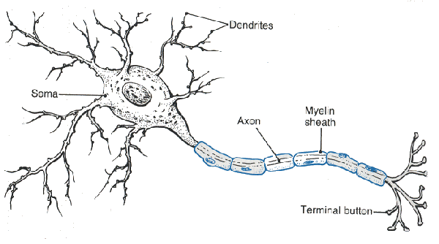
Neurones
Neurones are amongst the largest cells in the body (especially in terms on length).
They are highly specialised (differentiated) cells, adapted to rapidly carrying electrochemical changes called nerve impulses.
They are a means of conveying information over large distances within the body.

Slide 4
Neurone structure

Slide 5
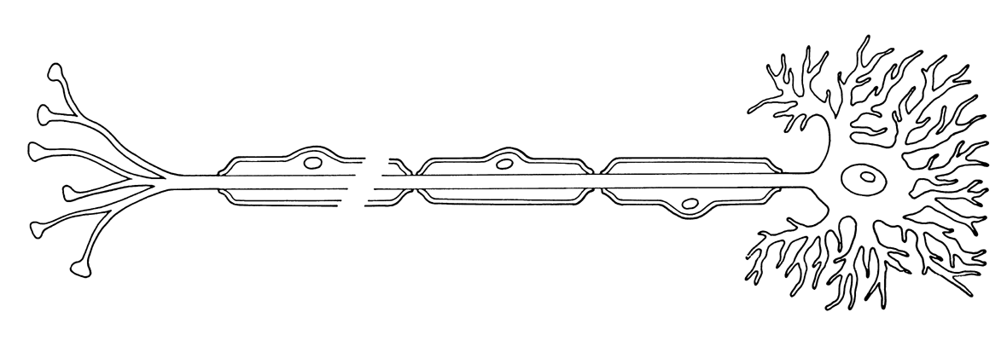
First things first…
In this diagram, the propagation of a nerve impulse occurs from LEFT TO RIGHT.
NERVE IMPULSE

Slide 6
The Cell Body
Contains the nucleus and a large amount of rough endoplasmic reticulum. This is in order to produce large amounts of protein – particularly NEUROTRANSMITTERS

Slide 7
Dendrons
These are extensions of the cell body. They are the ‘thickest’ parts of the branches. They are subdivided themselves, into…
Dendrites
These are small ‘fingers’ furthest away from the cell body. These ‘collect’ nerve impulses and carry them towards the cell body.

Slide 8
Axon
This is the single, long fibre that runs the length of the neurone. It carries the nerve impusle away from the cell body, propagating it from one place to another.

Slide 9
Schwann Cell
These cells wrap themselves around the axon many times.
They are a form of protection for certain types of neurone.
They also provide electrical insulation.
Finally, they can aid in the regeneration of damaged axons.
Myelin Sheath
Due to the many ‘wrappings’ of the Schwann Cell, many membrane layers form around the axon. These are rich in a lipid known as myelin. Myelinated neurones carry nerve much faster than unmyelinated ones.

Slide 10
Nodes of Ranvier
These are gaps between adjacent Schwann Cells. They are therefore areas with no myelin sheath. The gaps are around 2-3µm long, and occur every 1-3mm in humans.

Slide 11
Try to spot all structures on the next slide…

Slide 12
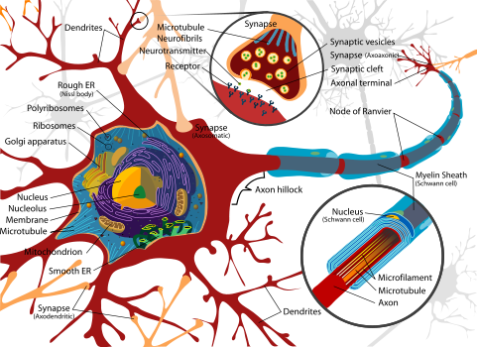

Slide 13
Different types of neurones

Slide 14
Classification of Neurones
Sensory Neuron:
These transmit nerve impulses from a receptor to the central nervous system or an intermediary neurone.
Their cell body usually appears to be an
extension of the axon.
Motor Neuron:
These transmit nerve impulses from the CNS or an intermediary neuron to an effector.
These usually have a long axon and many
short dendrites.

Slide 15
Classification of Neurones
Intermediary Neuron:
The transmit impulses between other neurones, for example, between sensory and motor neurones.
Their structure is self-explanatory.
They have lots of dendrites at both
sides, in order to propagate an
impulse between two neurones.

Slide 16
Learning Ojectives
To understand the structure and function of neurones.
To learn that there are different types of neurones in the human body.

