Slide 1
10. The Variety of Life
10.2 Oxygen Dissociation Curves

Slide 2
Starter
What is the structure of haemoglobin?

Slide 3
Learning Objectives and Success Criteria
Describe and explain an oxygen dissociation curve
State and explain the effect of CO₂ concentration on the curve
Relate the properties of haemoglobins in different organisms to their environment and way of life
You can draw graphs for oxygen dissociation in varying CO₂ concentrations
You can answer questions on the effect of CO₂ concentration
You can turn information on loading and unloading of oxygen into a flow chart
You can complete application questions

Slide 4
Oxygen Dissociation Curves
Haemoglobin does not absorb oxygen evenly when exposed to different partial pressures
Why?
Very low concentration of oxygen: the 4 chains in the haemoglobin are very closely united, making it difficult to load the first oxygen molecule
Once loaded, the oxygen causes the chains to load the other oxygen molecules very easily
The graph of this is called the oxygen dissociation curve

Slide 5
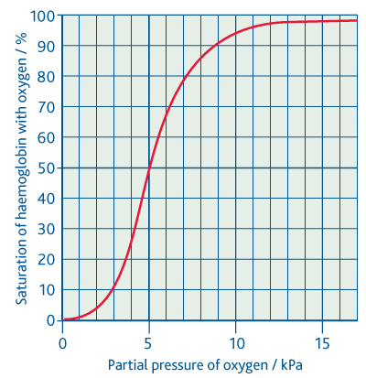
Oxygen Dissociation Curves
Other 3 oxygen molecules bind easily
First oxygen molecule is difficult to bind
Small decrease in partial pressure of O₂ leads to a lot of dissociation

Slide 6
Oxygen Dissociation Curves
May be different for different haemoglobins (in different organisms), but will have a similar shape
Will be in a different place on the graph:
Further to the left: Greater affinity for O₂
Further to the right: Lower affinity for O₂

Slide 7
Effects of Carbon Dioxide Concentration
How do you think CO₂ will affect the affinity of haemoglobin for oxygen?
At a high CO₂ concentration: Haemoglobin has a reduced affinity for oxygen
At a low CO₂ concentration: Haemoglobin has a higher affinity for oxygen
Questions:
How does this explain behaviour of haemoglobin in the lungs?
How does this explain behaviour of haemoglobin in the muscles?
Why does haemoglobin have a reduced affinity for oxygen at higher CO₂ concentrations?
Bohr Effect
CO₂+ H₂O H⁺ + HCO⁻₃

Slide 8
Answers
In the lungs the level of carbon dioxide is low because it diffuses across the surface and is breathed out. So, haemoglobin has a higher affinity for oxygen (there is also a higher concentration of oxygen in the lungs). This means oxygen is readily loaded by haemoglobin.
In the muscles the level of carbon dioxide is high because it is produced by respiration. So, haemoglobin has a lower affinity for oxygen (there is also a lower concentration of oxygen in the muscles). This means oxygen is readily unloaded by haemoglobin.
Dissolved CO₂ is acidic and the low pH causes haemoglobin to change shape, making it readily lose its oxygen when there is a high concentration of CO₂.
CO₂+ H₂O H⁺ + HCO⁻₃

Slide 9
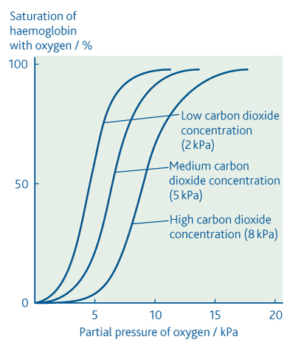
Effects of Carbon Dioxide Concentration
On your second graph, sketch on the graphs you would expect at Low, Medium and High CO₂ concentrations
The Bohr Effect

Slide 10
Loading, transport and unloading of oxygen
Turn the following information into a flow chart
Carbon dioxide is constantly being removed at the gas exchange surface. The removal of carbon dioxide raises the pH (makes it less acidic). This causes the shape of haemoglobin to change so that it can now load oxygen more readily. This shape also increases haemoglobin’s affinity for oxygen, making sure that oxygen is not released during transport in the blood. The respiring tissues produce carbon dioxide. This makes the pH of the blood in the tissues lower, as carbon dioxide is acidic in solution. The shape of haemoglobin changes as the pH is lower, it now has a lower affinity for oxygen. Therefore, oxygen is released into the respiring tissues.

Slide 11
Application Questions
Read and complete Application questions on pages 153 – 155.

Slide 12
Application Questions - Answers
At this partial pressure of oxygen, lugworm haemoglobin is 90% saturated, more than enough to supply sufficient oxygen to the tissues of a relatively inactive organism. Human haemoglobin is only 10% saturated – insufficient to supply enough oxygen to keep tissues alive.
The dissociation curve of the lugworm is shifted far to the left. This means it is fully loaded with oxygen even when there is very little available in its environment.

Slide 13
Application Questions - Answers
3. ‘The lugworm is not very active’. This means that it requires less oxygen and therefore what little there is in its burrow when the tide is out is sufficient to supply its needs. Hence it survives.
4. Respiration produces carbon dioxide. This builds up in the burrow when the tide is out. If lugworm haemoglobin exhibited the Bohr effect, it would not be able to absorb oxygen when it was present in only very low concentrations in the burrow.

