Slide 1
Starch, Glycogen and Cellulose
10.3

Slide 2
Starter
Haemoglobin summary on kerboodle

Slide 3
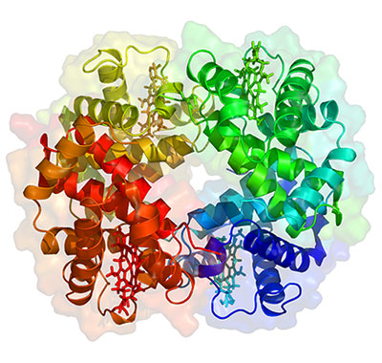
Exam Practice
Haemoglobin is a protein.
A) What is meant by the quaternary structure of a protein? (1 mark)
B) The tertiary structure of haemoglobin allows it to carry oxygen. Explain how. (2 marks)
1 (a) the way in which polypeptide chains fit together; 1
Quaternary structure only applies to a protein molecule that has more than one
chain, so you must put chains to show more than one.
(b) each polypeptide has a specific 3D shape;
haemoglobin has hydrophilic groups that allow it to mix with blood; 2
The specific shape allows the oxygen molecules to fit into the proteins.
The hydrophilic groups are on the outside of the molecule and can access the
oxygen in the blood.

Slide 4
Learning Objectives and Success Criteria
Describe how α-glucose monomers are arranged to form the polymers of starch and glycogen
Describe how β-glucose monomers are arranged to form the polymer cellulose
Explain how the structures of starch, glycogen and cellulose relate to their functions
You can match up carbohydrates to functions
You can make models of the structure of glucose, starch and cellulose
You can answer exam questions on carbohydrates

Slide 5
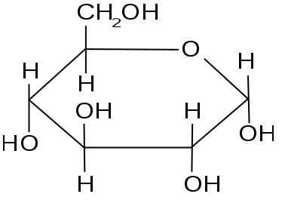
Starch Structure
Starch is made from chains of α-glucose monomers
These are linked by glycosidic bonds, formed by condensation reactions (water released)
Draw out an α-glucose monomer

Slide 6
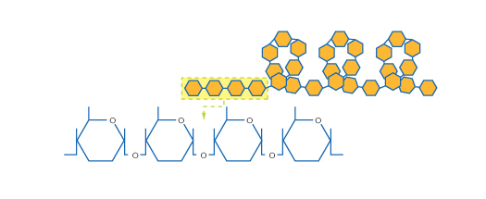
Starch Structure
The chain of α-glucose is wound into a tight coil

Slide 7
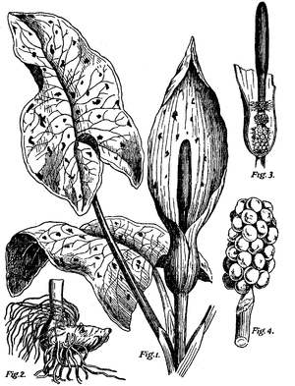
Starch
Where is starch found in a plant?
Many parts as starch grains
Seeds
Storage organs e.g. Potato tubers

Slide 8
Why is starch a good molecule for storage in plants?
In pairs come up with a list of reasons
It is insoluble, so doesn’t draw water into cells by osmosis
Won’t easily diffuse out of cells because it is insoluble
It can be stored in a small space because the tight coils make it compact
Can be easily hydrolysed to give α-glucose, which can be used in respiration

Slide 9
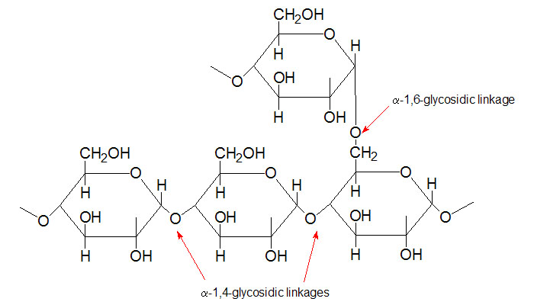
Glycogen
Starch is not found in animal cells, glycogen is used instead
It is similar to starch, but has shorter chains and is more highly branched
Storage molecule for animals, found as small granules in the muscles and the liver
Because of the shorter chains it is even more readily hydrolysed than starch

Slide 10
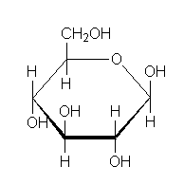
Cellulose
Made of β-glucose, rather than α-glucose
Draw a molecule of β-glucose

Slide 11
Cellulose
To form glycosidic links, each β-glucose molecule is rotated 180° compared to the one next to it
Has straight, unbranched chains that run parallel to one another
Hydrogen bonds link the chains

Slide 12
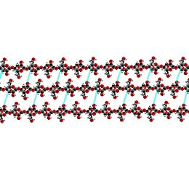
Cellulose
So many hydrogen bonds help to strengthen cellulose
This makes cellulose a good structural material, hence its use in plant cell walls to aid rigidity
Cellulose does this by grouping together to form microfibrils → fibres
Cellulose also prevents cells bursting, so they are turgid when full with water. This helps support stems

Slide 13
Carbohydrates
For each of these statements, pick the correct carbohydrate from the list opposite
Stains deep blue with iodine solution
Is known as ‘animal starch’
Found in plants
Are polysaccharides
Monosaccharide found in starch
Has a structural function
Can be hydrolysed
Easily diffuses in and out of cells
Carbohydrates – may be used once, more than once or not at all
α-glucose
β-glucose
Starch
Cellulose
Glycogen

Slide 14
Carbohydrates - Answers
Stains deep blue with iodine solution - Starch
Is known as ‘animal starch’ - Glycogen
Found in plants - α-glucose, β-glucose, starch, cellulose
Are polysaccharides - Starch, cellulose, glycogen
Monosaccharide found in starch - α-glucose
Has a structural function - Cellulose
Can be hydrolysed - Starch, cellulose, glycogen
Easily diffuses in and out of cells - α-glucose, β-glucose

Slide 15
Activity – make models of the molecules out of the equipment available
Make an α-glucose ring
Make a starch molecule
Make a β-glucose ring
Make a cellulose molecule

Slide 16
Exam Questions
Work through the exam questions on carbohydrates

Slide 17
Learning Objectives and Success Criteria
Describe how α-glucose monomers are arranged to form the polymers of starch and glycogen
Describe how β-glucose monomers are arranged to form the polymer cellulose
Explain how the structures of starch, glycogen and cellulose relate to their functions
You can match up carbohydrates to functions
You can make models of the structure of glucose, starch and cellulose
You can answer exam questions on carbohydrates

