Slide 1
10.4 Plant Cell Structure
The Variety of Life

Slide 2
Plant Cell Structure Learning Objectives
There are fundamental differences between plant cells and animal cells.
The structure of a palisade cell from a leaf as seen with an optical microscope.
The appearance, ultrastructure and function of
• cell wall
• chloroplasts.
Candidates should be able to apply their knowledge of these and other eukaryotic features in explaining adaptations of other plant cells.

Slide 3
Starter
Draw a plant cell and label it

Slide 4
Plant Cell
Complete plant cell worksheet
Make sure you know what the key parts do

Slide 5
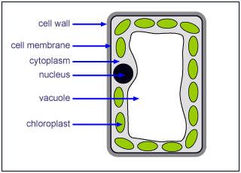
Palisade Cells – Adapted to the function of photosynthesis
Continuous layer to absorb sunlight
Many chloroplasts around edges to collect maximum light
Large vacuole to push chloroplasts to edges

Slide 6
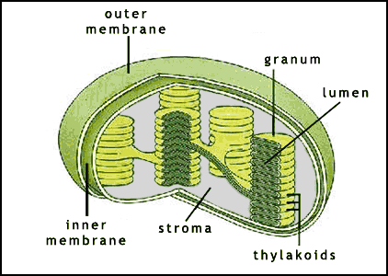
Chloroplasts
Chloroplast envelope – double plasma membrane. Controls what is allowed in and out.
Grana – stacked thylakoids, which contain chlorophyll.
Stroma – full of fluid and contains starch grains.

Slide 7
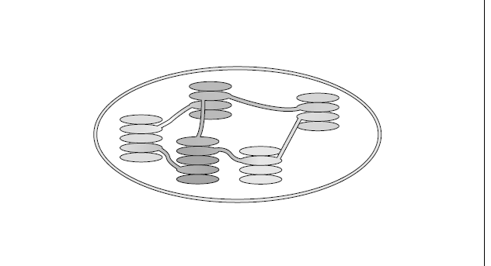
Chloroplasts
Label and annotate the diagram of the chloroplast

Slide 8
Chloroplasts
chloroplast
envelope
thylakoid
contains
chlorophyll
granum
stroma

Slide 9
Adaptations of chloroplasts
Granal membranes = large surface area for chlorophyll, electron carriers and enzymes essential for the first stage of photosynthesis
Stroma (fluid) contains enzymes needed for the second stage of photosynthesis
Contain DNA and ribosomes to enable quick and easy manufacturing of proteins needed for photosynthesis

Slide 10
Cell Walls – Complete the table
Structure | Functions
Made of polysaccharides (cellulose) . A thin layer (middle lamella) forms the boundary between cell walls. The cellulose molecules are found in microfibrils. | Provides strength to prevent cells bursting. Gives mechanical strength to the whole plant. Sticks adjacent cells together. Allows water to pass along it, so water can keep moving through the whole plant.

Slide 11
Plenary
Differences between plant and animal cells
Plant Cells | Animal Cells
Have cellulose cell walls as well as a cell membrane around the cell | Cell membrane around the cell
Large numbers of chloroplasts | No chloroplasts
Usually have a large vacuole | Rarely have a vacuole, and if they do they are small
Starch grains used for storage | Glycogen granules used for storage

Slide 12
Application
Work through questions 1 – 11 on pages 160 – 161 of the AS textbook.

