Slide 1
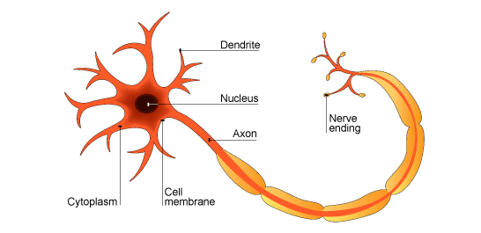
10.5 Speed of the Nerve Impulse

Slide 2
Learning Objectives
To understand what factors affect the speed of conductance of an action potential.
To understand what the ‘refractory period’ is.
To understand what the role of the refractory period is in separating one impulse from the next.
To understand what is meant by the all-or-nothing principle.

Slide 3
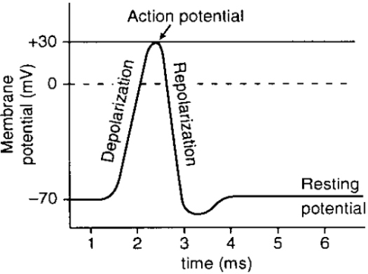
Action Potentials Do Not Lose ‘Energy’
It is very important to know that once an action potential has been initiated at the start of an axon, the subsequent action potentials do not decrease in size.
The action potential at the end of an axon will have the same size (or ‘electrical energy’) as the one initiated at the beginning.

Slide 4
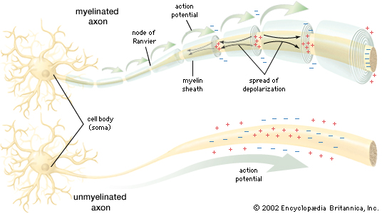
But the Speed of Action Potentials can be Different
Although the size of an action potential is not variable, the speed at which action potentials are propagated can vary.
The speed depends mainly on the properties of the axon.
There are three main factors you need to know about.
They can cause the speed to range from just 0.5ms⁻¹ to 120ms⁻¹!
As you should already know, myelination plays a big role in how fast action potentials are propagated.

Slide 5
Factors affecting the speed at which an action potential travels…

Slide 6
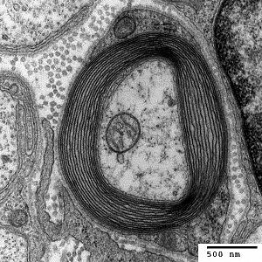
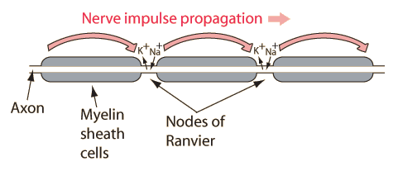
1. Myelination
Last lesson, you learnt that action potentials travel very fast in myelinated neurones.
The many layers of the myelin sheath result in specific parts of the axon being electrically insulated.
Remember that in those areas, no action potentials can occur.
This means that they have to be initiated at the Nodes of Ranvier.
They then ‘jump’ from node to node.
Myelination can increase the speed of action potentials to around 90ms-1, compared to 30ms-1 in unmyelinated neurones.

Slide 7
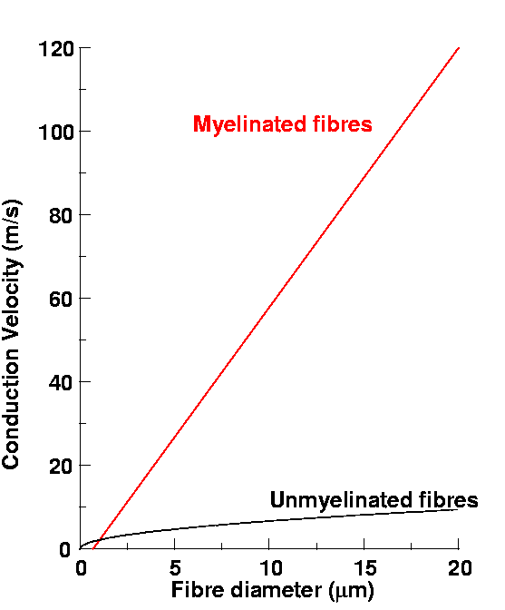

Slide 8
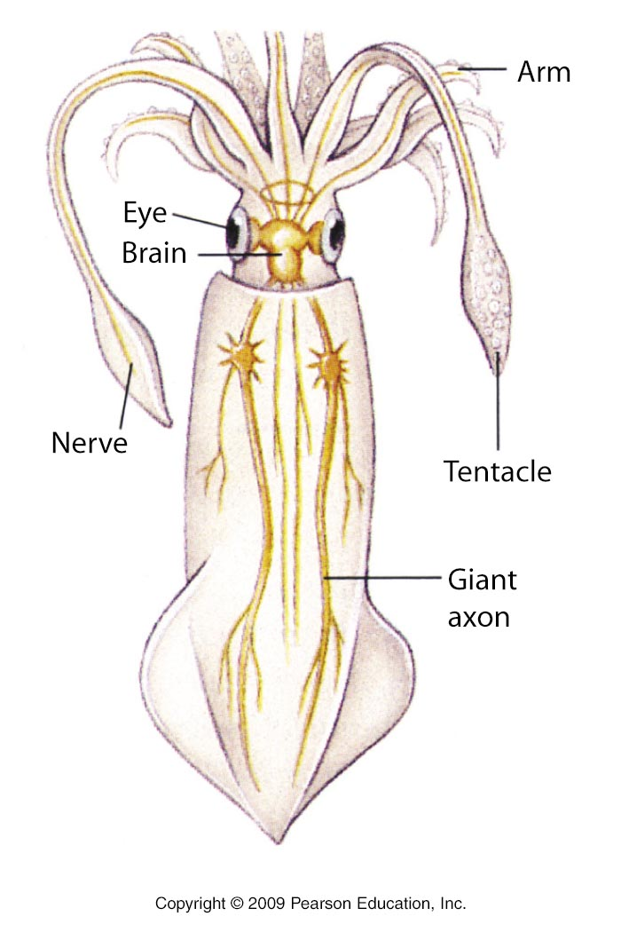
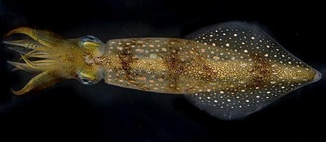
2. The Axon Diameter
Studies on Giant Squid axons have shown that axons with a larger diameter conduct action potentials much quicker than their narrower counterparts.
In larger axons, the positive ions tend not to ‘leak’ as much as in narrow axons.
This means that membrane potentials are more easily maintained.
This speeds up action potentials.

Slide 9
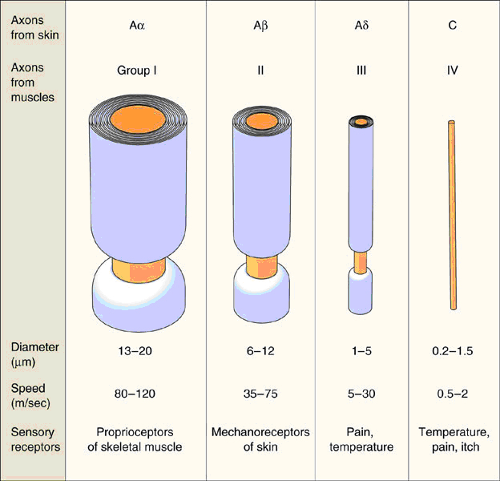

Slide 10
3. Temperature
Simple science shows that molecules move faster when they are at higher temperatures.
Higher temperatures will therefore increase the rate of diffusion of IONS.
Secondly: The energy required to drive the sodium-potassium pumps (used to restore resting potential) is generated in respiration.
Higher temperatures increase the efficiency of enzymes involved in respiration (sensible temperatures! No denaturing allowed).
Cold-blooded organisms have confirmed this, as they seem to have slower responses when their core-temperature is low.

Slide 11
How is action potential speed measured?

Slide 12
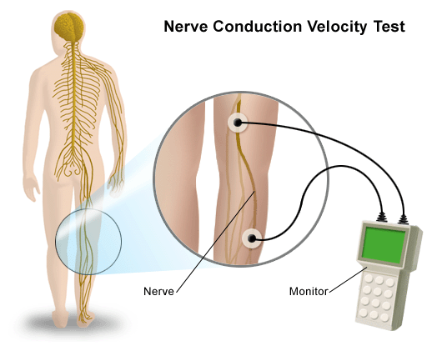

Slide 13
Refractory period

Slide 14
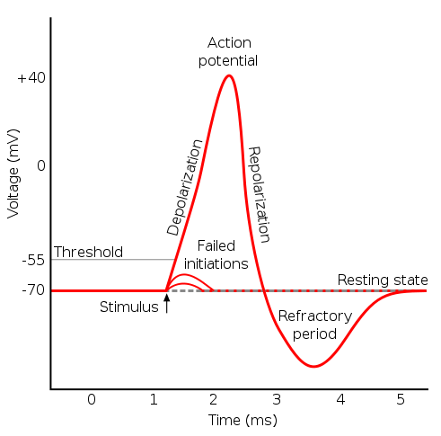
The Refractory Period
Study this graph showing an action potential:
You should see that the refractory period is the portion of the graph that leads back to the resting potential.
Remember that another action potential cannot be initiated in that part of the axon until the resting potential is restored.
So can you describe what the refractory period is?

Slide 15
4. So basically, the refractory period is the time that it takes for sodium influx to be possible again.
During the refractory period, no further action potentials can be generated
2. Now remember that they close when the maximum voltage is reached during depolarisation (usually +40mV)
3. They won’t open again until the resting potential is reached again!
1. Remember that action potentials start because sodium channels open.

Slide 16
The purpose of the refractory period

Slide 17
1. Ensuring That Action Potentials Are Only Propagated In One Direction
When an action potential occurs in one area of an axon, we know that it stimulates the area next to it to initiate the next action potential…
It can only do this if the next area is at resting potential.
The area before the action potential will be in refractory period, so a new action potential could never be generated here.
The area of the original action potential is now in refractory period, and cannot accept another action potential…
This means that the next action potential has to occur further down the axon, where resting potentials are present.
Action potential here, causes a new one further down the line….
Which means…
Direction of Action Potential Propagation

Slide 18
2. Refractory Period Ensures That Action Potentials Are Discrete (Separate)
This reason is related to the previous one.
Due to the refractory period, a new action potential cannot be formed immediately behind the first one.
This ensures that action potentials are separated from each other.

Slide 19
3. Refractory Period Limits The Number Of Action Potentials Passing Along An Axon At One Time
Use your brain on this one.
Axons are only so long.
If the refractory period controls which way action potentials travel in, and also produces discrete action potentials…
… then only a certain number of action potentials will ‘fit’ on an axon!
These action potentials have to occur at fixed distances after one another. They can’t occur ‘behind’ one another. That means only four can occur on this axon.

Slide 20
The ‘all-or-nothing’ principle

Slide 21
2. Basically, a weak stimulus will not cause enough sodium ions to enter the axon, meaning the voltage does not reach the threshold.
3. Stimuli that do reach the threshold, all cause action potentials of the same strength.
It does not matter how much above the threshold- the action potential will always be the same.
4. If this is the case, how do we tell the difference between strong and weak stimuli!?!?
1. If a stimulus does not have enough energy, it will not reach the threshold value.

Slide 22
Number of nerve impulses – stronger stimulus = more impulses.
By having different neurones, with different threshold values.

Slide 23
Learning Objectives
To understand what factors affect the speed of conductance of an action potential.
To understand what the ‘refractory period’ is.
To understand what the role of the refractory period is in separating one impulse from the next.
To understand what is meant by the all-or-nothing principle.

