Slide 1
The Structure and Function of Synapses
10.6

Slide 2
Starter
Complete Cloze sheet on nerve impulses
The nerve impulse
Action potentials usually pass more quickly along a _________________________ nerve fibre because ion exchange only occurs at the nodes of _________________. Sodium ions can jump from node to node, which is described as __________________ conduction.
After an action potential has occurred, there is a brief __________________ period during which the neurone can’t conduct another action potential. This ensures that nerve impulses pass along the nerve fibre in one ____________________ only, and ensures that one nerve impulse does not merge with another.
If a stimulus is below a certain ____________________ value, an action potential will not occur. Action potentials obey the ___________ or ___________ law.
The intensity of a stimulus is conveyed by the ______________ of action potentials.

Slide 3
Starter - Answers
The nerve impulse
Action potentials usually pass more quickly along a myelinated nerve fibre because ion exchange only occurs at the nodes of ranvier. Sodium ions can jump from node to node, which is described as saltatory conduction.
After an action potential has occurred, there is a brief refractory period during which the neurone can’t conduct another action potential. This ensures that nerve impulses pass along the nerve fibre in one direction only, and ensures that one nerve impulse does not merge with another.
If a stimulus is below a certain threshold value, an action potential will not occur. Action potentials obey the all or nothing law.
The intensity of a stimulus is conveyed by the frequency of action potentials.

Slide 4
Learning outcomes
Success criteria
By the end of this lesson I will know that
• Describe unidirectionality
• Explain temporal and spatial summation - several action potentials might be needed to produce enough neurotransmitter to overcome threshold of postsynaptic membrane.
• Explain inhibition – an impulse in one neurone can inhibit another
Describe the sequence of events across a synapse
By the end of this lesson I can
Discuss previous knowledge from KS4 on synapses
Label a diagram to show the structure of s synapse
Describe features of a synapse
Draw diagrams describing summation
Answer summary questions

Slide 5
Synapses
Write down 2 things you can remember from KS4 about Synapses

Slide 6
The Synapse
The point at which one neurone communicates with the dendrite of another, or with a effector, is called a synapse
Nerve impulses can’t pass directly across the gap, communication is by means of chemical called a neurotransmitter
Examples of neurotransmitters – acetylcholine, noradrenaline, dopamine

Slide 7
The structure of a synapse
At the synapse the presynaptic neurone communicates with the postsynaptic neurone
At the end of the presynaptic neurone there are synaptic knobs
Synaptic knobs contain many mitochondria and large amounts of ER to manufacture neurotransmitters.
There is a tiny gap known as the synaptic cleft (about 20 nanometres wide)

Slide 8
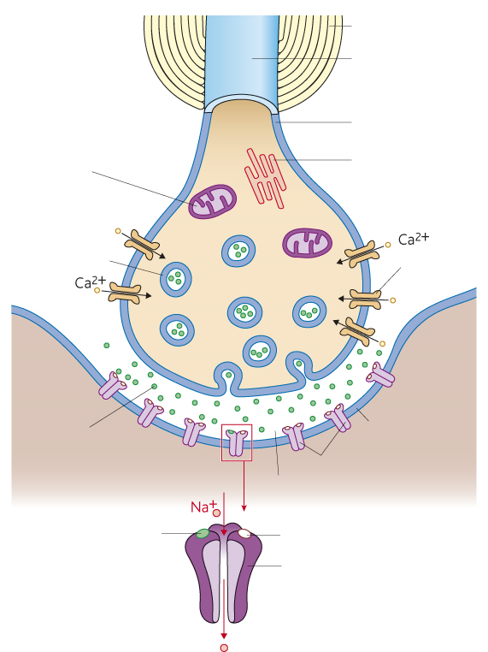
Synapse Structure

Slide 10
Functions of Synapses
Junction between one synapse and the next, allowing:
A single impulse along one neurone to be transmitted to a no. of different neurones at a synapse, allowing a single stimulus to create a no. of simultaneous responses
A no. of impulses to be combined at a synapse, allowing stimuli from different receptors to interact in order to produce a single response.

Slide 11
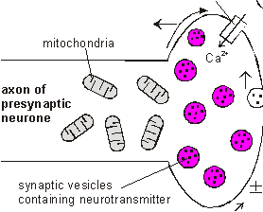
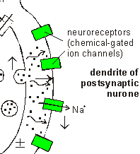
Neurotransmitter
Neurotransmitter is made by the pre-synaptic neurone and is stored in synaptic vesicles at the end of the axon.
When an action potential reaches the synaptic knob neurotransmitter is released and diffuses across the synaptic cleft
The membrane of the post-synaptic neurone has chemical-gated ion channels called neuroreceptors. These have specific binding sites for neurotransmitters. This sets up a new action potential.

Slide 12
Cholinergic Synapses
Acetylcholine is a common transmitter.
Synapses that have acetylcholine transmitter are called cholinergic synapses.
Some neurones form more than 1 synapse.
This is an electron micrograph of synapses between nerve fibres and a neurone cell body.

Slide 13
Summation
Spatial Summation
A number of neurones all release enough neurotransmitter to exceed the threshold and trigger an action potential in the next neurone.
Temporal Summation
One neurone releases neurotransmitter many times over a short period of time to exceed the threshold and trigger an action potential in the next neurone.
TASK – use page 176 – draw diagrams explaining summation

Slide 14
Unidirectionality = Synapses can only pass in one direction – from the presynaptic to the postsynaptic neurone.
Inhibitory Ion Channel Synapses
Some synapses have chloride (Cl⁻)channels that can be opened
When the channels open, negative ions flow in causing a local hyperpolarisation (more negative than resting potential) and making an action potential less likely.
So with these synapses an impulse in one neurone can inhibit an impulse in the next.

Slide 15
Plenary – Summary Qs p175
Peer mark answers
1. Lots of mitochondria, and endoplasmic reticulum
2. It has receptor molecules
3. AP reaches synaptic knob and neurotransmitter is released from vesicles in presynaptic neurone it diffuses across the synapse to receptor molecule on postsynaptic neurone – starting a new AP
4. Only one end can produce neurotransmitter, so only this end can produce a AP in the neurone on the opposite side of a synapse.
5. a)Low level frequency Aps in sensory neurones in ear, due to quiet background. Amount of neurotransmitter is insufficient to exceed threshold value and trigger an AP so noise is ignored. Louder = higher frequencies, amount of neurotransmitter is sufficient (temporal summation))
b) Reacting to low level stimuli (background traffic) that present little danger can overload the (central) nervous system and so organisms fail to respond to more important stimuli. High level stimuli (horn) need a response because are more likely to represent danger
6. Inside is too negative (too difficult for depolarisation), so stimulation is less likely to reach threshold value needed for new AP.

