Slide 1
11.1 Replication of DNA

Slide 2
Learning Objectives
What happens during DNA replication?
How is a new polynucleotide strand formed?
Why is DNA replication known as ‘semi-conservative’?

Slide 3
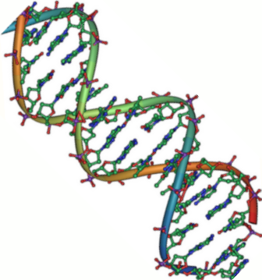
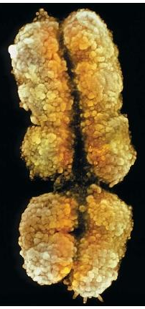
Putting What We’ve Learnt So Far In To Context...
8.1 Structure of DNA
We focussed mainly on the chemical structure of DNA as a whole. DNA is a double-stranded polymer, but what makes it up?
8.2 The Triplet Code
Here, we introduced RNA. We found out that the code in RNA is actually converted to RNA before protein synthesis.
8.3 DNA & Chromosomes
In this lesson, we found out how DNA is actually stored. How is it possible to fit such a vast amount of information into something as small as a cell?

Slide 4
This Lesson...
For the moment, forget about chromosomes and triplet codes and RNA.
Get back to basics and think about the basic structure of DNA....
phosphate
phosphodiester
bond
base
deoxyribose

Slide 5
Good. Now Cell Division...
What processes allowed you to become the 75 or so TRILLION cells that you are?
MITOSIS
What process produces the sex cells within your body?
MEIOSIS

Slide 6
Cell Division...
When cell division occurs, a cell will basically split into two identical cells.
Whatever was in the original cell has to be DUPLICATED and then packaged into two new cells!
Therefore, the entire cell contents have to be doubled before a cell can divide.
And the most important content of all, is the DNA in the nucleus.
This leads us to DNA Replication........
!!!

Slide 7
Replicating DNA
Possibly the most perfect process in the universe, for it will happen inside you nearly a quadrillion times, flawlessly.

Slide 8
Replicating DNA
For years after the structure of DNA was discovered, scientists came up with countless theories on how the molecule reproduced itself.
Today, the accepted method is the...
SEMI-CONSERVATIVE REPLICATION OF DNA
This method of replication requires 4 conditions to be met:
A pool of the four types of nucleotides must be present.
Both strands of the DNA being copied, act as a template.
The enzyme, DNA Polymerase must be present.
A source of energy (ATP) is required to drive the process.

Slide 9
Semi-Conservative Replication
Step 1: An enzyme called DNA Helicase breaks the hydrogen bonds between the bases of the two strands of DNA.
DNA Helicase
Note:
The two strands don’t completely separate. They stay linked at the top, because DNA helicase has an ‘unzipping’ action.
Meet the section of DNA being replicated.

Slide 10
Semi-Conservative Replication
After DNA Helicase...

Slide 11
Semi-Conservative Replication
Step 2: DNA helicase completes the splitting of the strand, and as it is doing this, free nucleotides start to be attracted to their complementary bases on the templates.

Slide 12
Semi-Conservative Replication
Pool of free nucleotides

Slide 13
Key Point:
Although a free nucleotide is attracted to its complementary base on the template....
.... it cannot join until it is activated by energy.
This energy is supplied by ATP.
ADP
ATP!

Slide 14
Semi-Conservative Replication
Step 3: Once the nucleotides are in position, phosphodiester bonds are formed between their phosphates and deoxyribose sugars. This is done by the enzyme DNA polymerase.
DNA Polymerase
links the nucleotides

Slide 15
Semi-Conservative Replication
Step 4: Two identical strands have now been formed! They are exact copies of the strand that we started off with.
You can now see why the process is called semi-conservative. Half of the original molecule is conserved, and the other half is newly synthesised! ☺

Slide 16
In words...
The enzyme DNA Helicase breaks the hydrogen bonds between the bases of the two strands.
The double helix separates into its two strands.
Each exposed strand now acts like a template.
Complementary free nucleotides are attracted to the exposed bases on the strands.
Energy (ATP) is required to activate the free nucleotides.
Once the nucleotides are in place, their ‘backbone’ is joined together by DNA Polymerase.
Two new DNA strands are produced.
Each of these contains half of the original strand, and half a new strand.

