Slide 1
Evidence for Semi-Conservative Replication

Slide 2
A Few Things You Should Know...
Isotopes:
Different atomic forms of the same element, which have the same proton number, but a different neutron number.
Ultracentrifuge:
This machine is so advanced and sensitive, that it can separate out molecules that contain Nitrogen-14 and Nitrogen-15.
It does this by spinning vessels containing the molecules in a way that causes them to collect in different areas, depending on their densities.
N
The mass number of the ‘heavier’ isotope changes due to different numbers of neutrons. The atomic/proton number stays the same.
N
14
15
7
7

Slide 3
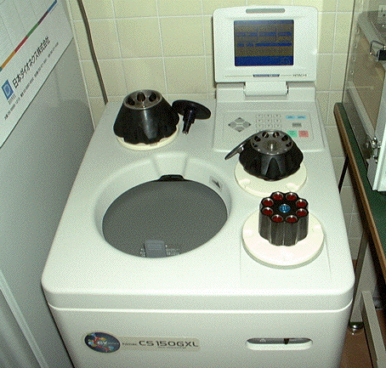
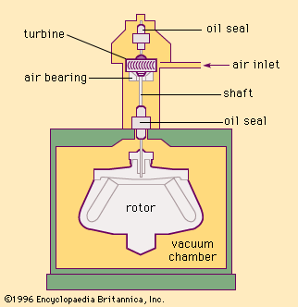
Ultracentrifuge
A sample containing the molecules being tested are placed in tubes.
The ultracentrifuge will then spin them at great speed, causing molecules of different densities (weight, if you like) to separate at different bands in the tube.
Heavier molecules separate out in lower bands than light molecules.

Slide 4
Let’s go back to 1953...

Slide 5
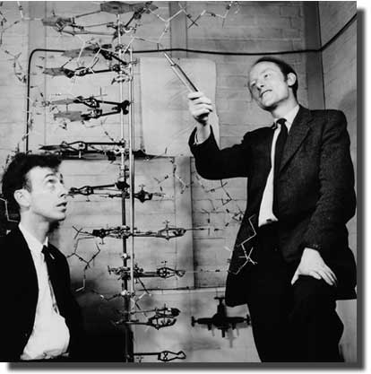
Elucidation of the Structure of DNA
On April 25, 1953, James Watson and Francis Crick released a paper in which they described the structure of:
Deoxyribose Nucleic Acid
The paper probably stands as one of the most important documents ever to be released in the field of Molecular Biology.
Towards the end of the paper, the duo commented:
‘It has not escaped out notice that the specific pairing we have postulated immediately suggests a possible copying mechanism for the genetic material.’
Their assumption would be followed up by other scientists though.

Slide 6
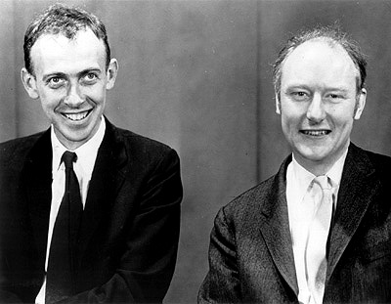
3 Possible Copying Mechanisms?
Immediately after Watson and Crick delivered their paper on DNA structure, scientists began the race to find out how the molecule copied itself.
Matthew Meselson and Franklin Stahl were a pair of scientists who decided to be unbiased, and focus on the 3 accepted, possible copying mechanisms at the time.
The experiment they carried out is one of the most famous in Biology.
They were the first to work out which of the 3 mechanisms (next slide) was correct.
They achieved their goal in 1958

Slide 7
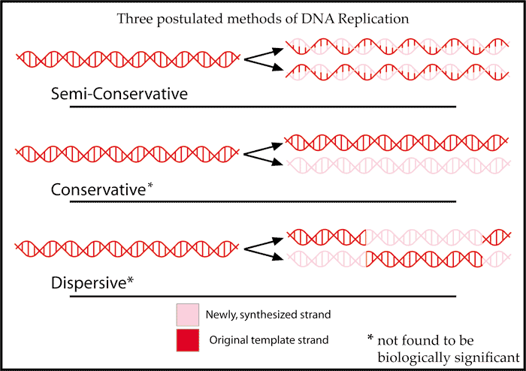

Slide 8
The Conservative Method
This model suggested that the original, parental DNA molecule would remain intact. It said that a separate, new DNA molecule would be made from scratch.
The Semi-Conservative Method
Proposed that the original, parental molecule would split in half, into two separate strands. These then act as a template for the ‘missing half’ of each to be filled in with free nucleotides.
The Dispersive Method
Idiotic.

Slide 9
Now We Need An Experiment...
If we disregard the Dispersive Method, we’re left with two plausible explanations for DNA replication.
Theoretically, to find out which mechanism is correct is easy.
You just ‘label’ the old nucleotides, wait for the molecule to replicate, and then look at how the nucleotides were distributed after replication.

Slide 10
Welcome to 1958...

Slide 11
Enter, Meselson and Stahl
(finally)
Meselson and Stahl designed their experiment, with three facts in mind:
ALL BASES IN DNA CONTAIN NITROGEN
NITROGEN HAS TWO FORMS – ¹⁴N AND ¹⁵N
IF YOU PUT NITROGEN INTO A BACTERIUM’S GROWTH MEDIUM, IT WILL INCORPORATE IT INTO IT’S DNA
They theorised that growing bacteria on a medium containing ¹⁴N would cause those bacteria to have lighter DNA, than bacteria grown on a medium containing ¹⁵N.

Slide 12
The Experiment
Meselson and Stahl grew a huge population of Escherichia coli on a Nitrogen-15 (¹⁵N) growth medium, starting with a single cell.
ENTER THE ULTRACENTRIFUGE!!
So all of the DNA in these bacteria is ‘heavy DNA’, full of ¹⁵N
After centrifugation, the ‘heavy DNA’ appears as a band, quite low down in the tube.
If the bacteria was grown on ¹⁴N, where do you think the band would appear?

Slide 13
The Next Step
The bacteria grown in ¹⁵N, were then transferred to a ¹⁴N growth medium.
Now, any new DNA produced during replication will incorporate ¹⁴N into it’s structure.
After being transferred to ¹⁴N, the bacteria were allowed to replicate ONCE.
Where do you think a band would appear, if the DNA in these bacteria was centrifuged?
Remember:
The band appeared in the middle!
It was proved that DNA replication was semi-conservative, because the new DNA was neither ‘light’ nor ‘heavy’.
It appeared in the middle of the tube after centrifugation because it contained both ¹⁴N and ¹⁵N.

