Slide 1
Contraction of Skeletal Muscle
11.2

Slide 2
Learning Objectives
Explain the sliding filament mechanism
State what evidence supports the sliding filament mechanism
Explain where the energy comes from for muscle contraction
Success Criteria
Make notes on evidence for the sliding filament mechanism
Arrange statements for the detail of muscle contraction into the correct order

Slide 3
Starter
Draw the arrangement of actin and myosin in a sarcomere

Slide 4
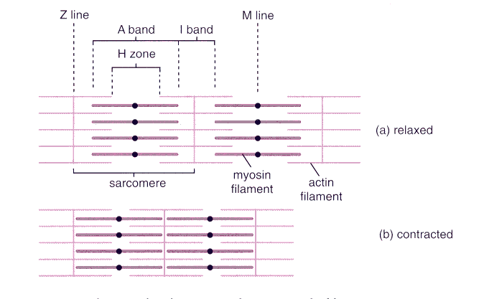
The Sliding Filament Mechanism
Actin and myosin slide past one another when the muscle contracts
Evidence for this:
Sarcomere gets shorter
More overlap
Z-lines get closer together
I-band gets narrower
H-zone gets narrower

Slide 5
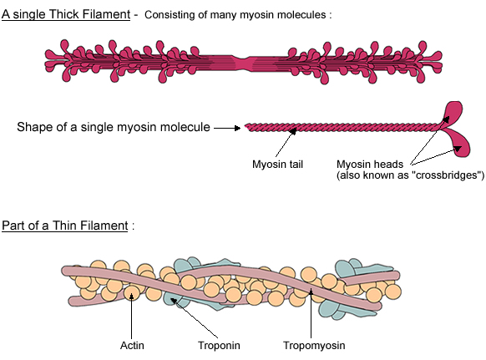
3 Main Proteins Involved
Myosin – 2 globular, bulbous heads and a long tail
Actin – a globular protein where the molecules are twisted into a helix
Tropomyosin – long, thin threads wrapped around actin

Slide 6
Muscle Contraction – Sliding Filament Mechanism
Heads of myosin form cross-bridges with the actin filaments (attach to binding sites)
Myosin heads flex together and pull the actin along the myosin
They detach
Return to original angle and re-attach (uses ATP)
Repeats 100 times a second

Slide 7
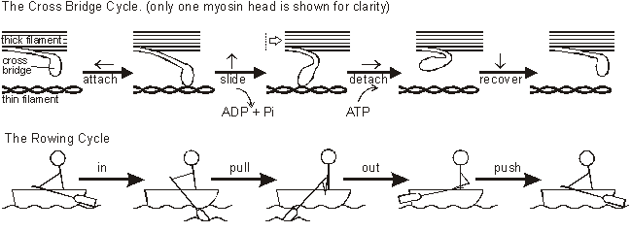
Muscle Contraction – Sliding Filament Mechanism

Slide 8
3 Stages of Muscle Contraction
1. Stimulation
Neuromuscular junctions – acetylcholine diffuses across the cleft and binds to receptors causing depolarisation
2. Contraction
Action potential carried through t-tubules
Ca²⁺ ions are released and tropomyosin molecules move away from binding sites
Myosin bind to actin and move it along
3. Relaxation
Ca²⁺ ions transported back to the ER and tropomyosin blocks the actin again

Slide 9
Detail on Muscle Contraction
Cut out the key stages and arrange them into the correct order under the 3 headings (Stimulation, Contraction, Relaxation)

Slide 10
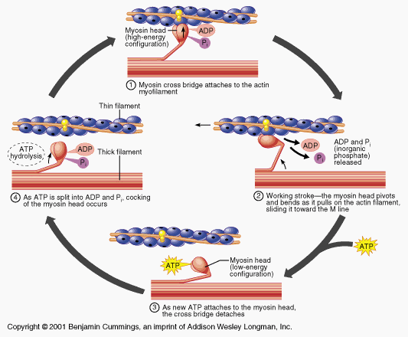

Slide 11
Energy Supply
Muscles need a lot of energy when they contract
Supplied by the hydrolysis of ATP
Because of the great demand for energy in certain cases (e.g. Fight or flight responses) then it is required that ATP be generated anaerobically as well
This is achieved by using phosphocreatine
Phosphocreatine is stored in the muscle and helps to regenerate ATP

Slide 12
Plenary
Look through the diagrams on page 190 and check you understand the detail of what is happening

Slide 13
Learning Objectives
Explain the sliding filament mechanism
State what evidence supports the sliding filament mechanism
Explain where the energy comes from for muscle contraction
Success Criteria
Make notes on evidence for the sliding filament mechanism
Arrange statements for the detail of muscle contraction into the correct order

