Slide 1
B3 – student gap fill

Slide 2
B3 part 1 - DNA
1. The ________ controls each cell in the body
2. The nucleus in cells in humans contains 46 (23 pairs) of DNA molecules called __________
A cell with ____chromosomes pairs = DIPLOID (2n)
A cell with 23 SINGLE chromosomes = _______ (n)
3. You get 23 chromosomes from your Mums ___ and 23 chromosomes from your dads _________
4. Each DNA molecule is shaped like a _______ ______with 4 chemicals called ______ in the middle
5. the bases are ___ ______ ______ ______
6. A always pairs with ___ , G always pairs with __
8. The sides of the helix are like a BACKBONE made of SUGAR-_________ molecules

Slide 3
B3 part 2 – Proteins 1 - general
1. Proteins molecules do the JOB of the DNA.
2. There are 4 types of proteins
_________ – such as amylase that breaks starch
STRUCTURAL proteins such as collagen in _______
HORMONES – e.g. _____ that reduces blood sugar
CARRIER proteins – e.g. hemoglobin that carries oxygen (becoming ____ hemoglobin)
3. Proteins are made by r__________
4. The information to make a protein is held by a precise DNA S______ called a G______
5. A copy of a gene is made called mRNA that leaves the ______ and goes to the _____in the cytoplasm of a cells

Slide 4
B3 part 2 – Proteins 2 – Enzymes
6. ALL proteins have a ______ shape
7. Changing the shape of a protein changes its _____ or stops ________
8. A protein may change shape because: (1) it is _______, (2) wrong ____, (3) the _______of the gene for that protein is wrong (a M___________)
9. The part of the enzyme that works is called the A_____ S_____ – this recognises its substrate
10. Increasing temperature increases the C_____ between the enzyme and its substrate
11. Above the OPTIMUM temperature (usually body temperature, ____) the enzyme is D______ (It _______ changes shape)

Slide 5
B3 part 2 – Proteins 3 – Enzymes detailed
12. Some mutations (c________) to genes may change the enzyme
13. Some mutations (changes) can actually make the enzyme B_____ (e.g. it works at a higher temp)
14. Mutations to genes (parts of DNA) can be caused by r________ and from c_______
15. The Q₁₀ measures compares the rate of reaction at 2 different temperatures 10C apart – simply divide the rate at the higher temperature by the rate at the lower temperature
16. Enzymes are needed to C______ (speed up) ALL cell reactions (including respiration) because 37C is a low t___________

Slide 6
B3 part 3 – Respiration 1
1. respiration happens in M__________
(MIE—TOE—KION—DREEE—AH)
word and symbol equations:
‘Energy’ is produced in the form of A_____
38 small ATP molecules are made from 1 large g_______ molecule
Respiration requires a GROUP of genes to be switched on in A______ cells
Energy is needed for: making p_____ (p______ s______), controlling body _____, muscle c______

Slide 7
B3 part 3 – Respiration 2 (links to coursework)
More ______ muscles need more energy so they ______ FASTER, therefore they need more _____
The _____ beats faster in exercise to get so that more blood goes to the ____ to get in more O₂
There is a limit to how ______ the heart can beat
So there is a point in exercise (the A_____ th______) when there is not enough O₂ getting into the blood to meet ______ – creating a O₂ ______
So glucose is turned into l_______ to get a bit of energy (ATP)
When there is more ______ (when _____) O₂ is used to break up lactic acid in l________
RQ = CO₂ ________ / O₂ ________

Slide 8
B3 part 4 – Cell division
1. Simple organisms (b______) divide to make identical copies of themselves (c_______)
2. Multicellular organisms are more complex so need so need o_____ to do specific tasks
3. Organs are needed to supply nutrients to cells (h_____), communicate between cells (b____) and control exchanges with the environment (l_____)
4. There are 2 types of cell division – m______ and m______

Slide 9
B3 part 4 – Cell division - MITOSIS
1. Produces ___ _____ daughter cells
2. Each daughter cells is ________
3. Mitosis is used for muscle r_____ and G______
4. The DNA is copied B_____ cells divide so that the DNA s_______ and all g_______ are the same
5. DNA is ___zipped to form s______ strands
6. C_______ bases (A with T, G with C) join to make a NEW id________strand (new chromosome)
7. The chromosomes move to the centre of cell
8. cell starts to d______
9. All chromosomes (copied and original) move to the o______ends of the dividing cell so that each new cell has _______ chromosomes in total

Slide 10
B3 part 4 – Cell division – MEISOSIS
1. Happens only with g_______ (sperm and egg)
2. Cells divide TWICE
3. First division = produces 2 cells with the _______ number of chromosomes (___ploid, __n, 23 P____)
4. Second division = produces 2 cells with HALF the number of chromosomes (___ploid, n, 23 SINGLE)
5. When a sperm f______ an egg, they both bring 23 SINGLE chromosomes to make 23 ______
6. Meiosis produces a little v____ (the sperm and the egg come from different people, e.g. tall / short)
Sperm are adapted by having many MI_________ for energy and ACROSOMES to d______ the tough membrane of the e_____

Slide 11
B3 part 5 – Circulatory system – single vs double
1. A ______ circulatory system means that the blood from the heart to lungs back to the heart (one loop) and then to the body and back to the heart (second loop)
2. A ______circulatory system goes from the heart to the lungs THEN to the body and back to the heart (one loop in total)
3. ALL blood going to the lungs must be _____ pressure because the lungs are so f________
4. Therefore a DOUBLE circulatory system is ____ as the blood from the lungs gets an extra _____ form the heart before going to the body – allowing greater __________to the tissues

Slide 12
B3 part 5 – Circulatory system – the heart
1. V_______ mean blood flows on only one direction (high pressure to low pressure)
2. TRI-cuspid valve = Right side of the heart
Bi-cuspid valve = left side of the heart
3. Right side of the heart pumps blood to the ____
4. Left side to the _____________
5. Left ventricle has the _________as it needs to pump blood to the __________
6. The atrium is always the chamber on the _____
7. The _____ is the chamber always on the bottom

Slide 13
B3 part 6 – Growth and cell types
1. Bacteria are very simple and have no n_____ or m______ – their DNA is in one loop called a plasmid
2. Plants have c_______ for photosynthesis, v_____ (middle) for support and a c___ w____
3. Mass can be measured by an increase in height, w______ w_____ or dry m_______
4. It is better to measure _______ as it provides a more ______ measure of recording growth
5. In humans the 2 main phases of growth occur ________ and in __________
6. Cells d_________ to become more specialised

Slide 14
B3 part 7 – Modifying (changing) genes
1. A mutation is a change to the DNA sequence of a gene that causes the order of a_________ a__________ in the protein to change
2. Mutations in the DNA of a gene causes its p_____ to change s_______
3. Most mutations are harmful (h_______ has the wrong shape so cannot carry oxygen) but some may be b__________ (e.g. so that hemoglobin carries more oxygen)
4. D_____ of a gene (e.g. insulin from a human cell) can be ______ from one organism can be ______ into the DNA another (e.g. b_______ to make lots of insulin)

Slide 15
B3 part 7 – Gene therapy
1. In theory inherited diseases can be permanently cured using gene therapy by inserting the c_______ D_________ S_________for a gene into the DNA of a gamete (sperm cell or egg cell)
2. A v______ can be used to insert the DNA sequence into a human cell but may cause _______ or may insert the DNA into a gene such as h__________, changing its DNA s______ and so changing the s______ of the protein so that it _______________
3. Changing the DNA of g______ is controversial because some of the effects may be unknown.

Slide 16
B3 part 7 – Selective Breeding and cloning
1. Cloning is where the ______ of an organism with desired characteristics is removed and inserted into an ______ cell with its nucleus removed.
The new egg cell is given an el_____ s_____ then divides to become an e_______ with the features of the organism the nucleus was taken from
2. Selective breeding is where organisms are breed to be less v______ and have only the d______ characteristics such as high ____________ in cows
3. Less variation = fewer g_____ around = smaller gene p_____. This leads to there being fewer genes to _____ ______ and so more animals get diseased.

Slide 17
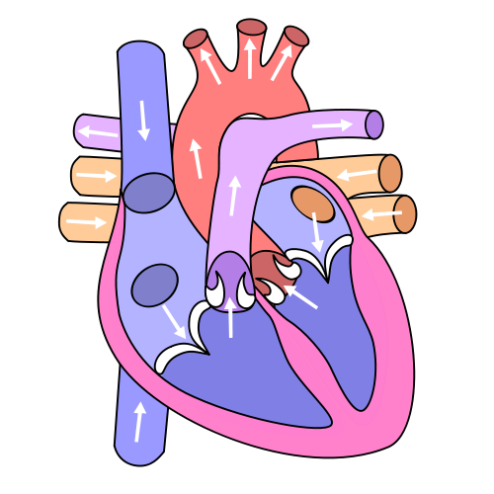
B3 part 5 – the heart
To lungs
from body
1
from lungs
To body
4
2
2
Right atrium
3
3
left atrium
7
5
left ventricle
B
right ventricle
T
8
6
tRi-cuspid valve
1
Bi-cuspid valve

Slide 18
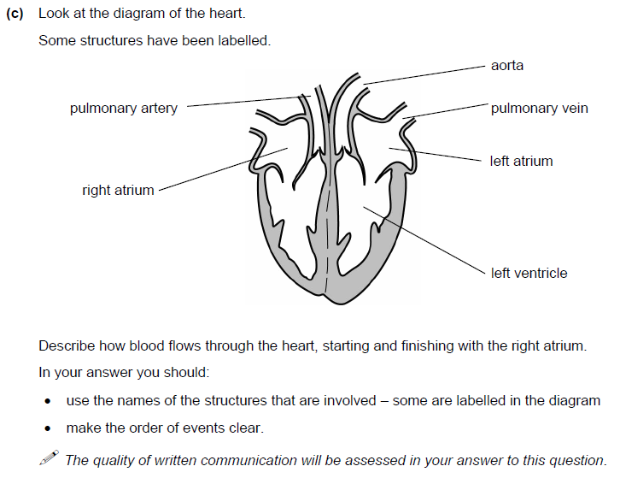
6 MARKS

Slide 19
4 MARKS

Slide 20
3 MARKS

Slide 21
3 MARKS

Slide 22
4 MARKS

