Slide 1
Thermoregulation
Controlling Temperature

Slide 2
What is thermoregulation?

Slide 3
Learning Objectives
Understand what is meant by thermoregulation.
Understand how the body detects rises and falls in body temperature.
Understand what the body does to bring temperature back to normal levels.

Slide 4
Success Criteria
Relate thermoregulation to negative feedback loops.
Be able to understand how exactly the corrective mechanisms work.

Slide 5
Endotherms
The following is all to do with organisms that generate their own heat, from metabolic reactions that occur within their own bodies...

Slide 6
Thermoregulation – A Homeostatic Mechanism
Homeostasis – The maintenance of a constant internal environment.
i.e. – to keep the physiological properties of the body at normal/constant levels.
Thermoregulation is the regulation of the core body temperature.
If there is a change in temperature, the body responds by reversing the change, returning it to the normal level.

Slide 7
Thermoregulation & Negative Feedback
Body detects the change and brings about a corrective mechanism.
Factor rises above normal level
Factor at normal level.
Factor at normal level.
Body detects the change and brings about a corrective mechanism.
Factor falls above normal level

Slide 8
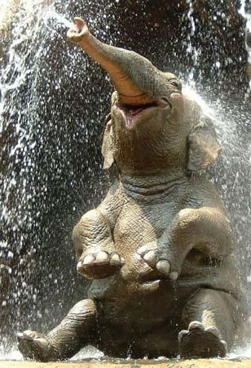
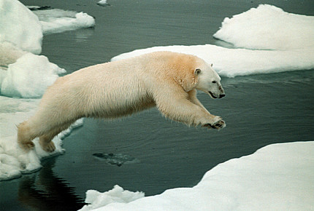
Mammals are adapted to the temperature of their environment
Hot climate mammals have a large surface area: volume ratio. They also have little fur and little body fat for insulation.
Cold climate mammals a small surface area: volume ratio.
They also have thick fur and a lot of body fat under the skin.

Slide 9
The idea behind Thermoregulation
Mammals are able to regulate their body temperatures to around 37 – 39^{O}C. This is also the optimum temperature for the enzymatic reactions occurring within them.
The main ways heat is lost or gained by the body are:
radiation conduction convection
Another one is evaporation, which is taken advantage of by the body, as a homeostatic mechanism.
We’ll look at the different mechanisms the body uses to lose or gain heat.

Slide 10
Thermoregulation & Negative Feedback
Body detects rise in temp. and brings about a corrective mechanism.
Core body temp. rises above normal level
Core body temp. at normal level.
Core body temp. at normal level.
Body detects rise in temp. and brings about a corrective mechanism.
Core body temp. falls above normal level

Slide 11
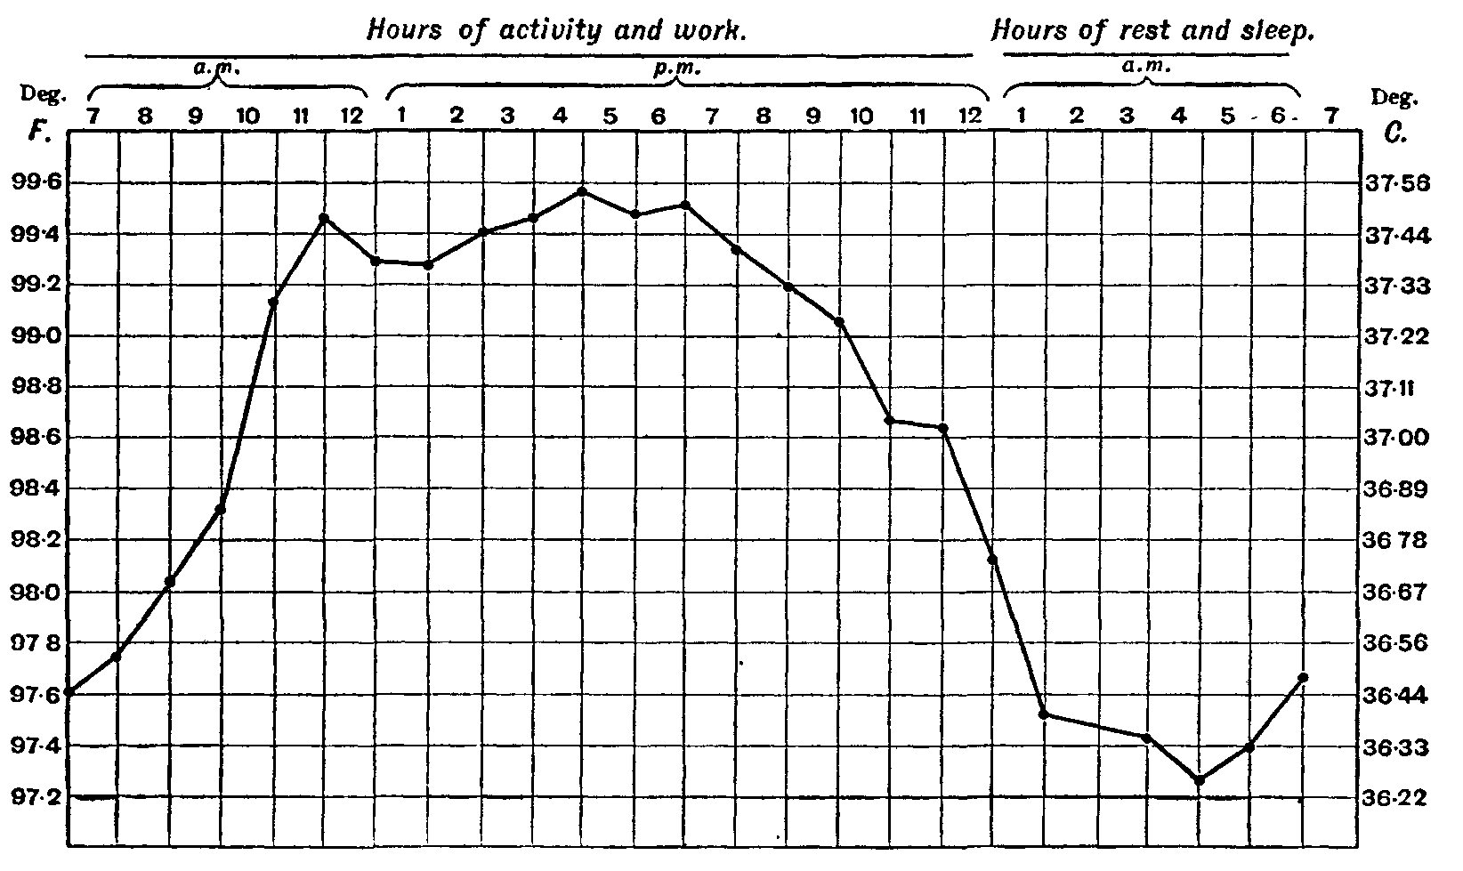

Slide 12
Hot
37°C (98.6°F) - Normal body temperature (which varies between about 36.12-37.5°C (96.8-99.5°F)
38°C (100.4°F) - Sweating, feeling very uncomfortable, slightly hungry.
39°C (102.2°F) - Severe sweating, flushed and very red. Fast heart rate and breathlessness. There may be exhaustion accompanying this. Children and people with epilepsy may be very likely to get convulsions at this point.
40°C (104°F) - Fainting, dehydration, weakness, vomiting, headache and dizziness may occur as well as profuse sweating.
41°C (105.8°F) - (Medical emergency) - Fainting, vomiting, severe headache, dizziness, confusion, hallucinations, delirium and drowsiness can occur. There may also be palpitations and breathlessness.
42°C (107.6°F) - Subject may turn pale or remain flushed and red. They may become comatose, be in severe delirium, vomiting, and convulsions can occur. Blood pressure may be high or low and heart rate will be very fast.
43°C (109.4°F) - Normally death, or there may be serious brain damage, continuous convulsions and shock. Cardio-respiratory collapse will likely occur.
44°C (111.2°F) or more - Almost certainly death will occur; however, patients have been known to survive up to 46.5°C (115.7°F).[

Slide 13
Cold
37°C (98.6°F) - Normal body temperature (which varies between about 36-37.5°C (96.8-99.5°F)
36°C (96.8°F) - Mild to moderate shivering (it drops this low during sleep). May be a normal body temperature.
35°C (95.0°F) - (Hypothermia) is less than 35°C (95.0°F) - Intense shivering, numbness and bluish/grayness of the skin. There is the possibility of heart irritability.
34°C (93.2°F) - Severe shivering, loss of movement of fingers, blueness and confusion. Some behavioural changes may take place.
33°C (91.4°F) - Moderate to severe confusion, sleepiness, depressed reflexes, progressive loss of shivering, slow heart beat, shallow breathing. Shivering may stop. Subject may be unresponsive to certain stimuli.
32°C (89.6°F) - (Medical emergency) Hallucinations, delirium, complete confusion, extreme sleepiness that is progressively becoming comatose. Shivering is absent (subject may even think they are hot). Reflex may be absent or very slight.
31°C (87.8°F) - Comatose, very rarely conscious. No or slight reflexes. Very shallow breathing and slow heart rate. Possibility of serious heart rhythm problems.
28°C (82.4°F) - Severe heart rhythm disturbances are likely and breathing may stop at any time. Patient may appear to be dead.
24-26°C (75.2-78.8°F) or less - Death usually occurs due to irregular heart beat or respiratory arrest; however, some patients have been known to survive with body temperatures as low as 14.2°C (57.5°F).[

Slide 14
Hypothalamus – the control centre

Slide 15
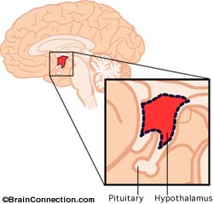
The Hypothalamus Monitors Body Temp.
The hypothalamus is a small part of the brain that acts like a thermostat.
Thermoreceptors of the hypothalamus monitor the temperature of the blood flowing through it – the CORE BODY TEMPERATURE.
There’s also thermoreceptors in the skin, which measure SKIN TEMPERATURE.
Both sets of thermoreceptor send nerve impulses to the hypothalamus if the core or skin temperature is too high or low.
The hypothalamus can then initiate corrective mechanisms.

Slide 16
Two Different Centres in the Hypothalamus
The thermoregulatory area of the hypothalamus actually has two distinct centres:
Heat GAIN Centre
This area is activated by a fall in blood temperature. It is responsible for controlling the mechanisms that will increase the blood temperature.
Heat LOSS Centre
This area is activated by a rise in blood temperature. It is responsible for controlling the mechanisms that will decrease the blood temperature.
Of course, it is usually the skin thermoreceptors that detect temperature changes first.

Slide 17
The corrective mechanisms

Slide 18
Thermoreceptors in hypothalamus
Hypothalamus
Thermoreceptors in skin
Sweat glands
Hairs on body (erect or flat)
Skeletal muscles (shivering)
Adrenal/Thyroid Glands (metabolism)
Smooth muscle in arterioles (vasodilation/vasoconstriction

Slide 19
High temperature

Slide 20
If the body/skin temperature gets too high....
... the thermoreceptors detect this, and send impulses to the hypothalamus. The hypothalamus brings about corrective mechanisms to decrease the core body temp:
VASODILATION: allows more blood to the surface of the skin.
INCREASED SWEATING: causes a ‘cooling effect’
PANTING: causes a ‘cooling effect’
PILOREXATION: hairs lie flat. Less air trapped = less insulation.
DECREASED METABOLISM: to less heat is produced by respiration.

Slide 21
1. Vasodilation
Nerve impulses are sent from the hypothalamus to the smooth muscle in skin arterioles.
This causes the smooth muscle to relax, opening up blood capillaries near the surface of the skin.
Blood flows near the skin surface now, and heat can be radiated away.

Slide 22
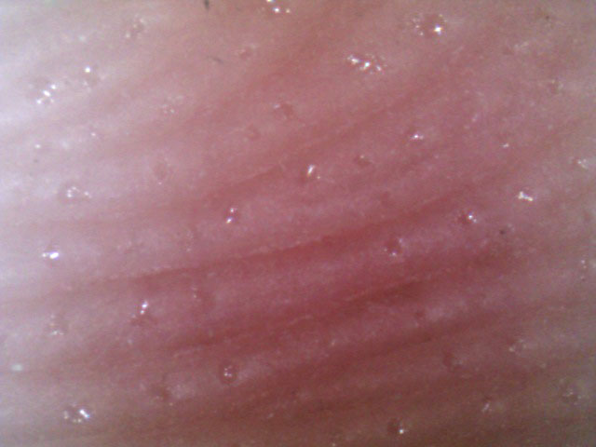
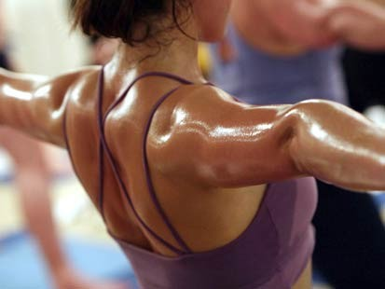
2. Increased sweating
Vasodilation also increases blood flow to the sweat glands.
This causes more sweat to be secreted onto the surface of the skin.
The sweat evaporates from the skin, causing a cooling effect.

Slide 23
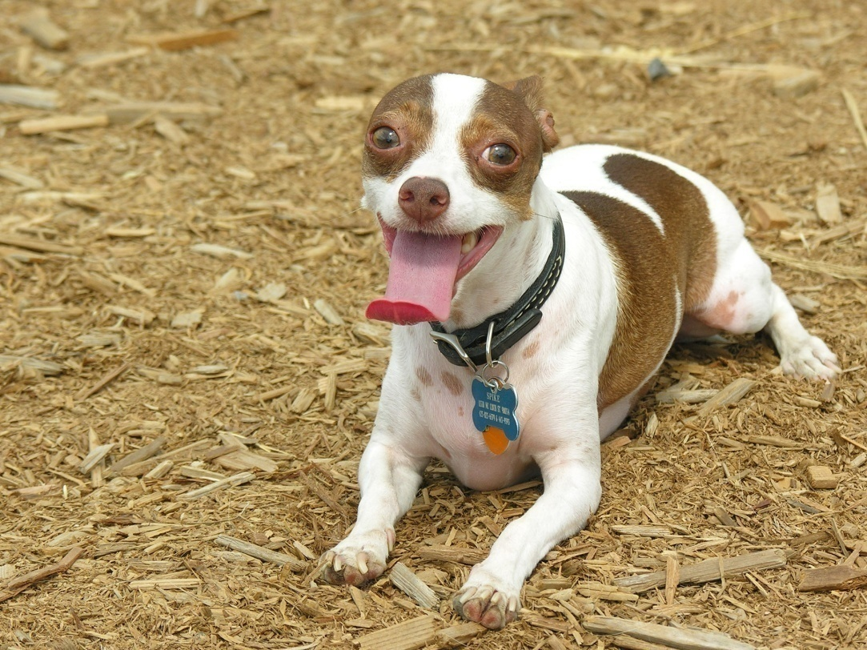
3. Panting
Some animals have few, if any sweat glands at all. They lose heat by panting.
Panting involves quick, short breaths of air, which evaporate water from the tongue, producing a cooling effect.

Slide 24
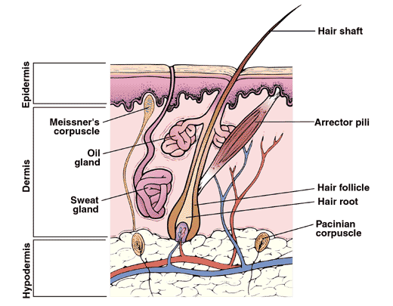
4. Pilorelaxation
Nerve impulses to cause erector pili muscles to relax, causing hairs on the body surface to lie flat.
This means that less air is trapped between the hairs and the skin, causing less insulation.

Slide 25
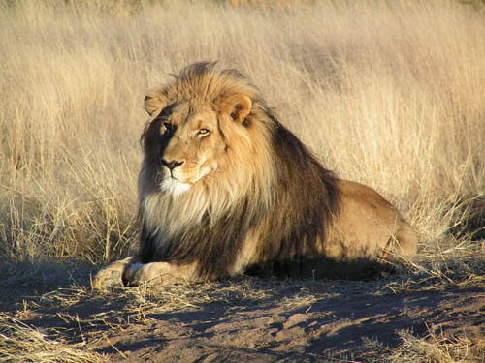
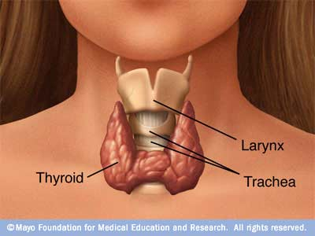
5. Behavioural/Metabolic changes
Inactivity – this is also a behavioural change that results in less energy being used for respiration. Less heat is produced.
Decreased metabolism – In extreme cases, long-term exposure to high temperature, the thyroid gland suppresses thyroxine, which reduces the metabolism.

Slide 26
Hyperthermia
A sustained increase in temperature above the normal range is called hyperthermia.
A fever is when pyrogens are released by the immune system.
Pyrogens act on thermoreceptors, causing them to ‘malfunction.’
This causes heat exhaustion and heat stroke.

Slide 27
low temperature

Slide 28
If the body/skin temperature gets too low....
... the thermoreceptors detect this, and send impulses to the hypothalamus. The hypothalamus brings about corrective mechanisms to increase the core body temp:
VASOCONSTRICTION: allows LESS blood to the surface of the skin.
DECREASED SWEATING
PILOERECTION: hairs lie flat. More air trapped = more insulation.
SHIVERING: increases metabolism by respiration.
INCREASED METABOLISM: metabolic rate increased.

Slide 29
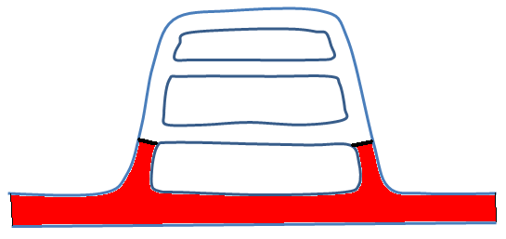
1. Vasoconstriction
Nerve impulses from the hypothalamus to the smooth muscle in the arterioles cause them to contract.
Blood is diverted away from the capillaries near the skin, so less heat is lost by radiation.
This why you look paler on a cold day.

Slide 30
2. Decreased sweating
Vasoconstriction also decreases blood flow to the sweat glands.
This causes less sweat to be secreted onto the surface of the skin.
Less heat energy will be lost as there will be no ‘cooling effect.’

Slide 31
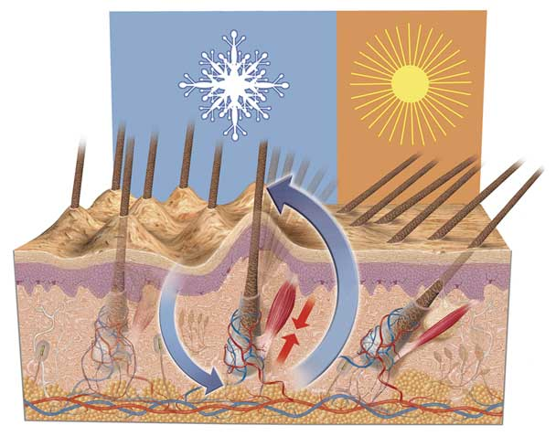
3. Piloerection
Nerve impulses to cause erector pili muscles to contract, causing hairs on the body surface to be pulled up straight.
This means that more air is trapped between the hairs and the skin, causing more insulation. This not very useful in humans, but is good for furry mammals.

Slide 32
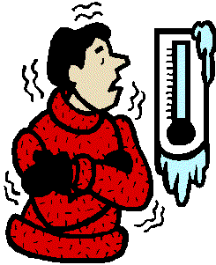
4. Shivering
Skeletal muscles contract and relax rapidly.
As the muscles are increasing their activity, the rate of respiration increases.
This increase cause the release of heat energy, which increases the core body temperature.

Slide 33
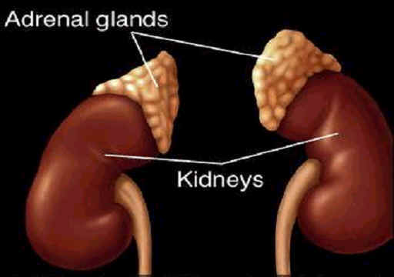
5. Metabolic changes
The hormone adrenaline is released by the adrenal gland. This causes a great increase in metabolic rate, resulting in heat production.
Long-term exposure to low temperatures causes the release of thyroxine by the thyroid gland – this causes sustained increases in metabolism.

Slide 34
Hypothermia
This happens when the core body temperature falls below about 35.5^{O}C for a sustained period of time.
Symptoms include sever shivering, muscle mis-coordination, metabolic shutdown and reduced brain-activity.

Slide 35
summary

Slide 36
Summary
High Temperatures
Low Temperatures
Vasodilation
Sweating
Panting
Pilorelaxation
Decreased Metabolism
Vasoconstriction
Decreased sweating
Piloerectrion
Shivering
Increased metabolism

Slide 37
ECTOTHERMS
The following is to do with animals that obtain large amounts of heat from environmental sources (such as the sun)...

Slide 38
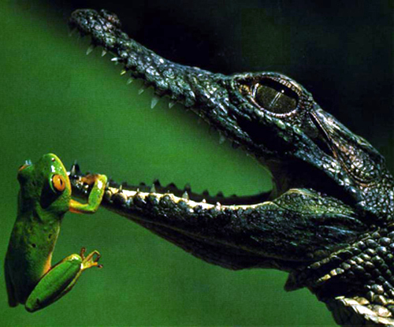
Ectotherms
Ectotherms gain most of their heat energy from their surroundings.
Therefore, if the temperature of their environment fluctuates, their internal temperature will fluctuate too.
This means that ectotherms have to adapt their behaviour to adapt to the external temperature.
Ectotherms will do the following to control their body temperature:
- Expose themselves to the Sun.
- Take shelter.
- Gain warmth from the ground.
- Generate metabolic heat.
- Colour variations.

