Slide 1
Introduction to Homeostasis
And Controlling Blood Glucose Levels

Slide 2
Keeping Control
We know that organisms have to respond to their external environment – especially in a conscious way.
But what about when the internal environment of an organism gets out of control?
The maintenance of a constant internal environment is known as HOMEOSTASIS
In such complex organisms, it is essential that all internal conditions are kept relatively constant
BODY TEMPERATURE
BLOOD GLUCOSE LEVELS
BLOOD WATER POTENTIAL
BLOOD CO2 LEVELS

Slide 3
Why So Important?
There are 3 main reasons why keeping a constant internal environment (and therefore homeostasis) is essential...
Enzymes are the reason your body is functioning the way it is right now. Without these special proteins, essential biochemical reactions simply could not take place. However, these enzymes are highly sensitive to certain factors – such as TEMPERATURE and pH. If temperature or pH deviate from their normal levels, enzymes can become denatured, rendering them useless.
Water Potential plays an important role in maintaining the structure of animal cells. Osmosis is controlled by differences in water potential in two regions. If water potentials reach levels they shouldn’t be at, this could cause cells to shrink or expand – even to the point where they burst.
Our ability to thrive almost anywhere is a direct result of homeostasis. Imagine if your body did not regulate it’s temperature – you’d only be able to survive in mild climates. Because of homeostasis, you are able to cope with environments with considerably high or low temperatures. In fact, mammals are found all over the globe.

Slide 4
Negative Feedback
In order keep a constant internal environment, the factor that changes, needs to be DETECTED first.
Then, a CORRECTIVE MECHANISM is implemented, and this brings the factor back to its normal level.
This system is called negative feedback.
Body detects the change and brings about a corrective mechanism.
Factor rises above normal level
Factor at normal level.
Factor at normal level.
Factor falls below normal level
Body detects the change and brings about a corrective mechanism.

Slide 5
Blood glucose levels

Slide 6
Blood Glucose
Blood glucose levels in a healthy human are regulated to a range of 70-100mg per 100cm³ of blood.
Blood glucose levels need to be regulated because:
Glucose is the main respiratory substrate.
Glucose affects blood water potential.
High Blood Glucose Levels – called HYPERGLYCAEMIA. Causes muscle to break down, weight loss, tiredness.
Low Blood Glucose Levels – called HYPOGLYCAEMIA.
Causes sweating, hunger, irritability, double vision.

Slide 7
Why does it change?
Blood glucose levels increase after consuming food – especially if it’s high in carbohydrates.
Blood glucose levels decrease after exercise because it is broken down in respiration.
Blood glucose/mg 100cm⁻³
7am 8am 9am 10am 11am 12pm

Slide 8
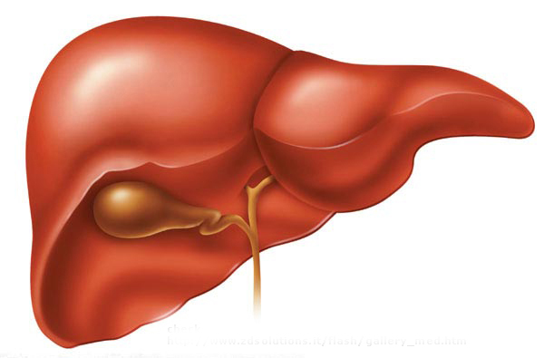
Where do our bodies actually get glucose from then?
There are some pretty obvious ways that glucose enters our bloodstream, but also some tricky ways...
GLYCOGENOLYSIS
Excess glucose is stored in the liver and muscles as GLYCOGEN. This can be broken down when required, releasing glucose.
Directly from the Diet
In a nutshell, we take in carbohydrates in our food, which are then broken down into glucose.
It is these two of course, that form part of the homeostasis mechanism of controlling blood glucose levels
GLUCONEOGENESIS
This is different from glycogenolysis. Glucose is produced from molecules other than carbohydrates – such as glycerol and amino acids in the liver.

Slide 9
The pancreas & hormones

Slide 10
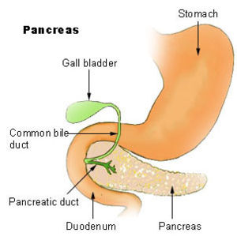
The Pancreas
The pancreas is a ‘leaf-shaped’ organ in the abdomen, which has two main functions.
It produces enzymes such as amylase, protease and lipase.
It produces hormones involved in controlling blood glucose levels.
It is this function that we are most interested in when it comes to controlling blood glucose levels.
The majority of the pancreatic tissue is just made up of cells that produce digestive enzymes, but interspersed within these cells are the specialised cells that produce the hormones we are interested in.

Slide 11
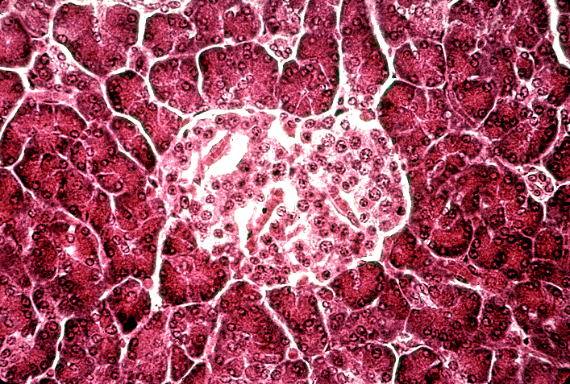
The pancreas secretes hormones to control blood glucose levels
In the pancreas, there are clusters of cells called the Islets of Langerhans. There’s two main types of cells here:
α-cells. These secrete glucagon, when blood glucose levels are LOW.
β-cells. These secrete insulin, when blood glucose levels are HIGH.

Slide 12
High blood glucose levels

Slide 13
High Levels of Blood Glucose
If the blood supplied to the islets of Langerhans through the hepatic portal vein is high in glucose, the β-cells detect this.
They then secrete the hormone, insulin into the bloodstream.
The insulin binds to the cell membranes of target cells (liver and muscle).
The liver and muscle cells take in glucose from the blood, and convert into a storage compound called GLYCOGEN.

Slide 14
What Insulin Does...
Insulin lowers the blood glucose level in several ways:
Insulin stimulates the uptake of glucose by all respiring cells, but mainly liver and muscle cells.
Insulin stimulates the increased use of glucose in respiration.
Insulin activates enzymes in liver and muscle cells which convert glucose to GLYCOGEN.
Insulin activates other enzymes which convert the excess glucose to fatty acids.

Slide 15
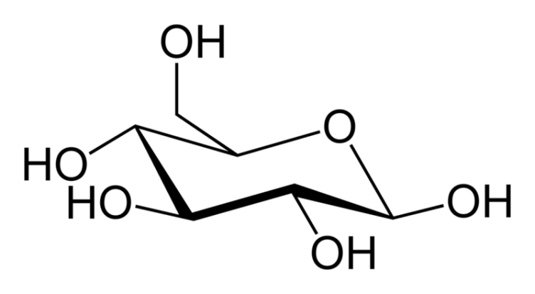
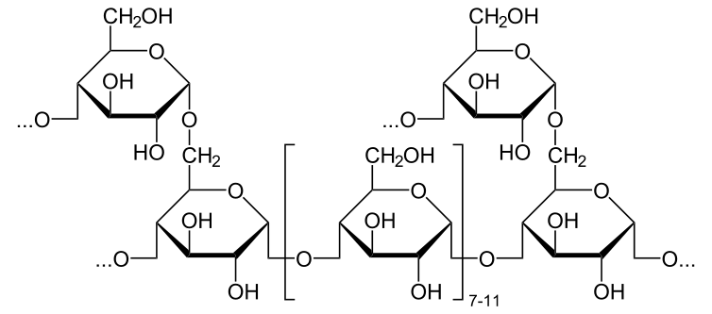

Slide 16
Low blood glucose levels

Slide 17
Low Levels of Blood Glucose
If the blood supplied to the islets of Langerhans is low in glucose, the α-cells detect this.
These cells then secrete the hormone, GLUCAGON into the bloodstream.
The glucagon binds to the cells membranes of target cells (mainly liver and muscle cells), which causes TWO PROCESSES TO OCCUR.....

Slide 18
GLYCOGENOLYSIS
When glucagon binds to the receptors on cells, it activates enzymes within the cells, which convert glycogen to glucose.
GLUCONEOGENESIS
When glucagon binds to receptors on cells, it also stimulates the conversion of glycerol and amino acids to glucose.
This glucose is then released into the blood.

Slide 19
This is
GLYCOGENOLYSIS

Slide 20
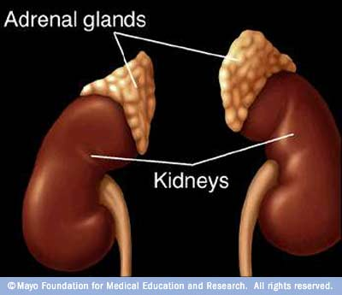
Adrenaline
Other than glucagon, there is another hormone that can increase blood glucose levels – ADRENALINE.
Sometimes, in an unexpected time of excitement, your body requires a quickfire shot of energy.
Adrenaline is pumped into the blood by the adrenal glands.
Adrenaline then travels throughout the bloodstream, activating cells in the liver, causing them to break glycogen down into glucose.

