Slide 1
12.4 Diabetes and its Control

Slide 2
Learning Objectives
Learn the two types of diabetes and how they differ.
Learn how each type of diabetes can be controlled.

Slide 3
Diabetes mellitus
Some people’s bodies are unable to regulate blood glucose levels, and suffer from diabetes. Of which there are 2 types:
Type 1
Type 2
Type 1 diabetics do not produce enough insulin. So after a meal, their blood glucose is very high, and glucose can’t enter cells.
Type 2 diabetics are usually older people, whose islet cells are less efficient at producing insulin.

Slide 4
What do diabetics need to do?
With type 1 diabetes, people inject themselves with insulin. This allows glucose to enter cells and either be used or stored.
If too little insulin is injected, the blood glucose levels will remain high, and the person is said to be hyperglycaemic.
If too much insulin is injected, the blood glucose levels will fall too low, and the person is said to be hypoglycaemic.
Diabetics monitor their blood glucose levels with a meter.

Slide 5
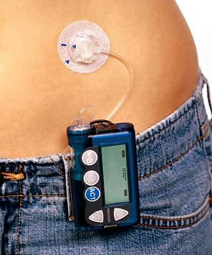
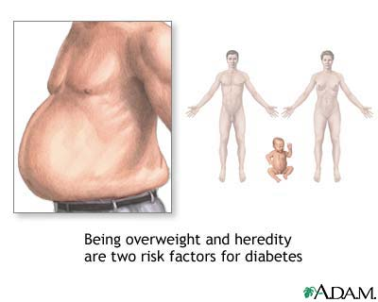
What do diabetics need to do?
Type 2 diabetes tends to occur later in life, especially in people who are overweight.
Type 2 diabetes is usually treated by a combination of exercise and diet.

Slide 6
Suggest how type 2 diabetes could be controlled by exercise and diet.

