Slide 1
Exchange and Transport
13.1 Exchange between organisms and their environment

Slide 2
HIPPO
MOUSE
Build a mouse!
e.g. A cube measuring
1cm x 1cm x 1cm
Build a hippo!
e.g. A block measuring
2cm x 4cm x 4cm
What is the surface area of each ‘animal’?
What is the volume of each ‘animal’?
Calculate and compare the surface area to volume ratio for the ‘mouse’ and ‘hippo’
Notes:
STARTER ACTIVITY – need card and scissors and rulers and pencils
- could be done using plasticine models and rough guide to measurements?

Slide 3
Learning objectives
Students should be able to understand the following:
The relationship between the size of an organism or structure and surface area to volume ratio
How larger organisms increase their surface area to volume ratio
How exchange surfaces are specially adapted
Candidates should be able to:
Explain the significance of the relationship between size and surface area to volume ratio for the exchange of substances and of heat
Notes:
Refer to exchange surface adaptations in larger organisms

Slide 4
Substances organisms need to exchange with their environment:
Cells need oxygen (for aerobic respiration) and nutrients (glucose, fatty acids, amino acids, vitamins and minerals)
Cells must excrete waste products like carbon dioxide, urea and water
Heat must be exchanged to keep organisms at roughly the same temperature
Notes:
Explain cells exchange such things across their plasma membranes – what processes allow this to happen?

Slide 5
How substances are exchanged
TASK
Describe three processes by which organisms exchange substances across their cell surfaces
Give examples of each process

Slide 6
How substances are exchanged
Examples:
Diffusion and Osmosis
passive processes
require no energy
Active transport
energy is required
Notes:
Feed back ideas and write up on white board (examples)
NB need to give examples of diffusion, osmosis and active transport
Diffusion – gas exchange in alveoli, glucose absorption in small intestine
Osmosis – movement of water into plant cells to make them turgid, also bacteria
Active transport – glucose absorption against concentration gradient – uses carrier protein and ATP hydrolysis

Slide 7
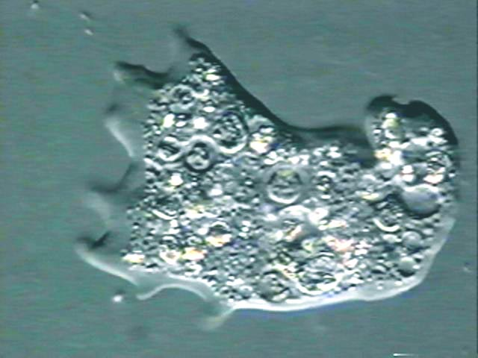
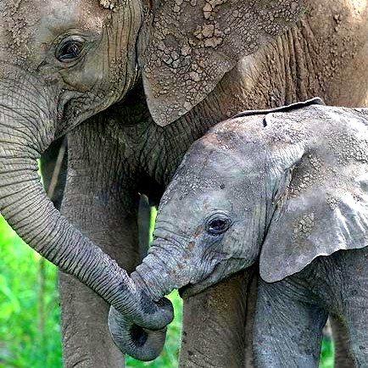
Effective exchange of substances
Small organisms have a relatively large surface area : volume ratio and therefore efficient exchange of substances can occur across the body surface (e.g. Amoeba proteus)
A larger organism has a smaller surface area : volume ratio making it more difficult to exchange substances between the environment and all the cells making up its volume (e.g. Elephant)
Notes:
Refer back to starter activity here

Slide 8
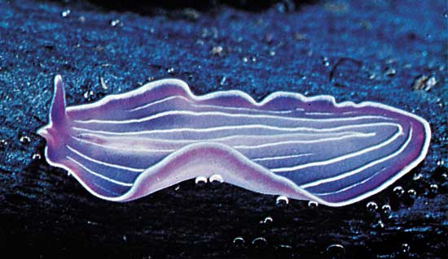
Adaptations for exchange
Larger organisms have evolved to make exchange of substances more efficient:
Flattened shape brings all cells close to the surface (e.g. Flatworms)
Specialised exchange surfaces with large surface area (e.g. Lungs in mammals, gills in fish)
Mass transport systems to carry substances to and from their individual cells (e.g. Circulatory system in mammals)
Notes:
Larger organisms are adapted to efficiently exchange substances between the environment and ALL their cells

Slide 9
Features of specialised exchange surfaces
GROUP TASK
Explain how mammalian lungs are adapted for gas exchange in each of the following ways:
A large surface area to volume ratio
Diffusion distance is short
Partially permeable
Movement of the environmental medium to maintain a diffusion gradient
Movement of the internal medium to maintain a diffusion gradient
Notes:
Feed back ideas from individual groups

Slide 10
Efficient gas exchange in mammalian lungs
The rate of diffusion is proportional to:
Surface area x difference in concentration
length of diffusion path
Notes:
Summarise points from group task on previous slide

Slide 11
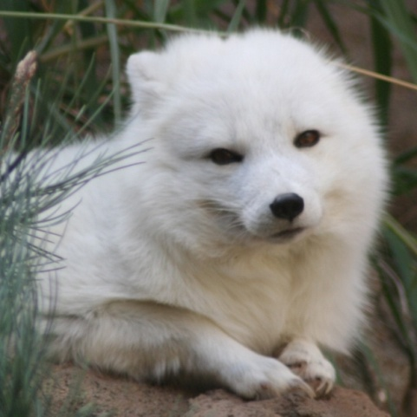
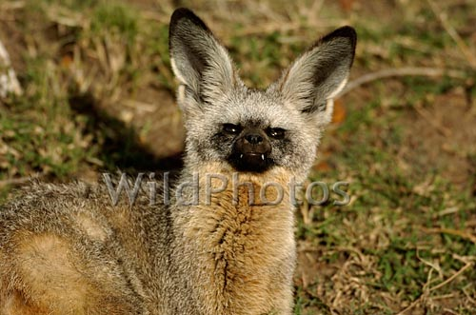
Adaptations for effective exchange of body heat and water with the environment
Body size and shape affect heat exchange:
Arctic fox
African bat-eared fox
Small ears and a round head reduce its SA:Vol ratio and heat loss
Large ears and pointed nose increase SA:Vol ratio and heat loss
Notes:
Explain water and heat loss increases across body surface as SA:volume ratio of organism increases therefore small mammals lose heat and water more quickly than large aquatic mammals like blue whales

Slide 12
Exchange of body heat and water with the environment
Explain the following behavioural and physiological adaptations:
Small desert mammals have kidney structure adaptations so they produce less urine
Small animals living in cold regions have higher metabolic rates
Smaller mammals may have thick fur and/or hibernate when the weather gets really cold
Elephants have large flat ears and hippos spend a lot of time in the water
Notes:
GROUP TASK 2 (do on plain A4 paper – sketch rough ideas then feed back to group)

Slide 13
Application
Significance of the surface area to volume ratio in organisms
AQA AS Biology textbook pg 177
Answer questions 1 and 2
Notes:
Do as individual written task

Slide 14
Learning objectives
Students should be able to understand the following:
The relationship between the size of an organism or structure and surface area to volume ratio
How larger organisms increase their surface area to volume ratio
How exchange surfaces are specially adapted
Candidates should be able to:
Explain the significance of the relationship between size and surface area to volume ratio for the exchange of substances and of heat

