Slide 1
13 Feedback Mechanisms
13.1 The Principles of Feedback Mechanisms

Slide 2
Starter
Name the 5 stages of homeostatic control of any system (from 12.1)

Slide 3
Homeostatic control of systems
The set point
A receptor
A controller
An effector
A feedback loop

Slide 4
Learning Objectives
Explain the principle of negative feedback
Describe how negative feedback helps to control homeostatic processes
Explain the differences between negative and positive feedback
Success Criteria
You can state the 5 stages of homeostatic control

Slide 5
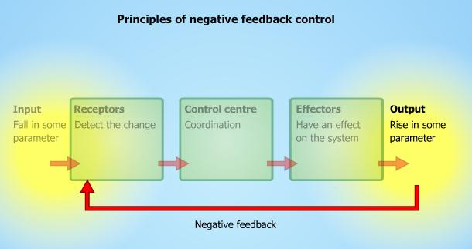
Negative Feedback
View animation on Kerboodle (Under A2 Biology, Unit 2, 12. Homeostasis, Animation: Negative and Positive Feedback)

Slide 6
Negative Feedback
Negative feedback is when the feedback causes the corrective measures to be turned off.
This returns the system to a normal level.
Receptors
Detect the change
Control Centre
Coordination
Effector
Have an effect on the system
Input
Fall in some parameter
Output
Rise in some parameter

Slide 7
Negative Feedback in the control of body temperature
As the temperature of the blood increases, it is detected by thermoreceptors in the hypothalamus
These then send nerve impulses to the heat loss centre (this is also in the hypothalamus)
This then sends signals to the skin (the effector organ)

Slide 8
What happens at the skin to reduce blood temperature?
Sweating
Lowering of body hairs
Vasodilation
What would happen if the reduction in temperature wasn’t fed back to the hypothalamus?
Blood temperature would keep dropping and would fall below normal
This may cause hypothermia and death
This is why we need negative feedback!

Slide 9
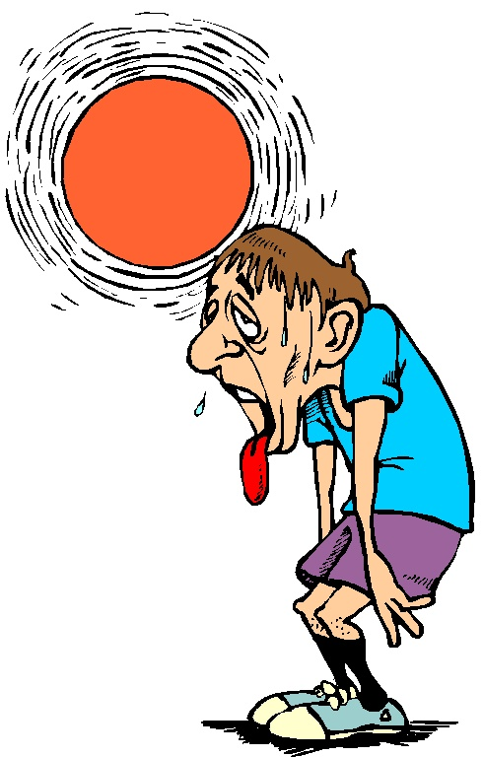
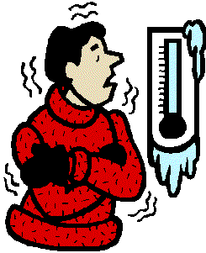
Task
Think about controlling body temperature and create a negative feedback loop for how the body keeps a constant temperature after the blood temperature rises

Slide 10
Negative Feedback in the control of temperature
Nerve impulses
Nerve impulses
SKIN
Vasodilation
Sweating
Lowering Hairs
Thermoreceptors in the hypothalamus
Heat loss centre in the hypothalamus
Normal blood temp
Rise in
blood temperature
Blood at original temperature turns
off corrective measures (NEGATIVE FEEDBACK)

Slide 11
A fall in blood temperature
If blood temperature falls, then it will be the heat gain centre that acts
This will cause the hairs to rise, reduced sweating and vasoconstriction
These mechanisms will be turned off once blood at a normal temperature passes through the hypothalamus

Slide 12
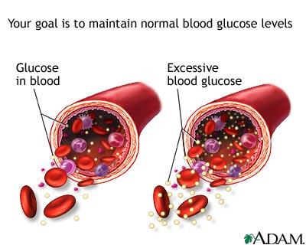
The control of blood glucose
Think back to topic 12.3 and draw a negative feedback loop for what happens when there is a fall in blood glucose concentration

Slide 13
Negative Feedback in the control of blood glucose
Blood containing glucagon
LIVER
Glycogen → glucose gluconeogenesis
Fall in
blood glucose concentration
α cells in the pancreas
Normal blood glucose concentration
Blood at normal glucose concentration turns
off corrective measures (NEGATIVE FEEDBACK)

Slide 14
A rise in blood glucose
If this happens, what hormone is released and from where?
Insulin is released from β cells in the pancreas.
What does this hormone do?
Insulin increases glucose uptake by cells and increases its conversion to glycogen and fat.
What happens to stop the hormone being produced?
Negative feedback then turns off production of insulin once blood glucose levels have returned to normal
ALWAYS talk about negative feedback in questions about blood glucose, don’t just describe what the hormones do.

Slide 15
Positive Feedback
Positive feedback is when the feedback causes the corrective measures to stay turned on
Can you think of any examples of this?
Neurones: influx of sodium ions increases the permeability of the neurone, causing more sodium ions to move in, which further increases the permeability etc. This allows a very fast build-up of action potential to respond very quickly to a stimulus
Diseases can cause positive feedback by disrupting the normal temperature regulation. E.g. Typhoid fever causes a rise in temperature which leads to hyperthermia

Slide 16
Tasks
Complete Summary and Application questions on page 214 of the textbook
If you want to try some more difficult questions, then attempt the Negative Feedback in the Kidney sheet

Slide 17
Summary - Answers
Positive feedback occurs when the feedback causes the corrective measures to remain turned on. In doing so, it causes the system to deviate even more from the normal level. Negative feedback occurs when the feedback causes the corrective measures to be turned off. In doing so, it returns the system to its original level.
If the information is not fed back once an effector has corrected any deviation and returned the system to the set point, the receptor will continue to stimulate the effector and an over-correction will lead to a deviation in the opposite direction from the original one.
It gives greater degree of homeostatic control.

Slide 18
Application - Answers
As sweating involves a loss of water from the blood, its water potential will decrease.
a) Osmotic cells (in the hypothalamus)
b) Kidney
Being a hormone, it is transported in the blood plasma.
Absorption of water (taking in or consumption or drinking) because water has been lost during sweating. As the water potential of the blood returns to normal, the lost water must have been replaced. However, the kidney only excretes less water, it does not replace it. Therefore process X must be the way in which water is replaced.
Negative feedback

