Slide 1
13.2 - Control of the Oestrous Cycle

Slide 2
Learning Objectives
Learn which hormones are involved in the control of the oestrous cycle.
Learn how these hormones interact in the control of the human menstrual cycle.
How are different forms of feedback loop involved in this control?

Slide 3
Oestrous Cycles
The reproductive system of mammals undergoes a regular pattern of changes.
As a species-wide phenomenon, this pattern is known as the oestrous cycle.
In human females, the oestrous cycle is initiated at the onset of puberty, continuing until the menopause.
In primates, the uterus lining is shed between each cycle.
Therefore the name we give to this special case is, the menstrual cycle.
The menstrual cycle is controlled by 4 different hormones, which interact with each other.
LH
FSH
Protein Hormones
Steroid Hormones
progesterone
oestrogen

Slide 4
Introduction to the Hormones
Follicle-Stimulating Hormone (FSH):
This hormone stimulates the development of follicles in the ovaries. It in turn stimulates the follicles to produce oestrogen.
Luteinising Hormone (LH):
This hormone triggers OVULATION. It’s second function is to then stimulate the corpus luteum to produce progesterone.
Oestrogen:
This hormone rebuilds the uterine lining (endometrium) after menstruation. It also stimulates release of LH, by the pituitary.
Progesterone:
Maintains the uterine lining in readiness for a fertilised egg. It also inhibits the production of FSH by the pituitary.

Slide 5
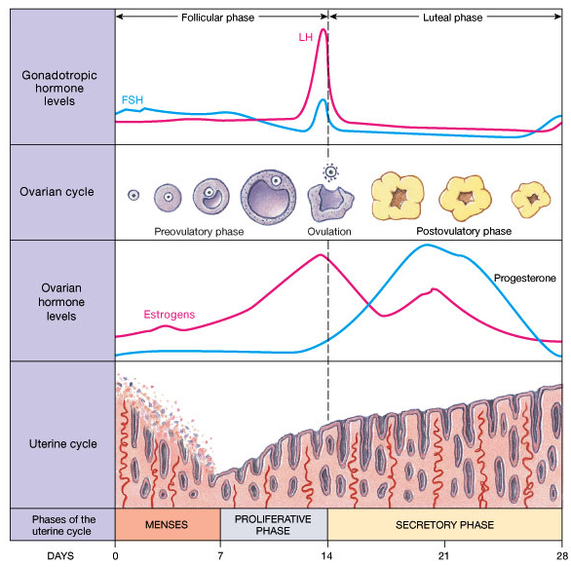

Slide 6
Human Female: Menstrual Cycle – PART 1
Oestrogen has 2 effects:
It binds to oestrogen receptors on the cells of the uterine wall – causing them to REPAIR and THICKEN.
It has FEEDBACK EFFECTS on FSH and LH.
In SMALL AMOUNTS, oestrogen INHIBITS release of FSH and LH.
In LARGE AMOUNTS, oestrogen PROMOTES the release of FSH and LH.
We take the beginning of menstruation as the start of the menstrual cycle (Day 1).
The lining of the uterus: the endometrium, passes through the cervix and vagina over 4-5 days.
The inner layer of endometrial cells is conserved so that a new layer can form by mitosis (later in the cycle).
At the same time (Days 1-5) the pituitary gland will release FSH.
FSH is responsible for stimulating the development of follicles, whose cells then start to divide, resulting in growth.
As the follicle grows, it begins to release oestrogen.

Slide 7
Human Female: Menstrual Cycle – PART 2
Early on, (days 5-10), oestrogen is released slowly, and therefore inhibits the release of FSH and LH.
This will obviously inhibit the development of other follicles.
However, at day 10, the follicles are quite large and developed, and so there is a surge in the production of oestrogen.
When the levels reach a critical point, oestrogen has a POSITIVE EFFECT on FSH and LH, leading to a rapid release of these 2 hormones at around days 12-14.
Due the release of LH, ovulation occurs at day 14, releasing the egg.
Now that the follicle is empty, LH tranforms it into a CORPUS LUTEUM.
Luteinising Hormone:
This hormone triggers Ovulation.
It transforms an empty follicle into the CORPUS LUTEUM.
It also stimulates the production of PROGESTERONE.

Slide 8
Human Female: Menstrual Cycle – PART 3
PROGESTERONE:
Progesterone has 2 main effects...
Its presence makes the uterine lining highly receptive to an embryo at days 20-21.
It has a feedback effect on FSH and LH.
At LOW levels, it has a negative effect on FSH, so now new follicles are stimulated in the 2nd half of the cycle.
At HIGH levels, it has a negative effect on LH. And since LH stimulates the corpus luteum to produce progesterone, it has a negative effect on itself.
The corpus luteum produces PROGESTERONE and oestrogen during the second half of the cycle.
From around day 15, the levels of progesterone rise, peaking at about day 21.
The levels of progesterone depend on whether the oocyte was fertilised by a sperm or not.
If it was fertilised, the embryo itself, will produce chemicals that will cause levels of progesterone to fall, which as you now know, will inhibit FSH.
If it was not fertilised, levels of progesterone will remain high for a while, causing inhibition of LH (negative feedback). This will eventually restrict blood flow to the endometrium, causing it to break down – menstruation.

