Slide 1
Exchange and Transport
13.2 Gas exchange in single-celled organisms and insects

Slide 2
Learning outcomes
Students should be able to understand the following:
How single-celled organisms exchange gases
How terrestrial insects balance the need to exchange gases with the need to conserve water
How insects exchange gases
Candidates should be able to:
Use their knowledge and understanding of the principles of diffusion to explain the adaptations of gas exchange surfaces

Slide 3
How single-celled organisms exchange gases
CO₂ Diffuses out of cell
O₂ Diffuses into cell
Unicellular organisms (e.g. Amoeba, bacteria) have a large SA : Volume ratio
Gases are exchanged efficiently across the whole body surface
There is a thin surface membrane and short diffusion pathway enabling oxygen to diffuse into the cell and carbon dioxide to diffuse out of the cell

Slide 4
Requirements for effective gas exchange across the body surface
Reminder: the rate at which a substance can diffuse is given by Fick's Law:
Rate of diffusion ∝ surface area x concentration difference
Distance
Organisms therefore need thin permeable surface membranes with a large surface area
BUT this would lead to excessive water loss in larger organisms

Slide 5
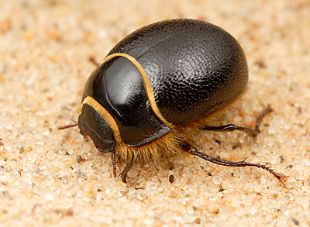
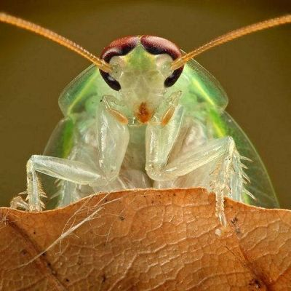
Insects are adapted to conserve water
Small Surface area :Volume ratio to minimise water loss from the body surface
Waterproof coverings
e.g. In insects the exoskeleton is covered with a waterproof cuticle

Slide 6
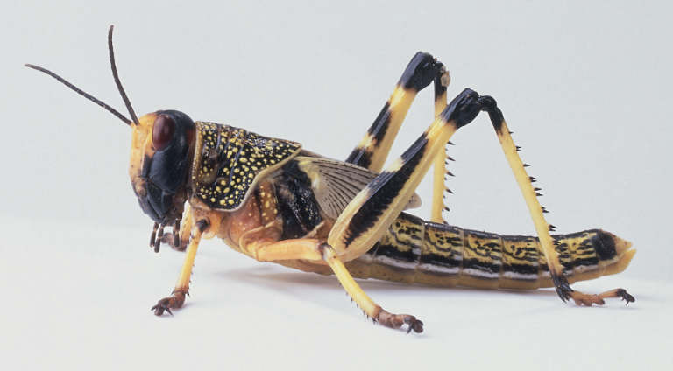
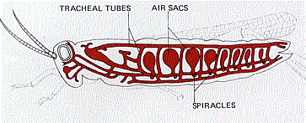
Insects are adapted for gas exchange
Insect Tracheal System
Tracheal tubes run from the body surface into the tissues
Transport gases directly between the external environment and the body cells

Slide 7
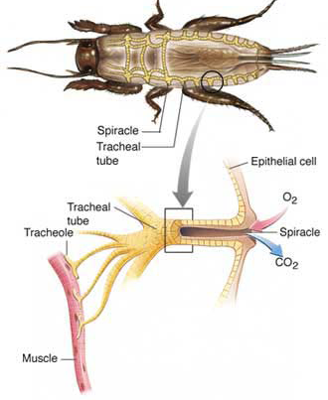
Anatomy of insect gas exchange system
Each segment of the insect (apart from the head) has a pair of lip-like openings called spiracles
Tracheal tubes connected to each spiracle branch into a series of tracheoles
Tracheoles repeatedly divide until their numerous microscopic ends penetrate into individual body cells
The spiracles can be closed to prevent water loss and opened when greater respiration is needed

Slide 8
How gases are exchanged in insects
Diffusion gradient
Oxygen moves down a concentration gradient from the air into body cells
Carbon dioxide moves down a concentration gradient from body cells into the air
Ventilation by rhythmic abdominal movements
Further speeds up the exchange of respiratory gases by generating mass movements of air in and out of the tracheal tubes

Slide 9
Application
Spiracle movements
AQA AS Biology textbook pg 179
Referring to Fig. 3, answer questions 1 - 5

Slide 10
Learning outcomes
Students should be able to understand the following:
How single-celled organisms exchange gases
How terrestrial insects balance the need to exchange gases with the need to conserve water
How insects exchange gases
Candidates should be able to:
Use their knowledge and understanding of the principles of diffusion to explain the adaptations of gas exchange surfaces

