Slide 1
Exchange and Transport
13.3 Gas exchange in fish

Slide 2
Learning outcomes
Students should be able to understand the following:
The structure of fish gills and how water is passed along them
The difference between parallel flow and countercurrent flow
How countercurrent flow increases the rate of gas exchange
Candidates should be able to:
Describe gas exchange across the gills of a fish (gill lamellae and filaments including the countercurrent principle)

Slide 3
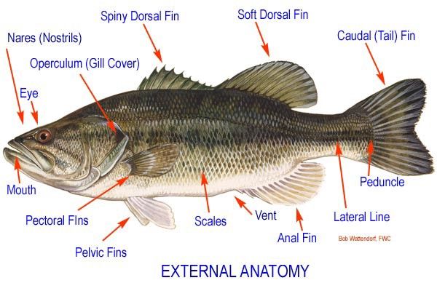
Structure of fish gills

Slide 4
Gills and gas exchange
Gills are the gas exchange surfaces in fish
Composed of gill filaments stacked like pages in a book
Gill lamellae project at right angles from the filaments and serve to increase the surface area of the gills for gas exchange
Gill lamellae are just a few cells thick and contain blood capillaries
How does this help facilitate gas exchange?
Why will a fish suffocate if left out of water?
Unit 2 Chap 13 Flash Files\fish gill lamellae.swf

Slide 5
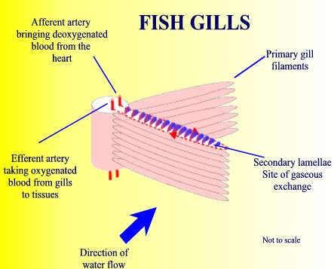
Water flow over fish gills
Unit 2 Chap 13 Flash Files\fish gill filaments.swf

Slide 6
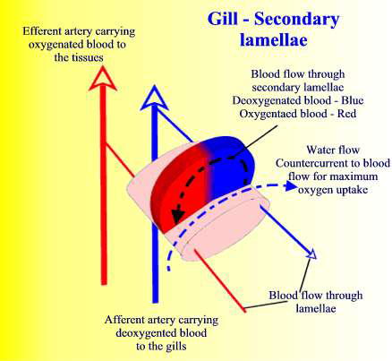
Gas exchange across gill lamellae

Slide 7
Countercurrent exchange principle
In countercurrent flow blood is always coming into contact with water that has a higher dissolved oxygen concentration
The diffusion gradient for oxygen is therefore maintained along the entire length of the gill structure
This facilitates maximun possible gas exchange across gill lamellae
Unit 2 Chap 13 Flash Files\counter-current flow.swf
In parallel flow the concentration gradient will level out when blood and water are both 50% saturated with oxygen
Diffusion therefore stops when the blood is only 50% saturated with oxygen
In the countercurrent system blood will continue absorbing oxygen from water as the concentration gradient does not level out
Unit 2 Chap 13 Flash Files\parallel flow.swf

Slide 8
Summary of gas exchange in fish by countercurrent flow
AQA AS Biology textbook pg 181
Answer summary questions 1 to 4
Unit 2 Chap 13 Flash Files\gas exchange in fish summary.swf
Build a model to explain the principle of gas exchange in fish gills by countercurrent flow

Slide 9
Complete the exam style questions on gas exchange in fish
Qu 2
(a) countercurrent mechanism; helps maintain diffusion gradient; 2
(b) mackerel has shortest total distance; for diffusion; (activity requires) oxygen for respiration / ATP production; 3 [5]
Qu 1
(a)(i) Arrow from vein towards artery, across lamella. 1
(ii) Water with high oxygen conc. meets blood with low oxygen conc; (may be derived from correct diagram) Difference in concentration maintained (across lamella); Diffusion gradient maintained. 2
(b)(i) 79 (Allow 78-80) – gains 2 marks. Length of cycle calculated from graph (0.75 - 0.77s) - gains 1mark Correct method (60 divided by cycle time), but cycle wrong time - gains 1 mark 2
(ii) Floor of mouth cavity lowered (increasing volume). 1 [6]

Slide 10
Learning outcomes
Students should be able to understand the following:
The structure of fish gills and how water is passed along them
The difference between parallel flow and countercurrent flow
How countercurrent flow increases the rate of gas exchange
Candidates should be able to:
Describe gas exchange across the gills of a fish (gill lamellae and filaments including the countercurrent principle)

