Slide 1
Blood Vessels and their Functions
13.6

Slide 2
Questions
What does a ‘double’ circulatory system mean?
Blood passes twice through the heart for each circuit of the body.
Why is it advantageous/necessary?
When blood passes through the lungs, the pressure lowers. If it didn’t go back to the heart before going off to the body, then circulation would be very slow.
Having a double circulation boosts pressure and helps to deliver substances to the rest of the body quickly (which is needed due to mammals having a high body temperature and a high metabolism)

Slide 3
Match up the names to the definitions
Arteries
Capillaries
Veins
Arterioles
Contain valves and carry blood back to the heart
These control the blood flow from arteries to capillaries
Carry blood away from the heart
Tiny vessels linking arterioles to veins

Slide 4
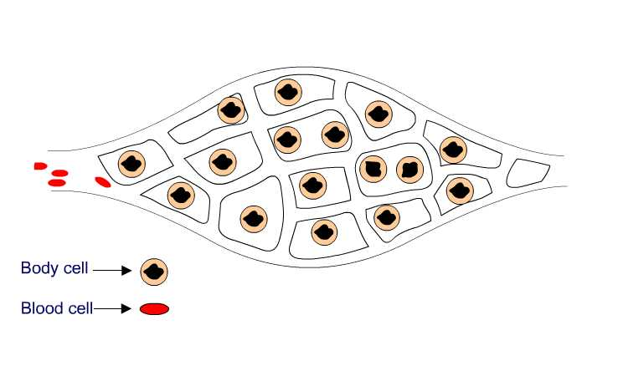
CAPILLARIES
These vessels link arteries with veins.
They are found all over the body and are essential for the exchange of materials between the blood and other body cells.
artery
vein
capillaries

Slide 5
Capillaries are so small that they can only be seen using a microscope.
A collection of capillaries is known as a capillary bed.
The wall of a capillary is only one cell thick!
very narrow lumen

Slide 6
Substances can diffuse across the lining of the capillary. This allows useful substances which are dissolved within the blood to move into surrounding cells whilst cellular waste moves in the opposite direction.
3
1
2
The exchange of materials between the blood and the body can only occur through capillaries.

Slide 7
Basic Structure of Blood Vessels
Arteries, Veins and Arterioles: Outside to inside:
Tough outer layer (resists pressure changes)
Muscle Layer (contracts to control flow of blood)
Elastic Layer (maintain blood pressure)
Endothelium (Smooth, prevents friction, thin for diffusion)
Lumen (where the blood flows through)

Slide 8
Tissue Fluid and its formation
What is it? – A watery liquid containing glucose, amino acids, salts, fatty acids and oxygen.
It supplies the materials to cells and receives carbon dioxide and waste substances from the cells for removal.
Formed by blood plasma, provides a constant environment for the cells it surrounds.

Slide 9
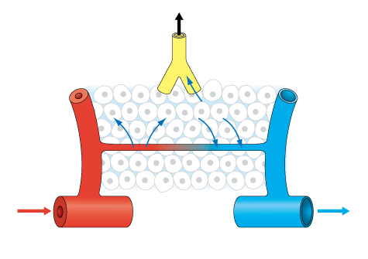
How does it get to the tissues?
When blood flows into the capillaries, water and other substances are exchanged between the blood and tissue fluid.
Two forces affect this exchange:
Hydrostatic pressure: caused by pumping action of heart – forces water out through capillary walls into tissue fluid
Water Potential: Due to large protein molecules in plasma, attracts water back into blood vessels from tissue fluid

Slide 10
Tissue fluid movement
Venous End
Water Potential gradient attracting water
into vessel is greater force than
hydrostatic pressure forcing
water out into tissues.
NET movement = into vessel
Arterial End
Hydrostatic pressure forcing water out is
greater force than water potential forcing water back in
NET movement = into tissues
arteriole
tissues
venule
capillary
artery
vein

Slide 11
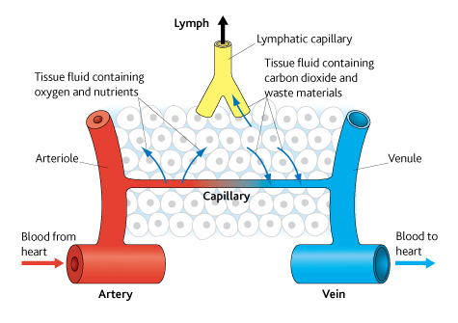

Slide 12
Tissue Fluid
The pressure is only strong enough to force small molecules out of the capillaries, so the cells and blood remain in the capillaries.
This is called ultrafiltration.

Slide 13
Lymphatic system
Some tissue fluid remains in tissues
It is carried away by lymphatic system
Network of vessels around body
Drains contents back to heart
Lymphatic system
Movement through vessels caused by
Hydrostatic pressure of fluid in tissue
Contraction of body muscles
squeezing the lymph vessels
arteriole
tissues
venule
capillary
artery
vein

Slide 15
Task
Using the diagrams you have been given, annotate them to explain the structure of Arteries, Arterioles, Veins and Capillaries using pages 186 – 188 of the textbook
You must include how the structure relates to the function
Once you have finished, complete the Application questions 1-5 and the Summary Questions 1-4 on page 188.

Slide 16
