Slide 1
Exchange and Transport
13.7 Movement of water through plant roots

Slide 2
Starter Activity: Label the parts of the transverse section of a root
A
B
C
H
G
D
F
E
Notes:
Students refer to double sided A4 handout of plant diagrams

Slide 3
Why do plants need water?
Plants need water for photosynthesis.
To keep their cells turgid, which is important for supporting the plant.
Water is also needed to transport mineral salts and organic solutes around the plant.

Slide 4
Learning outcomes
Students should be able to understand the following:
How water is taken up by root hairs
How water passes through the root cortex
How water is passed through the endodermis into the xylem
Candidates should be able to:
Describe the structure of a dicotyledonous root in relation to the pathway of water from root hairs through the cortex and endodermis to the xylem.
Describe Apoplastic and symplastic pathways.

Slide 5
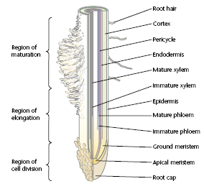
Inside the root
Epidermis
Pericycle
Root cap
Apical meristem
Ground meristem
Immature xylem
Immature phloem
Mature phloem
Root hair
Cortex
Region of cell division
Region of maturation
Region of elongation
Mature xylem
Endodermis

Slide 6
Root cap | This is outside the endodermis. It is made of cells called parenchyma cells. It stores starch.
Apical meristem | This covers the tip of the root. It is a tough layer of cells that are able to withstand the pressure of the root growing through the soil.
Region of cell elongation | These cells grow from the outer layer of root or epidermis. These are only found in a small area of the root, after the cell elongation zone. They are very enlarged epidermis cells which have a large surface area to absorb water.
Region of cell differentiation | These cells have a layer of a waxy substance called suberin around them. This forms the Casparian strip.
Root hairs | This is found behind the root cap. It contains a group of actively dividing cells.
Endodermis | This is the region where the new cells get longer
Cortex | This region is where plant cells develop into specialised kinds of cells.
Cortex
Root cap
Root hairs
Endodermis cells
Apical meristem
Region of cell elongation
Region of cell differentiation
Notes:
Refer to labelled diagram of root – match names of root parts to definitions – complete verbally with class so students can copy notes onto handout? OPTIONAL SLIDE?

Slide 7
A root hair cell
Root hair
Epidermis cell
These are very enlarged epidermis cells.
They have large surface area to absorb water.

Slide 8
Diagram of a transverse section through a plant root.

Slide 9
The Structure of Endodermis Cells
Endodermis cells have a layer of a waxy substance called suberin around them.
This forms a Casparian strip, which waterproofs the side walls of the endodermis cells.
As the endodermis cells get older, suberin is also laid down on their inner walls. This is important for the movement of water and ions through the root.

Slide 10
Parenchyma cells in the root cortex
The cortex is found outside the endodermis.
The cortex is made of cells called parenchyma cells.
It may store starch.

Slide 11
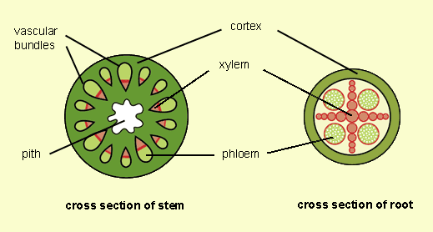
Transport tissues

Slide 12
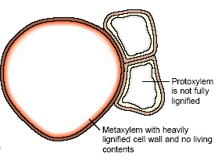
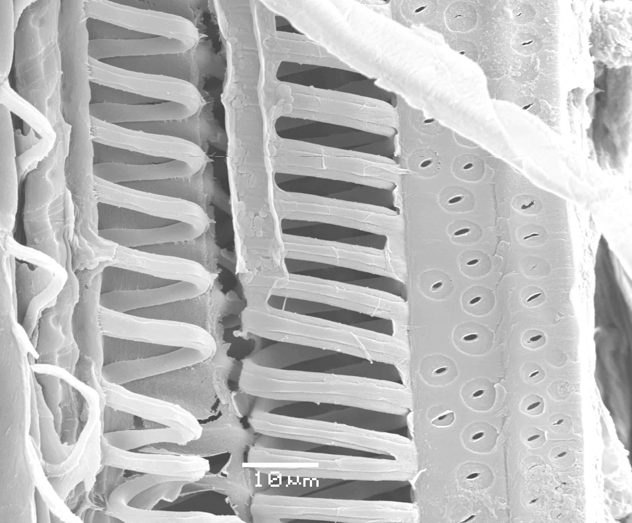
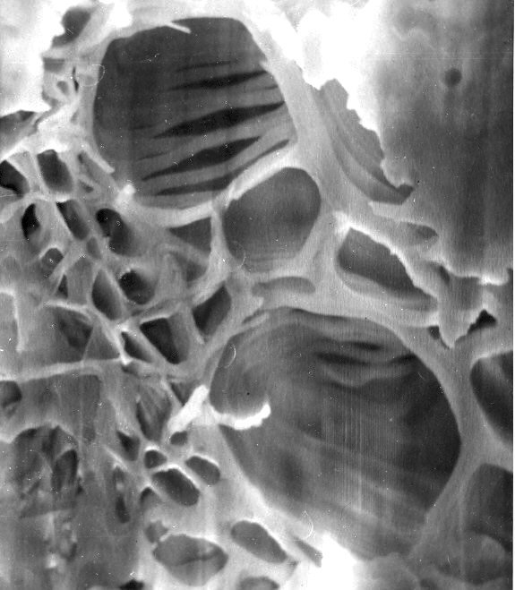
Xylem
Transport water and dissolved minerals.
Support
Long, non-living, tubular cells.
Most tissue – Vessels, with thickened strengthened walls.
Strengthened/waterproofed by lignin

Slide 13
Getting water in …
A thin film of water, containing tiny amounts of dissolved mineral ions, covers the particles of soil surrounding the roots.

Slide 14
Most of the water absorbed by the plant enters in the region of the root hairs. Water enters the root hair from the soil by osmosis, down a water potential gradient.

Slide 15
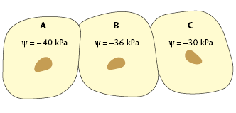
Quick Questions
Quick Recap First!
Osmosis is the diffusion of water through a partially permeable membrane
In which direction will osmosis occur in these cells?
Between which cells will the net movement of water be the greatest? Explain why.
Which has the higher water potential, the solution of water in the soil or the root hair cell? Explain your answer.

Slide 16
Answers
From C to B to A.
Between C and B, because there is a greater water potential gradient between these cells.
The water in the soil. It has the greater amount of water in the solution.

Slide 17
As water enters the root hair cell, this raises its water potential, so it is now higher than that of its neighbouring cell. This means water passes from the root hair cell to the cortex cell next to it. This process is repeated across the root, until the water enters the xylem.

Slide 18
The previous explanation is oversimplifies the process.
In fact, there are 2 different ways by which water can cross the root!
Are we OK so far?

Slide 19
The 2 pathways for water to move through the root of a plant

Slide 20
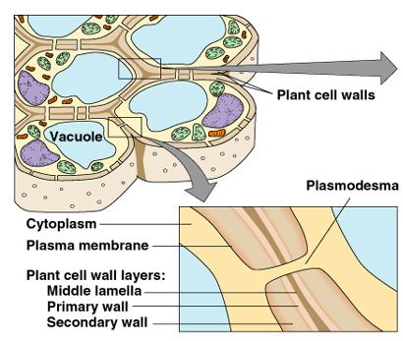
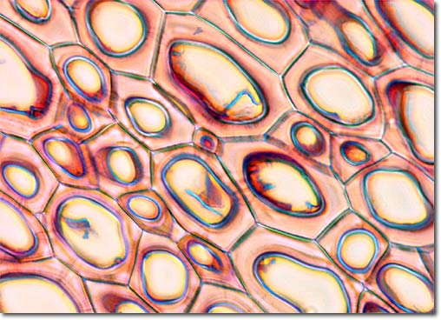
Quick Recap!
Strands called Plasmodesmata pass through pores in the cellulose cell walls and connect the cytoplasm of neighbouring plant cells.

Slide 21
The Symplast Pathway
Water enters the cytoplasm through the partially permeable membrane.
2) Water moves into the sap in the vacuole, through the tonoplast.
4
4
3
3) Water may move from cell to cell through the plasmodesmata.
3
2
4) Water may move from cell to cell through adjacent plasma membranes and cell walls.
1

Slide 22
Why there is a continuous movement of water
There is a water potential gradient pulling water across the root, because water is constantly moved up the xylem, and is replaced by water from neighbouring cells.
As water leaves the cells surrounding the xylem, this reduces their water potential, so water enters them by osmosis from their neighbours.
This movement continues across the root system, so there is a continuous movement of water from the watery film in the soil, across the root, and into the xylem.

Slide 23
The Apoplast Pathway
1) Water and dissolved mineral ions enters the cell wall.
2) Water moves through the cell wall.
3
3) Water may move from cell wall to cell wall, through the intercellular spaces.
4
2
4) Water may move directly from cell wall to cell wall.
1

Slide 24
How does the apoplast pathway work?
The cellulose cell wall is made up of a loose mesh of cellulose fibres, so there is plenty of space in the wall for water molecules.
Hydrogen bonding attracts water molecules to each other, so as water is taken up into the xylem, this draws water across the root (cohesion)
Notes:
NB water moves by osmosis in symplast but moves by cohesion only in apoplast

Slide 25
Water can only cross the root by the apoplast pathway until it meets the endodermis!!!

Slide 26
Why is the endodermis and Casparian strip – the end of the apoplast pathway?
Suberin in the Casparian strip stops water and mineral ions continuing along the apoplast pathway, so they have to enter the cytoplasm.

Slide 27
Question: What is the purpose of the endodermis and Casparian strip?
The Casparian strip provides a way of controlling the entry of water and mineral ions into the xylem
Water from the apoplast pathway joins water from the symplast pathway in the cytoplasm of endodermis cells

Slide 28
Passage of water into the xylem
Endodermal cells actively transport salts into the xylem
This requires carrier proteins in the cell surface membrane of endodermal cells
The xylem now has a lower water potential than endodermal cells so water moves into the xylem, by osmosis, along a water potential gradient
The resulting force (root pressure) helps to move water up the plant
Notes:
Draw diagrams alongside bullet points on board to explain movement of water?

Slide 29
Learning outcomes
Students should be able to understand the following:
How water is taken up by root hairs
How water passes through the root cortex
How water is passed through the endodermis into the xylem
Candidates should be able to:
Describe the structure of a dicotyledonous root in relation to the pathway of water from root hairs through the cortex and endodermis to the xylem.
Describe Apoplastic and symplastic pathways.

Slide 30
Homework
Read AQA AS Biology textbook pages 190-192 then answer summary questions 1-5 on page 192
Answer exam-style question 3 on page 203 of the AQA AS Biology textbook (AQA, 2001)

Slide 31
Mark scheme – exam style question
Answers
(a) A = xylem
B = endodermis 2
(b) (i) Cell walls 1
(ii) From high water potential to low water potential / higher water potential in soil / lower water potential in root;
By osmosis / diffusion of water. 2
[5]

