Slide 1
tRNA

Slide 2
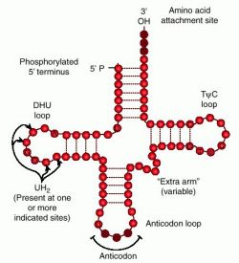
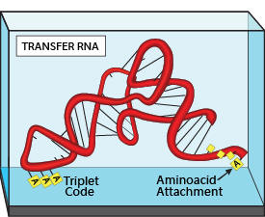
tRNA
Transfer RNA (tRNA) is a small molecule, existing as a single-strand that is folded into a clover-leaf shape.

Slide 3
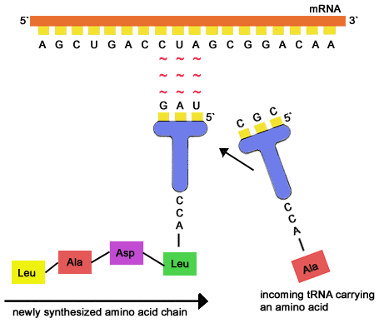
tRNA
The role of tRNA is to bring the amino acids to a ribosome where protein synthesis is taking place. (more on this later)

Slide 4
14.2 Protein Synthesis 1 Transcription & Splicing

Slide 5
Learning Objectives
How is the code within DNA copied into a molecule of mRNA?
What is pre-mRNA?
What are introns and exons?

Slide 6
Protein Synthesis
Last lesson we covered the basics of protein synthesis, the role of RNA and the Genetic Code.
This lesson we introduce protein synthesis as a 2-step process.
G
A
Transcription
C
U
C
Translation

Slide 7
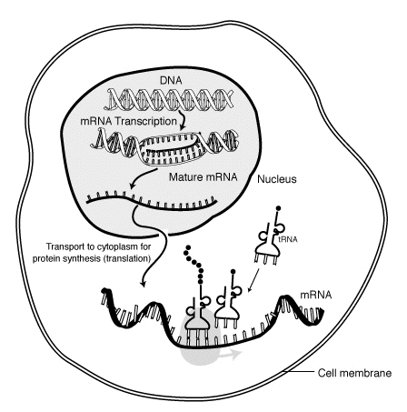
Protein Synthesis
There are 2 processes involved in protein synthesis.
Transcription
The production of mRNA by using DNA as a template. A length of DNA (a gene) is transcribed into a mRNA molecule.
Translation
Translating the base sequence of the mRNA molecule into an amino acid sequence. This occurs at a ribosome.

Slide 8
The 1st of the 2 steps is Transcription. This is a summary.
G
A
nucleus
C
U
C
C
T
G
cytoplasm
A
G
G
A
C
C
U
DNA

Slide 9
The previous slide was a summary of what happens overall in transcription. There are actually a number of enzymes involved in transcription, and the full process is detailed next...

Slide 10
RNA polymerase
When RNA polymerase reaches a particular sequence of bases on the DNA (stop triplet!), it detaches, and the production of pre-mRNA is complete.
DNA helicase
dna

Slide 11
1st Step - Transcription
DNA helicase (an enzyme) unwinds a section of DNA (gene) that is required for protein synthesis.
It does this by breaking the hydrogen bonds between bases in the middle of the double helix.
RNA polymerase (an enzyme) attaches to the start of one of the newly exposed template strands, and begins join complementary RNA nucleotides it.
This forms a molecule called pre-mRNA.
The synthesised pre-mRNA will then leave the nucleus through a nuclear pore.
Once the RNA polymerase has detached, the DNA can rewind, forming hydrogen bonds between its bases.

Slide 12
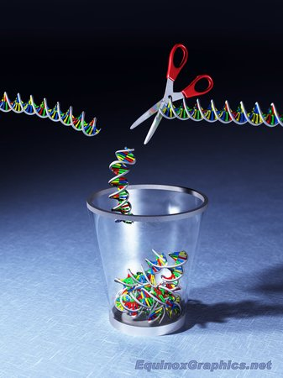
So why is it called pre-mRNA?!
Is all of the DNA within your cells useful?
i.e. Does it all code for proteins?
NO!
Only 2% of the DNA in your cells is ‘coding DNA.’
The other 98% is ‘non-coding.’

Slide 13
So a gene is riddled with non-coding DNA...
Imagine a gene is laid out in front of you.
You know around 98% of it is useless, so how do you go about extracting the right bits in order to get the instructions you need to make a protein?
Template Strand of DNA (a gene)
Transcription (production of pre-mRNA

Slide 14
Template Strand of DNA (a gene)
The coding sections are called EXONS.
The NON-coding sections are called INTRONS.
Transcription (production of pre-mRNA
Once the useful exons are removed from pre-mRNA, they are spliced together to form a final mRNA strand.

Slide 15
Summary
DNA provides the instructions in the form of a long sequence of nucleotides and the bases they possess.
A complementary section of part of this sequence is made in the form of a molecule called pre-mRNA – this is called transcription.
The pre-mRNA is modified to mRNA by removing the base sequences copied from non-functional DNA (introns) – a process called splicing.
The mRNA is used as a template to which complementary tRNA molecules attach and the amino acids they carry are linked to form a polypeptide – TRANSLATION.

