Slide 1
14.3 Translation

Slide 2
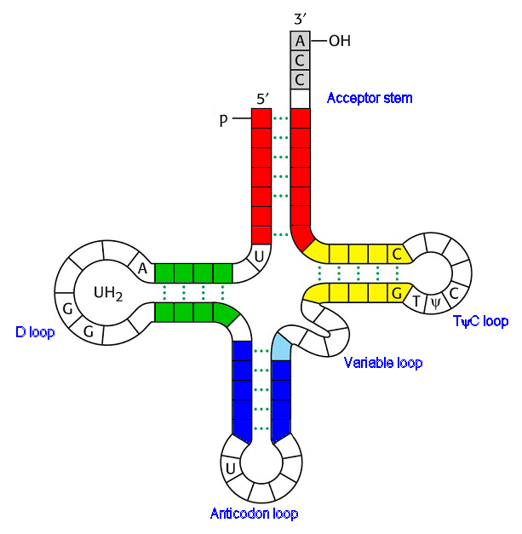
tRNA
A molecule heavily involved in translation is tRNA (transfer RNA).
These molecules are used to carry amino acids, so that they are in close vicinity to each other.
The open-end of a tRNA molecule is the ‘amino acid attachment site.’
The opposite end is the ‘anticodon loop.’
The anticodon loop consists of 3 unpaired bases.
These bases vary, giving tRNA specificity to amino acids.

Slide 3
The Sequence of Events....
Transcription
Splicing
Amino Acid Activation
Translation

Slide 4
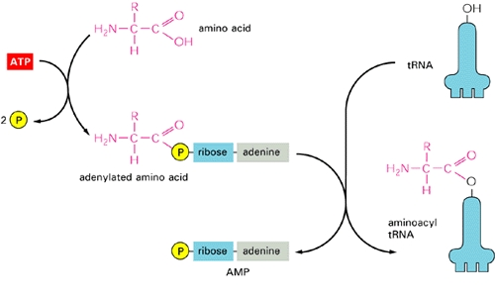
Amino Acid Activation
You now know that tRNAs carry specific amino acids.
However, you need to know that a tRNA cannot pick up an amino acid unless the amino acid is activated.
The amino acid attachment site of a tRNA will bind to a specific amino acid, if energy is supplied.

Slide 5
So... What’s happened so far?
We’ve created a strand of mRNA in transcription...
We’ve spliced it and taken out the 98% of ‘junk DNA’...
We’ve activated a load of amino acids and stuck them to tRNA molecules...

Slide 6
RNA polymerase
When RNA polymerase reaches a particular sequence of bases on the DNA (stop triplet!), it detaches, and the production of pre-mRNA is complete.
DNA helicase
dna

Slide 7
Template Strand of DNA (a gene)
The coding sections are called EXONS.
The NON-coding sections are called INTRONS.
Transcription (production of pre-mRNA
Once the useful exons are removed from pre-mRNA, they are spliced together to form a final mRNA strand.

Slide 8
Translation is now ready to happen...

Slide 9
In the cytoplasm...
Peptide Bond Forms
His
Peptidyl Transferase
Met
His
Arg
G
U
A
U
A
C
G
U
G
U
C
C
A
U
G
C
A
C
A
G
G
C
A
U
U
A
A
STOP CODON!!
RELEASE FACTOR

Slide 10
In Words...
Fresh out of transcription, the mRNA strand associates with a ribosome (in the cytoplasm).
The 1st 2 codons are now in the ribosome and attract their complementary tRNA molecules (which are carrying their specific amino acids).
A peptide bond is formed between the two amino acids (catalysed by peptidyl transferase).
The ribosome moves forwards by one codon (3 bases).
The first tRNA leaves the ribosome, while a new tRNA enters it, carrying it’s amino acid towards the newest codon.
Another peptide bond is formed between the 2nd and new tRNAs.
The ribosome continues moving along the mRNA until it reaches a stop codon. There, it will detach due to the presence of a release factor.
The polypeptide chain is then released, folding into the correct shape.

Slide 11
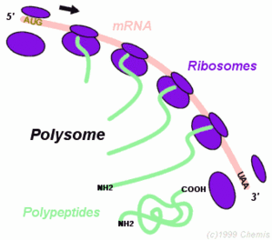
Multiple Ribosomes Working on a Single mRNA Strand
In reality, many ribosomes work simultaneously along a strand of mRNA.
This massively speeds up protein synthesis and increases the protein yield from a single mRNA strand.
Several ribosomes working their way along a single mRNA strand are called a polysome.

