Slide 1
15.1 – Genetic Comparisons Using DNA

Slide 2
Learning objectives
Students should understand the following:
Genetic comparisons can be made between different species by direct examination of their DNA or of the proteins encoded by this DNA.
Comparison of DNA base sequences is used to elucidate relationships between organisms. These comparisons have led to new classification systems in plants.
Similarities in DNA may be determined by DNA hybridisation.
Comparisons of amino acid sequences in specific proteins can be used to elucidate relationships between organisms.
Immunological comparisons may be used to compare variations in specific proteins.
Candidates should be able to interpret data relating to similarities and differences in base sequences in DNA and in amino acid sequences in proteins to suggest relationships between different organisms.

Slide 3
Evidence for classification
Classification – originally based on observable features.
We now know that:
DNA determines the proteins of an organism.
Proteins determine the features of an organism.
Hence changes in the feature of an organism are due to changes in it’s DNA.
Comparing the DNA and proteins of different species help scientists to determine the evolutionary relationships between them.

Slide 4
Comparison of DNA base sequences
During evolution one species gives rise to another, the DNA of the new species will initially be very similar.
Due to mutations the sequences of nucleotide bases in DNA changes.
Over time the new species will accumulate more differences in its DNA.
Therefore we would expect species that are more closely related to have more similarities in their DNA.

Slide 5
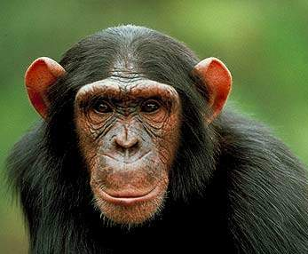
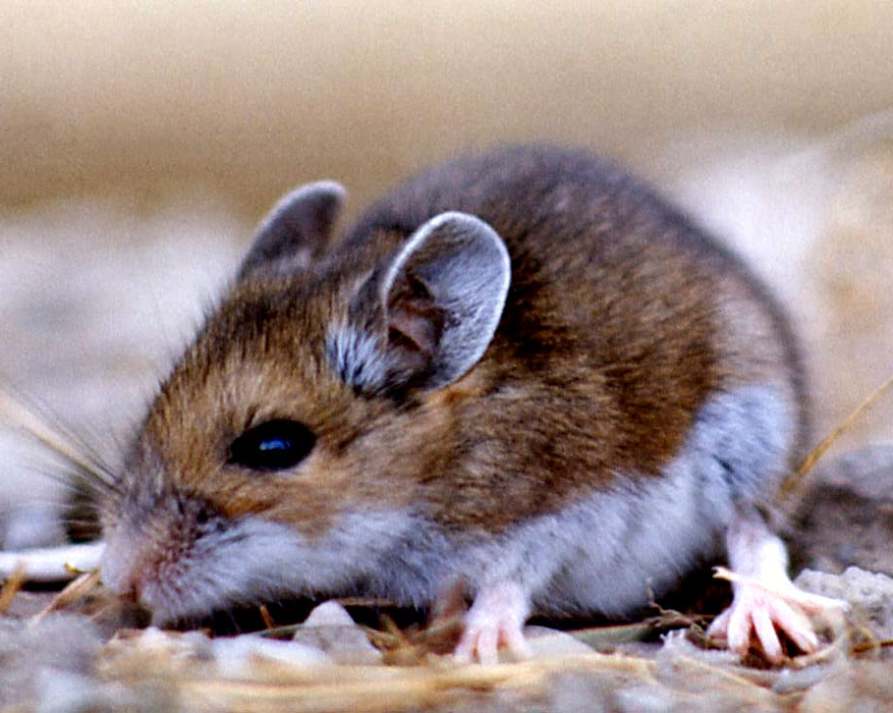
DNA sequencing
The DNA of organisms can be directly compared by looking at the order of bases in each.
Closely related species will have a higher percentage of similarities in their DNA base order.
Humans and chimps share 94% Humans and mice share 85%

Slide 6
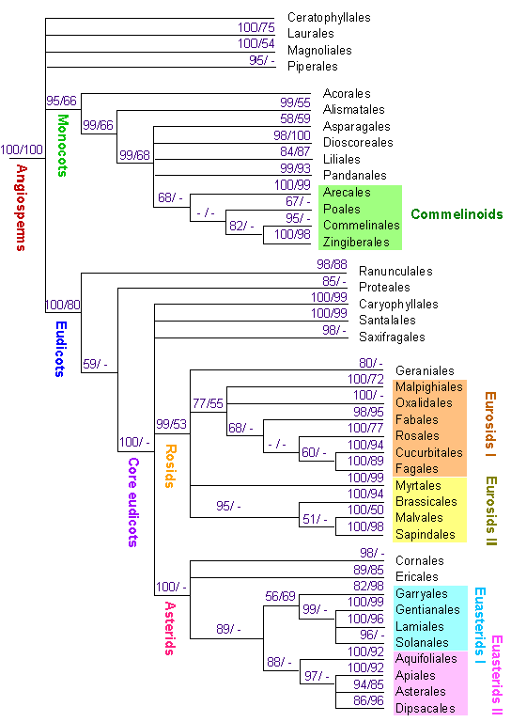
DNA sequencing
This technique has led to a new classification system for plants based almost entirely on similarities between DNA sequences.

Slide 7
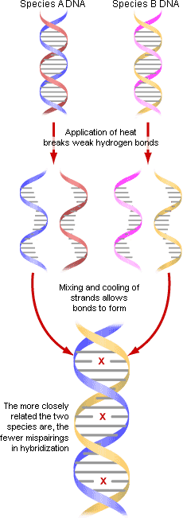
DNA hybridisation
Labelled using radioactive or fluorescent marker
DNA hybridisation is used to see how similar DNA is without sequencing it.
You need to understand the process – p208-209 of the text book
Closely related species –
more base pairing,
more hydrogen bonds formed,
higher temperature required to separate them
Distantly related species –
few bases pair up
less hydrogen bonds formed
lower temperature required to separate them

Slide 8
Comparing proteins
Similar organisms will have similar protein in their cells. Proteins can be compared in two ways:
1. Comparison of amino acid sequences
The sequence of amino acids in proteins is determined by DNA.
The degree of similarity in the amino acid sequence of the same protein in two species will therefore determine how closely related they are.

Slide 9
1. Comparison of amino acid sequences
Species A
Species B
Species C
Ser
Val
Ser
Phe
Phe
Phe
Val
Ser
Glu
Val
Glu
Phe
The amino acid sequence of species A and B are very similar.
The sequence from species C is very different from the others.
This would suggest that species A and B are more closely related.

Slide 10
Comparing proteins
2. Immunological comparisons
Similar proteins will bind the same antibodies.
Species A
Human
Blood serum -Albumin
(antigens)
Species B
Rabbit
Produces antibodies in response to the antigen from species A
serum injected
serum added to another species
The greater the number of similar antigens ,
the more precipitate formed,
the more closely related the species is.
Species C
Antibodies bind to corresponding
antigens on albumen of species C
producing a precipitate.

Slide 11
HOMEWORK -Establishing relationships
Read p211 – 212 Application and How science works
Answer questions 1 – 6
The answers are in the back of the book.
Don’t be lazy, you are here to learn.
SO MAKE AN EFFORT
AND LEARN

Slide 12
Learning objectives
Students should understand the following:
Genetic comparisons can be made between different species by direct examination of their DNA or of the proteins encoded by this DNA.
Comparison of DNA base sequences is used to elucidate relationships between organisms. These comparisons have led to new classification systems in plants.
Similarities in DNA may be determined by DNA hybridisation.
Comparisons of amino acid sequences in specific proteins can be used to elucidate relationships between organisms.
Immunological comparisons may be used to compare variations in specific proteins.
Candidates should be able to interpret data relating to similarities and differences in base sequences in DNA and in amino acid sequences in proteins to suggest relationships between different organisms.

