Slide 1
15.1 Totipotency and Cell Specialisation

Slide 2
Learning Objectives
Learn about totipotency of cells.
Learn about when totipotent cells are present and what their role is.
Learn how these cells can lose their totipotency.
Learn about multipotent cells.
Learn how totipotent and multipotent cells can be used to treat human disorders.

Slide 3
Totipotency
Stem Cells

Slide 4
Growth and Development
“Growth” of an organism is a simple concept, but “development” is much more complicated – especially in organisms as complex as mammals.
Development involves the specialisation of cells and arranging them into functional units.
This Blue Whale has grown to an enormous size.
It’s development though, is a series of changes involving cell differentiation.
It contains....
2 x 10¹⁷ cells....
200,000,000,000,000,000....
200 quintillion!
Each one is specialised.

Slide 5
Growth and Development
Development involves producing specialised cells and arranging them into tissues and organs.
Because cells in different areas of the body have to carry out specific functions, they have to become adapted.
The process of ‘becoming adapted’ is known as cellular differentiation.
An unspecialised cell becoming a muscle cell
To understand this better, you need to think back to the first cell that ever had anything to do with your existence...

Slide 6
This cell is the precursor for all the cells in your body at this moment in time.
This cell will divide countless times, giving rise to more and more daughter cells, until there are the 75 or so trillion cells that make up... you.
This one cell, has all of the information required to produce all of the millions of types of cells found in your tissues and organs.
WHADOOSH!
When a sperm and an egg cell fuse, the resulting cells is called a zygote.

Slide 7
Embryonic stem cells are highly important because they can differentiate into any type of cell.
zygote
morula (approx 16 cells)
blastocyst
For the first few weeks, the developing embryo contains unspecialised cells.
We call these... embryonic stem cells

Slide 8
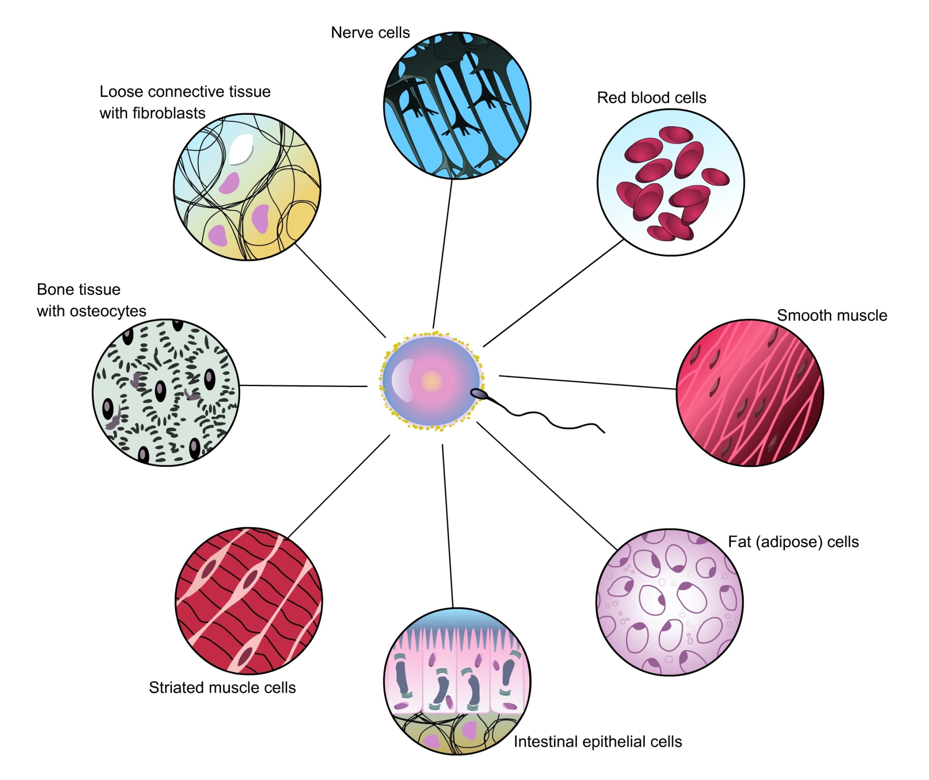

Slide 9
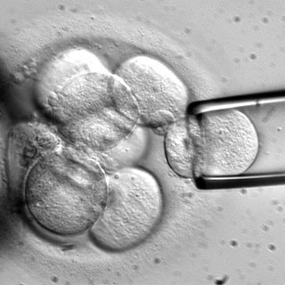
You’re too specialised
In an adult, all cells are specialised.
They have already been through the process of differentiation and cannot transform into another type of cell.
Only embryonic stem cells have the capacity to become any type of cell.
We call this ability....
totipotency

Slide 10
Totipotency
Totipotent cells have the ability to develop into any cell found in the human body.
This is obviously useful during embryo development, as we start off as a single cell, but are eventually a collection of millions of different cell types.
But what decides which stem cells in an embryo go on to become a certain cell type?
al
i
ial
tot
potent

Slide 11
Here is a totipotent cell
It was taken from an embryo
Imagine it was taken from a very simple mammal, with only a single homologous chromosome pair
That DNA in those c’somes contains genes (instructions) to make any cell type from any organ.
heart cell gene
intestinal cell gene
brain cell gene
The lineage that the stem cell takes, depends on which genes within it, are expressed.
If genes related to heart structure are expressed, the stem cell will become a heart cell.
Once a stem cell differentiates, it can never go back to being totipotent.

Slide 12
Unused library
Most of the DNA in a cell is never even transcribed!
E.g.: If a cell differentiates into a liver cell, it will never need to translate any mRNA that is not involved in liver activities.
It still has DNA in it that is related to every other cell in the body, but the only ‘special’ gene it may ever need to transcribe, could be the one for insulin.
In summary: Totipotent stem cells are unspecialised. They occur briefly in embryos. They can differentiate into any type of cell. Once they differentiate, they lose their totipotency.

Slide 13
Taking a specific route...
A developing embryo contains entirely totipotent cells for the first few weeks of its existence.
Eventually, the cells in the embryo begin to specialise, each diverting into its own lineage.
i.e. One totipotent stem cell will take up the responsibility for the digestive system.
But we know the digestive system is complicated... It contains many different tissues and organs.
The cell that took up the responsibility for this system, has now got to divide and specialise into individual sections of the digestive system (e.g. Pancreas, small intestine etc.)

Slide 14
multipotency
Stem Cells

Slide 15
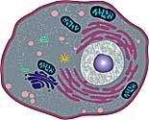
Animal cells are one-hit-wonders...
You’ve learnt that embryos contain totipotent stem cells with unlimited potential...
Once a cell becomes specialised, although it still contains all the genes of the organism, the specialisation is irreversible.
That is to say, for example....
A cell of the liver, can now not become (or divide into) a cell of the brain.

Slide 16
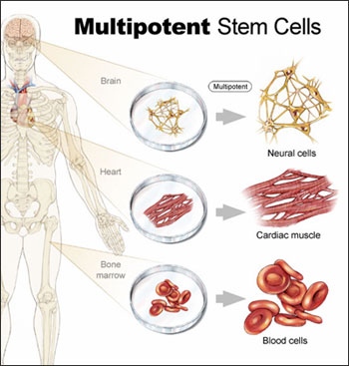
Except for a select few...
Although the majority of cells in your body lost their totipotency while you were an embryo....
There are a select few types of cell in your body that can still differentiate to a certain extent.
They are called MULTIPOTENT CELLS (or ‘adult stem cells).
These don’t have the totipotency of embryonic stem cells, but are still able to differentiate.
They can only differentiate into a limited number of cell type.

Slide 17
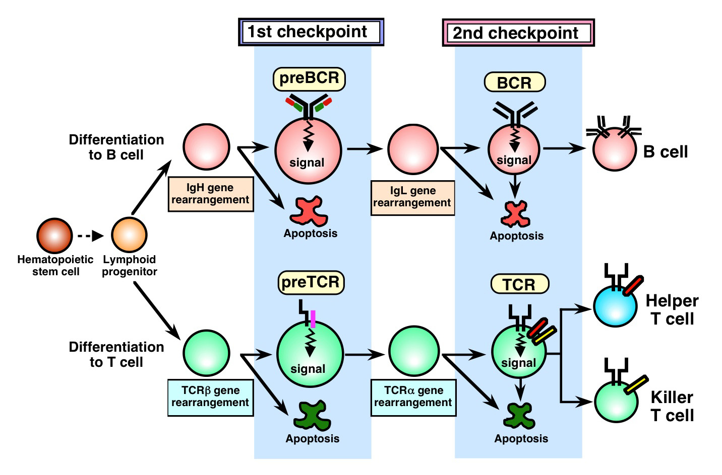
Bone marrow is the site where blood cells are manufactured. But because there are different types of blood cell, they are produced from multipotent stem cells.

Slide 18
Using stem cells to treat disorders
Stem Cells

Slide 19
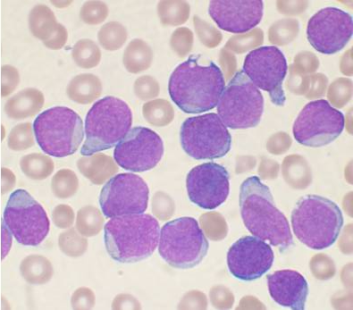
Stem Cells in Medicine
Stems are used in medicine to cure some diseases.
Leukaemia is cancer of the blood. The blood cells grow out of control, and abnormally. With abnormal white blood cells, a person with leukaemia can’t fight off disease.
Because bone marrow contains stem cell that can differentiate into blood cells.....
.....bone marrow transplants can help a patient with leukaemia develop healthy blood cells.
Stem cells from adult bone marrow have LIMITED uses though.

Slide 20
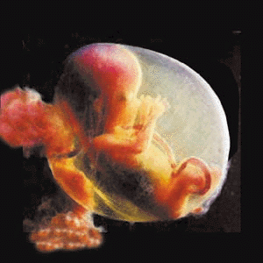
How about stem cells from an embryo?
Stem cells from a developing embryo can develop into any cell type....
......so a patient with paralysis or brain damage could benefit
if stem cells could be instructed to grow into new nerve cells.
A person who has suffered extreme burns could benefit from skin grafts...
.... the skin cells would be developed from embryo stem cells.
The embryo would be ‘sacrificed’ in order to improve a life. Is this acceptable?

Slide 21
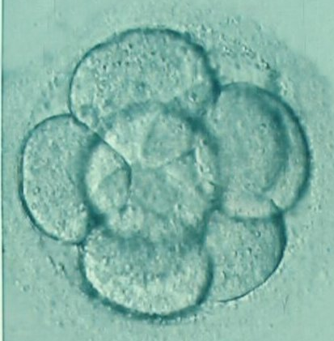
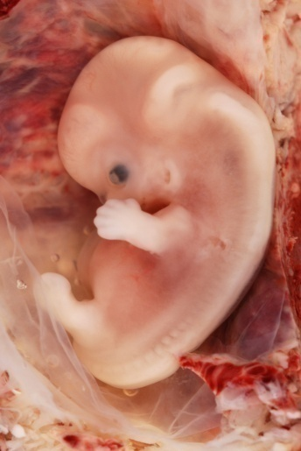
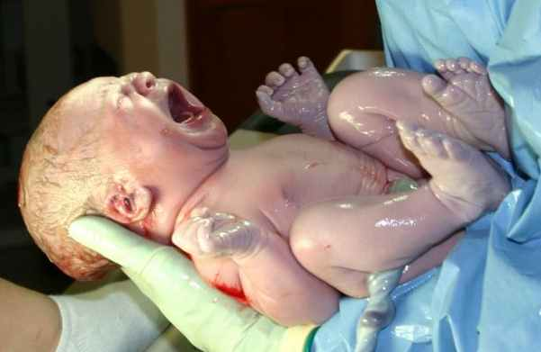
Ethics of Stem Cell Research
Each embryo is a potential human life. So some people argue that it is unacceptable to experiment with embryos.
But some people think that it is better to end a person’s suffering, rather than debate an embryo’s right to existence.
When do you think an embryo becomes a ‘human’?
7 days 9 weeks newborn baby

Slide 22
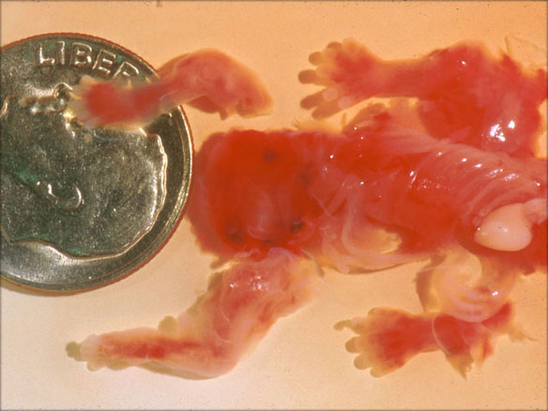
Unwanted embryos
An unwanted pregnancy, may be terminated by abortion.
This means the embryo/foetus is extracted from the womb prematurely.
A lot of countries allow abortion, but are unwilling to conduct stem cell research.
← This embryo was terminated at 7 weeks.
You can see that stem cell research is a very important, but controversial topic in science.

Slide 23
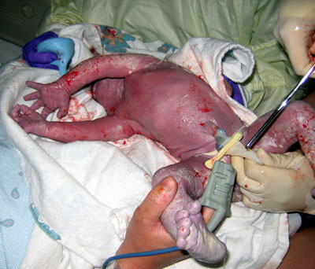
Umbilical cords
Using embryos for stem cell research is bound to raise ethical issues.
However, scientists have discovered that the umbilical cords of newborn babies contain a reservoir of stem cells, which is ethically much more acceptable.
‘Cord blood’ is collected, which contains a number of different stem cell types, some of which can be manipulated to be made totipotent.
As of yet, their uses are still limited.

Slide 24
Plenary
Read ‘application’ on page 238.
“Human embryonic stem cells and the treatment of disease.”

