Slide 1
15.2 Regulation of Transcription & Translation

Slide 2
Learning Objectives
Learn what a ‘transcription factor’ is.
Learn how oestrogen affects gene transcription.
Learn what siRNA is and how it affects gene expression.

Slide 3
Recap of 15.1
That the cells in our bodies are highly specialised.
They have specific functions to perform in different areas of the body, and have structures that reflect these functions.
Essentially, what are all structures in cells made of?
PROTEIN
In order to produce these molecules, what process did we establish had to occur?
GENE EXPRESSION
Gene expression is just a fancy way of saying.....
‘some DNA is used to produce protein’.

Slide 4
Here is a totipotent cell
It was taken from an embryo
Imagine it was taken from a very simple mammal, with only a single homologous chromosome pair
That DNA in those c’somes contains genes (instructions) to make any cell type from any organ.
heart cell gene
intestinal cell gene
brain cell gene
The lineage that the stem cell takes, depends on which genes within it, are expressed.
If genes related to heart structure are expressed, the stem cell will become a heart cell.
Once a stem cell differentiates, it can never go back to being totipotent.

Slide 5
Gene expression

Slide 6
Gene Expression
You know that the basics of gene expression is that:
Transcription has to occur.
Pre-mRNA has to be spliced.
Translation has to occur.
It’s all well and good knowing the process of getting from gene to protein product, but how is this process regulated?
Does it ‘just happen’?
But what decides when this happens and at which section of DNA?!

Slide 7
Transcription Factors
Genes don’t just start to transcribe themselves spontaneously.
If that was the case, cells in your pancreas would produce adrenaline, and cells in testicles would begin to release oestrogen!
Your body contains regulatory proteins called TRANSCRIPTION FACTORS.
DNA Binding Site
Transcription factors are a protein complex, with different subunits.
Transcription Factor
Receptor
Hormone Binding Site

Slide 8
How do the Transcription Factors Work?
The gene that codes for the required protein, is stimulated by a specific transcription factor.
There are millions of transcription factors and each one has a DNA binding site that is specific to a certain gene.
When it binds to the correct region of DNA, transcription begins.
This would then produce mRNA, which would then be translated into a protein.
What about when the gene doesn’t need to be expressed? How could you stop transcription factors from stimulating DNA?

Slide 9
There are 2 possibilities if you think about it....
1.
....maybe not
When a gene is not being expressed, the DNA binding site on its complimentary transcription factor is BLOCKED.
This inhibitor stops the transcription factor from binding to DNA, thus blocking transcription from occurring.
2.
Inhibitor Molecule

Slide 10
hormones

Slide 11
There are 2 Mechanisms of Hormone Action
The first mechanism involves protein hormones (such as insulin) and molecules called second messengers.
Transcription and translation though, are regulated via the other hormone mechanism, which involves lipid-soluble hormones (such as oestrogen).
Protein Hormones
Act via Second Messengers
e.g. Insulin
Lipid-Soluble Hormones
Act Directly
e.g. Oestrogen

Slide 12
Hormones like oestrogen can switch on a gene and start transcription. They do this by binding to their receptor on the transcription factor. This changes the transcription factors shape, and thus releases the inhibitor molecule. The transcription factor can then bind to DNA, starting up the process of transcription.

Slide 14
Using siRNA to Prevent Gene Expression

Slide 15
siRNA
Gene expression can be prevented by breaking down mRNA before it is translated into a protein.
To do this, small molecules of double-stranded RNA called siRNA are essential (small interfering RNA).
Large double-stranded molecules are cut into siRNA by enzymes.
The siRNA splits into single-stranded molecules, of which one, associated with a different enzyme.
The siRNA guides this enzyme to an mRNA molecule.
Once there, the enzyme cuts the mRNA into small sections.
This renders the mRNA useless, as transcription cannot occur.

Slide 16
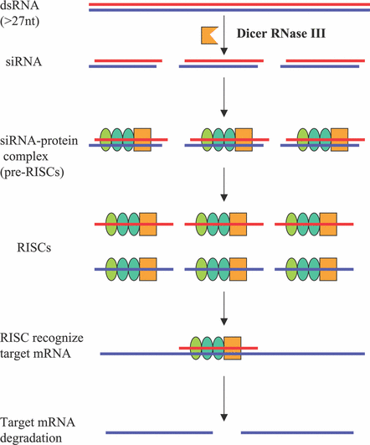
siRNA inhibits translation of mRNA and turns genes OFF
Enzyme 1 breaks up dsRNA making siRNA molecules
Enzyme 2 combines with one of the two molecules of siRNA
Complimentary base pairing between siRNA and target mRNA
Enzyme 2 cuts mRNA into small sections stopping it from being translated

Slide 17
Uses of siRNA
It could be used to identify the role of genes in a biological pathway. By using siRNA to block certain genes, you could observe what effects occur. This could then tell you what the role of the blocked gene is.
Some diseases are genetic and are caused by the expression of certain genes. If these genes could be blocked by siRNA, it may be possible to prevent the diseases caused by them.

