Slide 1
Evidence of relationships between organisms
15.2 Courtship behaviour

Slide 2
Learning objectives
Students should understand the following:
Courtship behaviour as a necessary precursor to successful mating. The role of courtship in species recognition.

Slide 3
Behaviour
Just as the physical and chemical make-up of organisms help them to distinguish member of their own species, so does behaviour.
Individuals can recognise their own species by the way they act.
Most behaviour is genetically determined.
When it comes to survival, courtship and mating are essential.

Slide 4
Why is courtship behaviour necessary?
It enables individuals to:
Recognise members of their own species
In order to produce fertile offspring
Identify a mate that is capable of breeding
Need to be sexually mature, fertile and receptive
Choose a strong and healthy mate
Approach each other closely without triggering aggression
Form a pair bond and synchronised mating
Leading to successful mating and raising of offspring

Slide 5
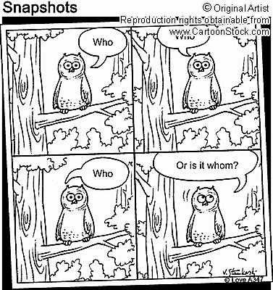
Courtship rituals
loon song video

Slide 6
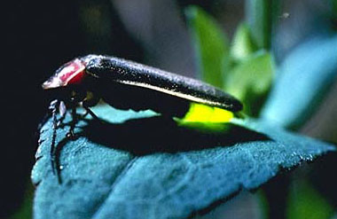
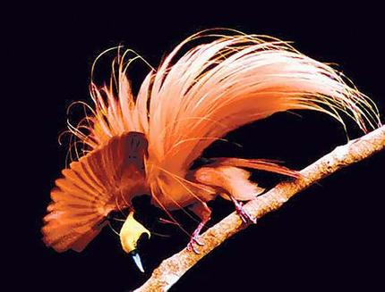
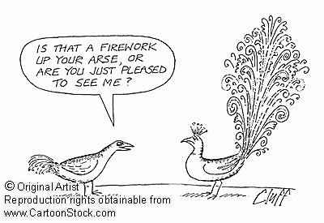
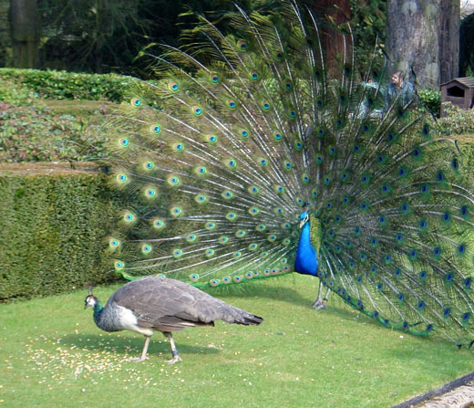
Courtship rituals
Visual signals – colourful plumage

Slide 7
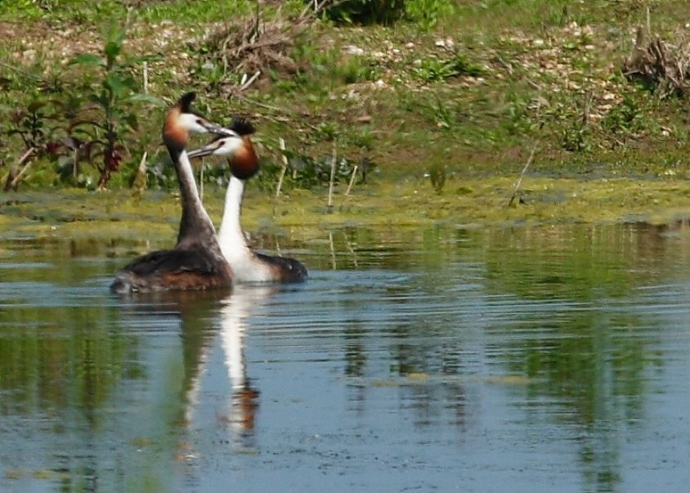
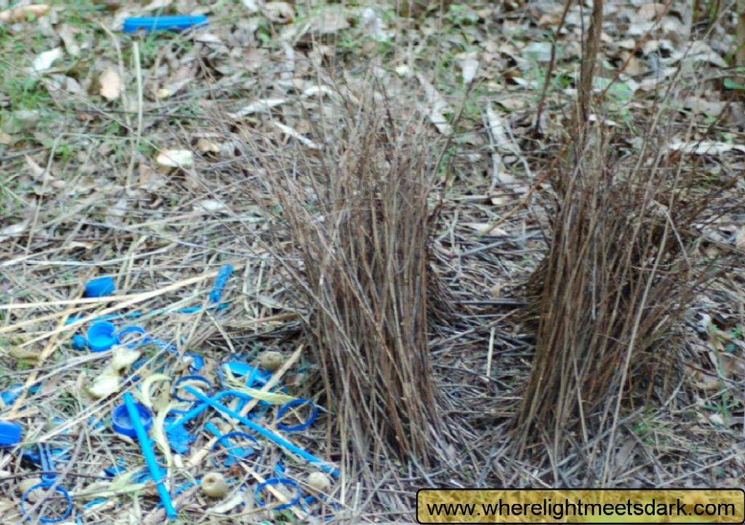
Courtship rituals
Behaviour – e.g. courtship dances, nest building
Bower bird nest
Great crested grebe

Slide 8
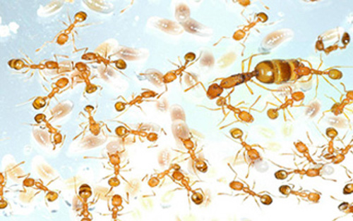
Pheromones
Pheromones are chemicals released by an organism into its environment enabling it to communicate with other members of its own species.

Slide 9
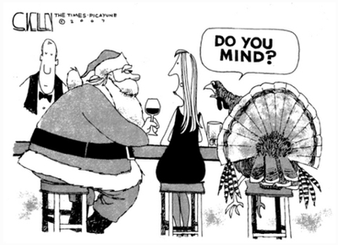
Why such elaborate and prolonged courtship displays?
Female needs to be sure that the male is of the right species

Slide 10
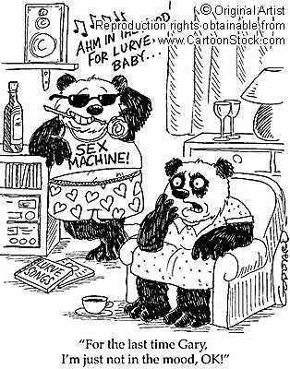
Why such elaborate and prolonged courtship displays?
The male needs to be sure that the female is sexually receptive at the time.

Slide 11
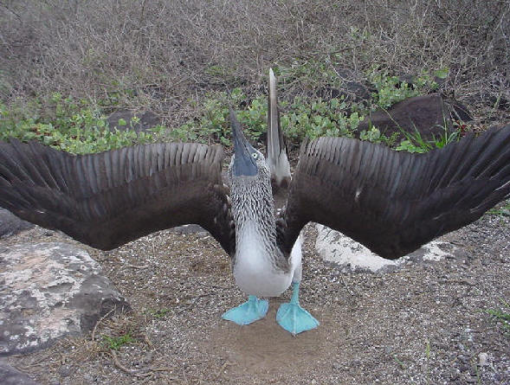
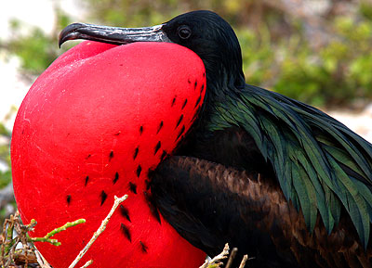
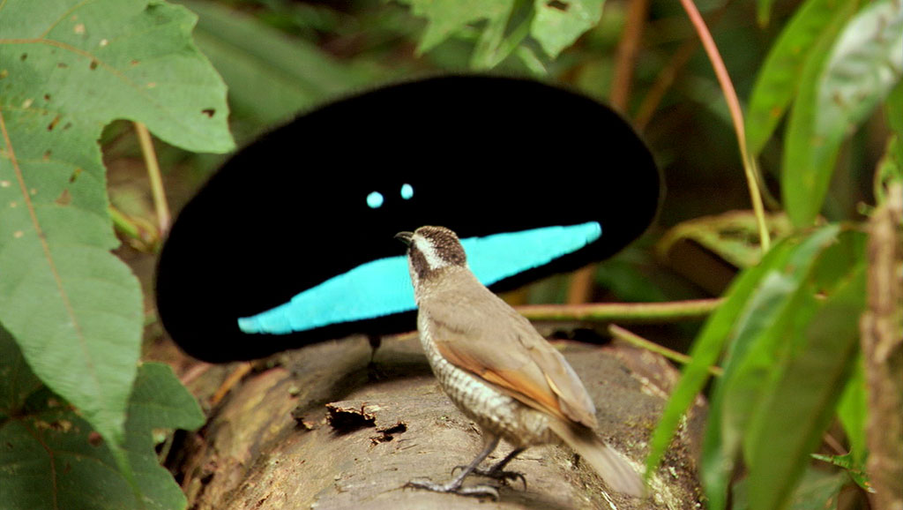
Why such elaborate and prolonged courtship displays?
The quality of the display may make the female more likely to choose a particular male.

Slide 12
Exam style questions
P215 – 217
Answer all questions – finish for homework

Slide 13
Learning objectives
Students should understand the following:
Courtship behaviour as a necessary precursor to successful mating. The role of courtship in species recognition.

