Slide 1
16.1 – Producing DNA Fragments

Slide 2
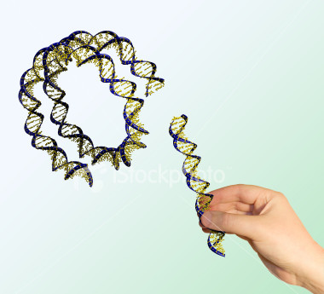
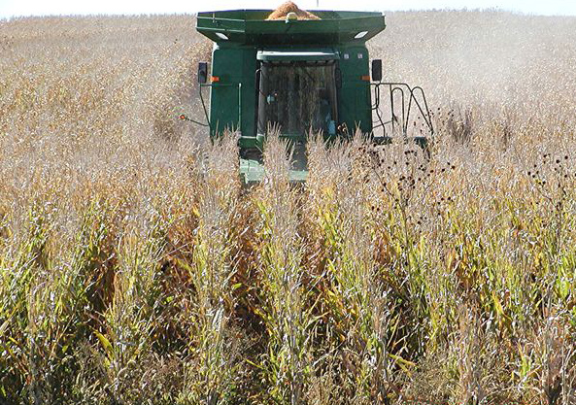
Genetic Engineering
Genetic engineering is a rapidly advancing field of Biology.
We can now manipulate, alter and even transfer genes from one organism to another.
The ability to do these things has proved invaluable in the industrial and medical sectors.

Slide 3
Helping Humans
Many human diseases are caused by the inability of the body to produce certain protein products.
These proteins of course, are the products of a gene.
This gene may be faulty, preventing the correct expression of the gene.
There are now ways of isolating a gene, cloning it, and then transferring it into microorganisms.
The microorganisms then act as ‘factories’ where the gene product (the desired protein) is continuously manufactured.
An example: The production of Insulin

Slide 4
Genetically Modified Organisms
When a certain gene is introduced into the DNA of another organism (such as a bacterial cell), it is then called recombinant DNA.
The resulting organism is known as a genetically modified organism (GMO).
The process of making a protein using DNA technology
5. Growth/cloning
of the population of host cells
Isolation
of the DNA fragments that have the gene for the desired protein.
3. Transformation
...Inserting the vector into a suitable host (such as a bacterial cell)
In this lesson, we will cover ‘Step 1’ (isolation) in detail
4. Indentification
of host cells that have taken up the gene, using gene markers
2. Insertion
of the DNA fragment into a vector.

Slide 5
Isolation of a gene
There are two ways of isolating a gene:
1. Using Reverse Transcriptase
This method uses an enzyme that ‘works backwards’. It can produce DNA from mRNA.
In a healthy individual, the desired protein is being manufactured in specific cells of the body
It follows that these cells will contain large quantities of the relevant mRNA for that protein.
If reverse transcriptase is added, it can make DNA from this RNA.
It does so, by producing complementary DNA (cDNA).
(see next slide)

Slide 6
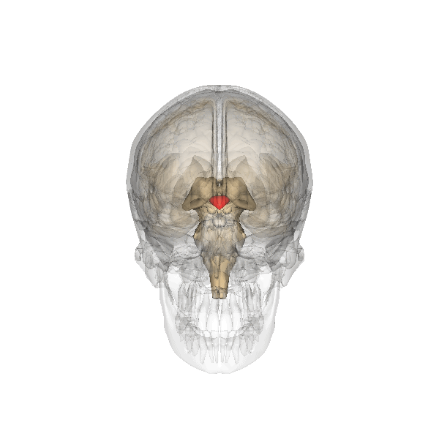
The Hypothalamus produces a hormone called vasopressin ☺
A
U
G
C
U
T
A
C
G
A
mRNA template for the hormone, vasopressin
You isolate the mRNA that has been transcribed from the gene you are interested in.
Reverse transcriptase is used to synthesis a complimentary DNA (cDNA) strand, to the mRNA molecule.
Our old friend DNA Polymerase (from translation) can then synthesise the other strand of DNA from free nucleotides.
A
T
G
C
T
You now have the actual gene that codes for your protein!
You can produce it in vast quantities and then insert them into plasmids!

Slide 7
Isolation of a gene
The 2nd method of isolating a gene:
Using Restriction Endonucleases
Restriction endonucleases are enzymes that cut DNA at specific base sequences (recognition sequences). These enzymes can be used to cut out a desired gene from the rest of the genome.
Cutting DNA with a restriction enzyme can have two results.
Some restriction endonuclease produce ‘blunt ends’
Some restriction endonuclease produce ‘sticky ends’

Slide 8
Summary Question In the following passage replace each number with the most appropriate word or words.
Where the DNA of two different organisms is combined, the product is known as (1) DNA. One method of producing DNA fragments is to make DNA from RNA using an enzyme called (2). This enzyme initially forms a single strand of DNA called (3) DNA. To form the other strand requires an enzyme called (4). Another method of producing DNA fragments is to use enzymes called (5), which cut up DNA. Some of these leave fragments with straight edges, called (6) ends. Others leave ends with uneven edges, called (7) ends. If the sequence of bases on one of these uneven ends is GAATTC, then the sequence on the other end, if read in the same direction, will be (8)

