Slide 1
16.1 – Genetic Variation in Bacteria

Slide 2
Learning objectives
Students should understand the following:
DNA is the genetic material in bacteria as well as in most other organisms.
Mutations are changes in DNA and result in different characteristics.
DNA may also be transferred during conjugation. This is horizontal gene transmission.

Slide 3
Diversity
DNA is the means by which genetic information is passed from generation to generation.
Diversity in organisms arises because of changes to its DNA.
These changes occur in 2 ways
Mutation
Recombining DNA (sexual reproduction)

Slide 4
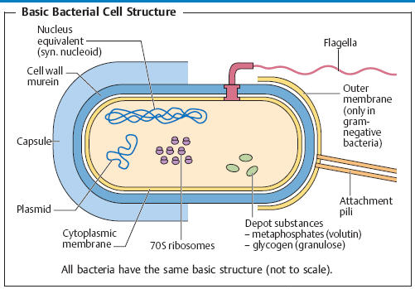
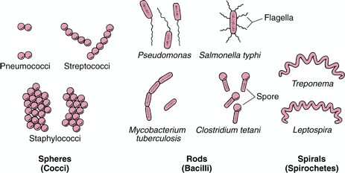
Bacteria
One of the most diverse and adaptable groups of organisms. Bacteria increase their diversity by changing their DNA in a similar way to other organisms :
Mutation
Conjugation (not strictly sexual reproduction)

Slide 5
Mutations
Mutations are changes in DNA that result in different characteristics. Mutations arise in many ways:
One or more bases may be added, deleted or replaced during replication.
Change in amino acid sequence
Different protein produced
Change in base sequence
Proteins are responsible for the characteristic of an organism, therefore changes in DNA are likely to result in changes to the characteristics of an organism.

Slide 6
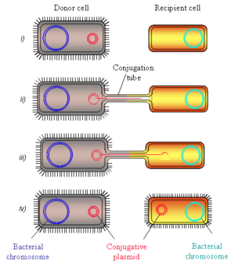
Conjugation
Conjugation occurs when one bacterial cell transfers DNA to another bacterial cell. This can occur between species.
This is known as horizontal gene transmission.
Vertical gene transmission is when genes are passed on from one generation of a species to the next generation of the same species.
Plasmid donor replicates
Replicated plasmid moves through conjugation tube

Slide 7
Task
Read p219 – 220 Application and How science works
Discovering conjugation in bacteria
Answer questions 1-4

Slide 8
Learning objectives
Students should understand the following:
DNA is the genetic material in bacteria as well as in most other organisms.
Mutations are changes in DNA and result in different characteristics.
DNA may also be transferred during conjugation. This is horizontal gene transmission.

