Slide 1
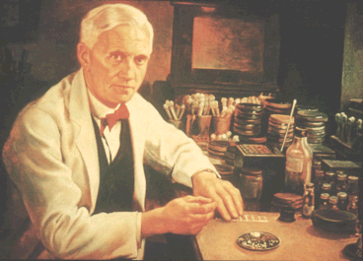
16.2 Antibiotics
"When I woke up just after dawn on September 28, 1928, I certainly didn't plan to revolutionize all medicine by discovering the world's first antibiotic, or bacteria killer - but I guess that was exactly what I did".
Alexander Fleming – Discoverer of Penicillin

Slide 2
Learning Objectives
To learn what antibiotics are.
Understand how antibiotics work to kill bacteria.
Understand how bacteria can become resistant to antibiotics.

Slide 3
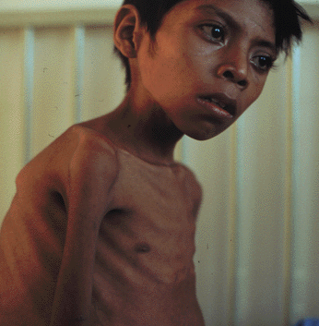
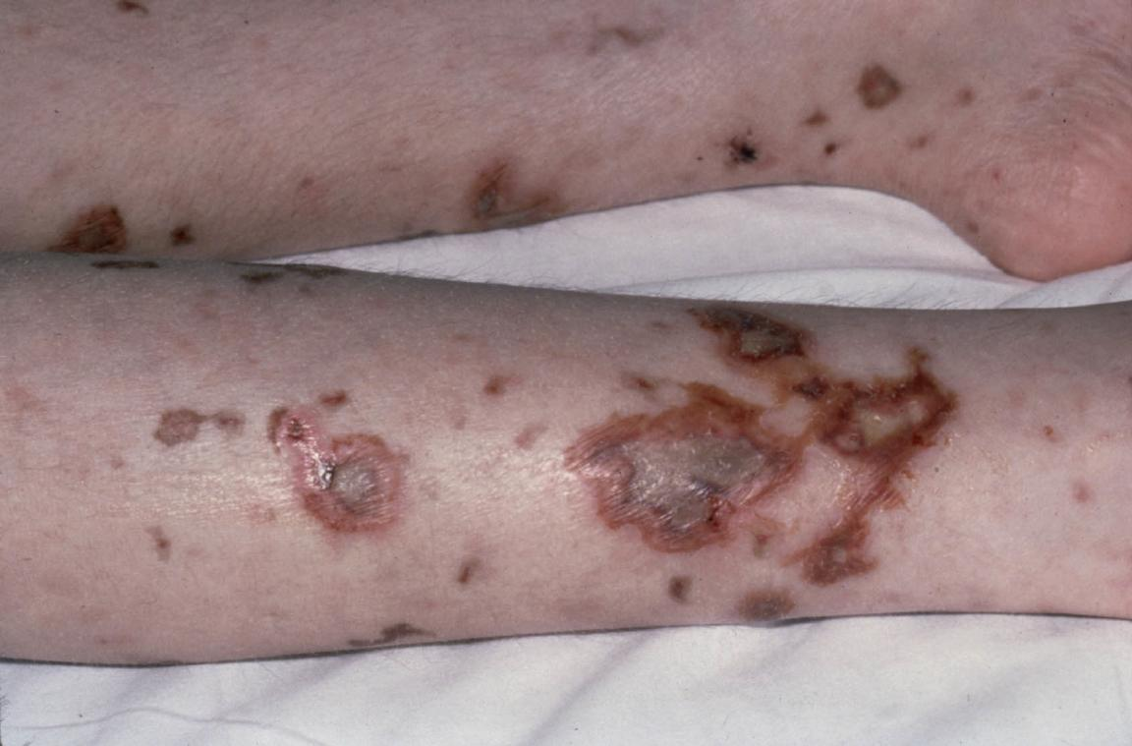
It’s no secret... Bacteria can be harmful
Many diseases affecting animals are caused by bacteria.
Remember, that bacteria themselves are living organisms.
Most of the time, our immune systems can handle bacterial infections.
Our white blood cells are good at fighting off bacteria, but sometimes it can get out of hand.
meningitis
syphilis
tuberculosis

Slide 4
Help
There are occasions when a bacterial infection overcomes the immune system and we need the help of an...
The ‘life’ that these substances are ‘against’ are actually microorganisms.
Ironically, most antibiotics are actually produced by certain types of bacteria!
Some antibiotics though, are produced by fungi.
Because they’re so useful, we take advantage of these bacteria and fungi and mass produce antibiotics.
anti
biotic
‘against’
‘life’

Slide 5
Alexander Fleming & the discovery of penicillin

Slide 6
Alexander Fleming
On the morning of September 3rd 1928, Prof. Fleming was clearing out some research he was doing on Staphyloccus bacteria. He had many agar plates covered in the bacteria.
One plate, also seemed to have a fungus growing on it.
This wasn’t out of the ordinary, except that in this particular case, there was a ring of no bacterial growth around where the fungus was situated.
fungus
‘clear zone’
Normal agar plate with even bacterial growth
Plate with fungus contamination

Slide 7
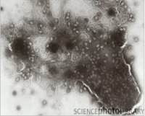
Alexander Fleming
Fleming looked at the clear zones carefully under a microscope.
He found dead bacterial cells that showed signs of lysis.
Basically, the cells had ‘exploded’ due to taking in massive amounts of water.
Fleming and a couple of other scientists managed to isolate the substance, calling it PENICILLIN.
They did this towards the end of WWII, saving many lives.
Fleming theorised that the fungus must have released a substance into the agar.
This then caused something to happen within the bacteria, causing them to die.

Slide 8
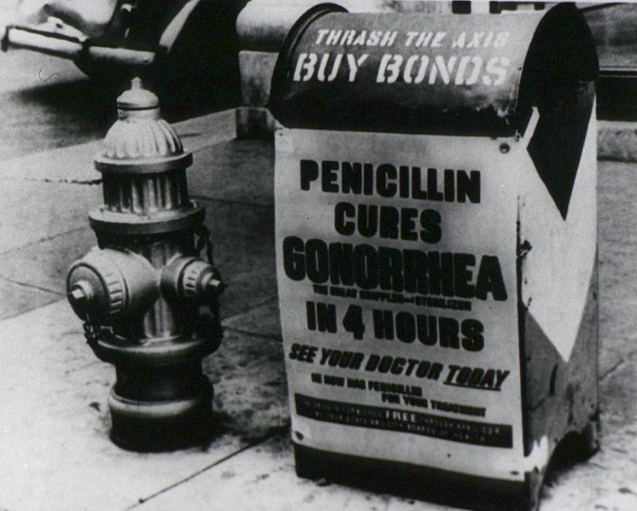
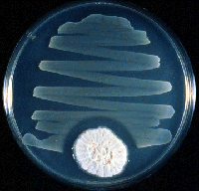
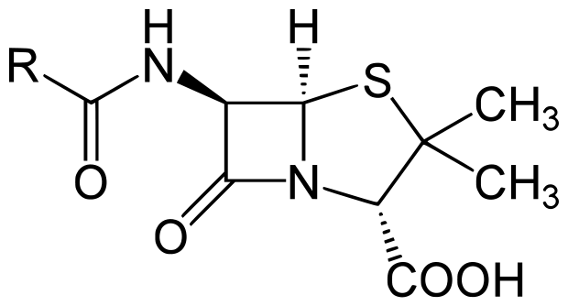
Penicillin was hailed as a wonder drug
The fungus produces penicillin in quite a simple process.

Slide 9
How do antibiotics work?

Slide 10
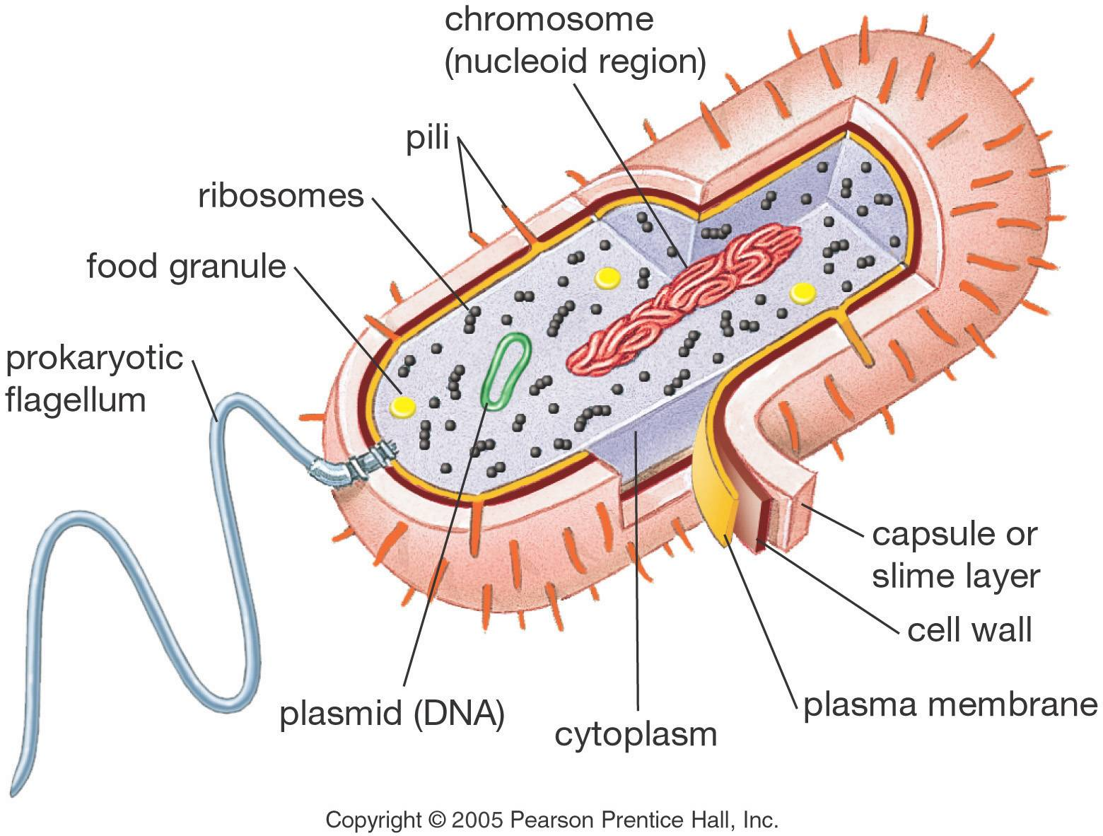
Just like plants, bacterial cells have cell walls.
Unlike plant cell walls though, they are made of peptidoglycan.
The function of the cell wall is the same as in plants though.
Water is constantly entering a bacterial cell, due to there being a more negative water potential within it than its surroundings.
The cell wall prevents the cell from bursting.

Slide 11
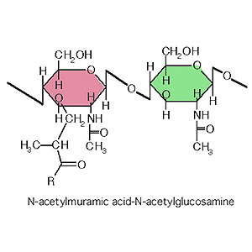
Bacterial Cell Walls
When a bacterial cell does burst, we call this osmotic lysis.
Some antibiotics prevent bacteria from forming normal cell walls.
This weakens the cell walls which means that as water enters a bacterial cell by osmosis, the walls cannot withstand the pressure – causing lysis.
Cross-linkages are prevented, which forms a very weak cell wall.

Slide 12
KABLAMMO!!!
Penicillin Mould (Fungus)

Slide 13
Bacteriaville
Pop: 0

Slide 14
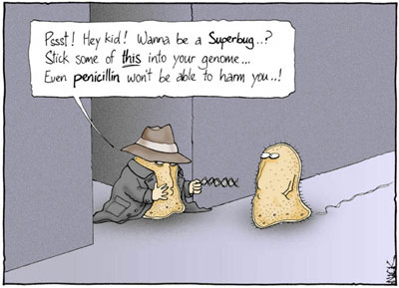
Antibiotic resistance

Slide 15
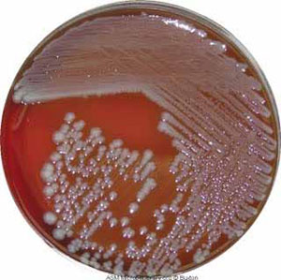
Immediate Setback
Just years after the discovery of Penicillin in 1928, it was apparent that some bacteria were resistant to antibiotics.
It was clear that some populations of bacteria had developed a way of beating penicillin.
CHANCE MUTATIONS had occurred with the DNA of the bacteria, allowing it to produce a new protein.
The new protein was able to produce the enzyme, PENICILLINASE.
This enzyme broke penicillin down before it could affect the bacteria’s cell walls.

Slide 16
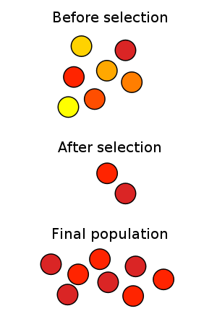
Mutations
It is very important to stress the following:
Resistance to antibiotics in bacteria is NOT because it has become TOLERANT to the antibiotic!
IT’S NOT THE PRESENCE OF AN ANTIBIOTIC THAT CAUSES BACTERIA TO BECOME RESISTANT TO IT.
MUTATIONS ARE RANDOM AND RARE!
IT’S CHANCE AND COINCIDENCE, THAT A POPULATION BECOMES RESISTANT TO AN ANTIBIOTIC.
A chance mutation occurred in it’s DNA.
It could have happened in a population that never even came into contact with an antibiotic.
The new mutation is then selected for, just as Darwin taught us.

Slide 17
Becoming Resistant
There’s just so many bacterial cells in a single colony, that eventually, a mutation will occur that is advantageous.
These mutations usually occur in small packets of DNA called PLASMIDS.
This only has to occur in a SINGLE bacterial cell!
This ‘super-cell’ then has TWO ways that it can pass this new ability on to other bacterial cells.
HORIZONTAL GENE TRANSMISSION (YOU KNOW THIS)
VERTICAL GENE TRANSMISSION (THIS IS OBVIOUS)

Slide 18
Summary Questions
What is an antibiotic?
Some antibiotics prevent the synthesis of cross-linkages in bacterial cell walls. Explain how this may lead to the death of a bacterium.
How is antibiotic resistance transferred from species to species?
Explain why antibiotic resistance is more likely to develop as more antibiotics are used.

