Slide 1
16.3 – Antibiotic Use and Resistance

Slide 2
Learning objectives
Students should understand the following:
Antibiotic resistance in terms of the difficulty of treating tuberculosis and MRSA.
Candidates should be able to
apply the concepts of adaptation and selection to other examples
evaluate methodology, evidence and data relating to antibiotic resistance
discuss ethical issues associated with the use of antibiotics
discuss the ways in which society uses scientific knowledge relating to antibiotic resistance to inform decision-making.

Slide 3
Antibiotic resistance and TB
TB is a bacterial disease of the lungs. Antibiotics can be used to treat TB but they need to be taken for 6 – 9 months and this is where the problem lies.
TB that is resistant to the 2 most commonly used antibiotics (isoniazid and rifampin) is called multidrug-resistant (MDR) TB.
MDR TB requires treatment for 18-24 months with "second-line drugs" (there are currently only six second-line drugs) that are much less effective, poorly tolerated by the patient, and far more costly.
Extensively drug-resistant TB (XDR TB) is a subset of MDR TB caused by strains of bacteria that are resistant to the most effective first- and second-line drugs.

Slide 4
Why have these resistant strains increased?
Antibiotics initially destroy the least resistant strains of TB
Patient feels better because vast majority of bacterium destroyed
Patient stops taking the antibiotics
More resistant strains survive and start to reproduce rapidly in the absence of the antibiotic
These strains exchange genes for resistance with other strains by conjugation
There is therefore a selection pressure that leads to an increase in resistant strains
Multiple-antibiotic-resistant strains develop
A cocktail of 3 or 4 antibiotics now needs to be used

Slide 5
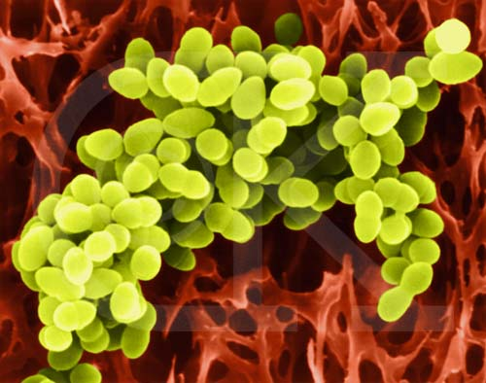
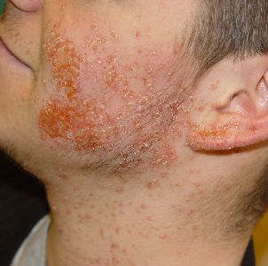
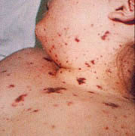
Antibiotic resistance and MRSA
Staphylococcus aureus is a bacterium that can be found on the skin and in the throat.
It causes a range of illnesses from minor skin infections to life-threatening diseases such as meningitis and septicaemia.

Slide 6
Antibiotic resistance and MRSA
Some strains of Staphylococcus aureus have evolved become resistant to one or more of the commonly used antibiotics including methicillin. These are termed methicillin-resistant Staphylococcus aureus (MRSA).
MRSA is especially prevalent in hospitals:
Here patients tend to be more vulnerable to the infection i.e. older, sicker and weaker.
People live together and are examined by doctors and nurses that have just touched other patients.
Many antibiotic strains are used, any resistant strains therefore have an advantage.

Slide 7
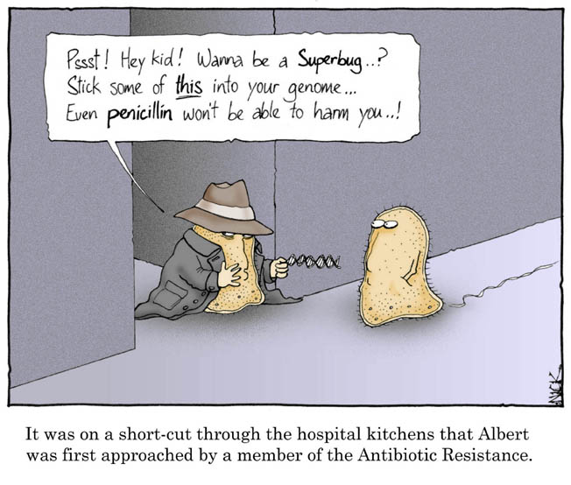

Slide 8
Antibiotic use
Antibiotics are used very widely, sometimes unnecessarily through patient pressure.
If used appropriately when a disease has been diagnosed then the infection may be eradicated. However, the patient must complete the whole course of antibiotic.
Sometimes patients stop taking the antibiotic as soon as they feel well. Doing this aids the development of resistance, as some of the bacteria may still be alive at this point, and these are going to be the very ones that are most resistant to the drug’s effects.
Antibiotics are sometimes used to treat viral diseases, because they may help prevent secondary bacterial infections to which the patient may be vulnerable.

Slide 9
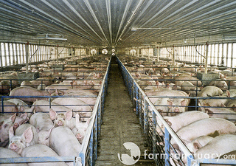
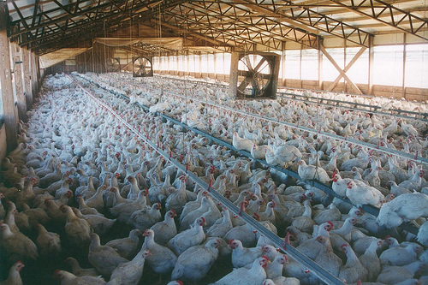
Antibiotic use
Antibiotics are also used widely in farming to prevent infection (prophylactically).
Farmers may add broad spectrum antibiotics to the feed of intensively reared farm animals.
This leads to animals that grow faster because they do not succumb to disease, so they reach marketable weight more quickly.
However, when antibiotics are used on this scale, more and more species of bacteria are exposed to them, increasing the chances of resistance developing.

Slide 10
TASK
P224 – 225 Application and how science works
Implications of antibiotic use
A dilemma
Answer all questions on p 225

Slide 11
Learning objectives
Students should understand the following:
Antibiotic resistance in terms of the difficulty of treating tuberculosis and MRSA.
Candidates should be able to
apply the concepts of adaptation and selection to other examples
evaluate methodology, evidence and data relating to antibiotic resistance
discuss ethical issues associated with the use of antibiotics
discuss the ways in which society uses scientific knowledge relating to antibiotic resistance to inform decision-making.

