Slide 1
16.6 – Locating and Sequencing Genes

Slide 2
Learning Objectives
Recap how DNA probes and DNA hybridisation is used to locate specific genes.
Learn how the exact order of nucleotides on a strand of DNA can be determined.
Learn how restriction mapping can be used to determine nucleotide sequences.

Slide 3
DNA Probes
DNA probes are simple, short and single-stranded sections of DNA.
They will bind to complementary sections of other DNA strands.
Due to being labelled in some way, they make this ‘other DNA’ easily identifiable.
Labelling with radioactivity
Labelling with fluorescence

Slide 4
Remember that probes can be used as an easy method of screening (detecting) for mutated genes. But also remember that the probe needs to be complementary to the mutated gene. So this means, that to produce a probe, you first need to sequence your gene. How do we sequence genes?

Slide 5
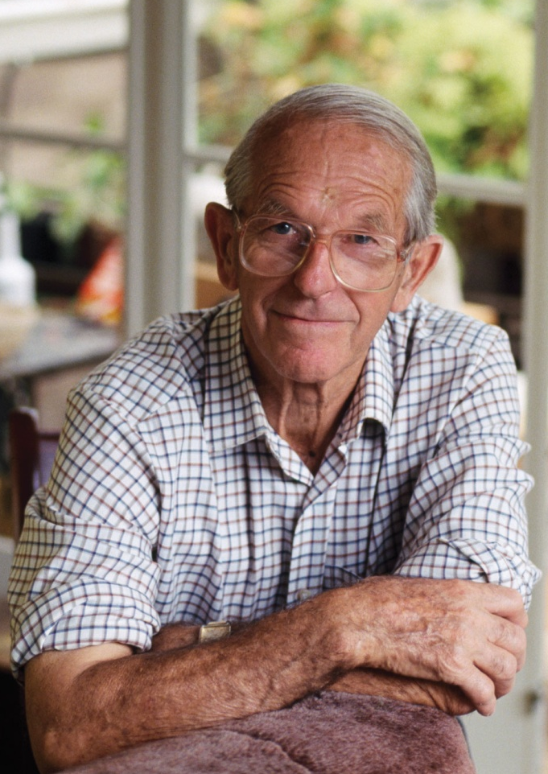
Meet Frederick Sanger...
Biochemist
Cambridge University
English
Two Nobel Prizes
Still Alive
Sanger’s work in the 1970’s, which earned him his second Nobel Prize, involved the sequencing of DNA.
His method used modified nucleotides that do now allow another nucleotide to join after them in a sequence.
Sanger Sequencing Method

Slide 6
Introducing Sanger Sequencing
The method is based on the premature ending of DNA synthesis.
If modified nucleotides are used during DNA synthesis, the process can be halted.
What normally happens during DNA synthesis...
T
A
T
G
G
A
T
C
T
G
A
C
C
T
T
A
G
A
T
A
C
C
T
A
G
A
C
T
G
G
A
A
T
C
What happens if you modify a nucleotide...
You call these modified nucleotides, TERMINATORS
T
A
T
G
G
A
T
C
A
T
A
C
C
T
A
G
A
C
T
G
G
A
A
T
C

Slide 7
What you need...
In Sanger Sequencing, four different terminators are used (A, C, T and G).
Due to this, four different reactions are run.
In each reaction, you have the following:
The DNA being sequenced.
A mixture of ‘normal’ nucleotides (A, T, C, D)
One type of terminator nucleotide.
A primer.
DNA Polymerase.
A
T
G
C
A
C
C

Slide 8
A
A
A
A
T
T
T
T
G
G
G
G
C
G
A
T
A
C
A
C
A
C
A
C
C
C
C
C
Remember that each tube probably contains millions of copies of the DNA template, countless nucleotides, and a good supply of the specific terminator nucleotide.
Due to this, you get a variety of ‘partially completed’ DNA strands, because they have been ‘terminated’ at different points.

Slide 9
So what happens in each tube?
Lets take the example of the tube with an adenine terminator
Now let’s imagine this is the sequence of the unknown DNA strand:
C C G T C T A G C A C T C A A G C T C T
A
T
What are the possible terminated sequences going to be when the reaction is over?
G
A
G G C A
Because there are both ‘normal’ and ‘terminator’ nucleotides in the mixture, there is a chance that either is placed as the next base
A
C
C
G G C A G A
G G C A G A T C G T G A
G G C A G A T C G T G A G T T C G A
G G C A G A T C G T G A G T T C G A G A

Slide 10
Remember that this is happening in four test-tubes, each with a different type of terminator nucleotide. DNA fragments in each of the four tubes are going to be of varying lengths. Now the lengths of DNA need to be separated, so that we can see why we went through all of this trouble...

Slide 11
Gel electrophoresis

Slide 12
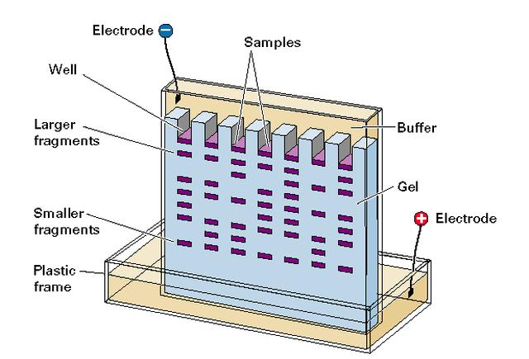
Gel Electrophoresis
When you’ve got a mess of DNA, especially DNA strands of varying lengths, you can separate them out using this technique.
The whole process relies on the fact that the phosphates in the backbone of DNA, are negatively charged.
DNA fragments are placed in wells at the top of an agar gel.
An electric current is applied over it.
Agar is actually a ‘mesh’, which resists the movement of the DNA fragments through it.
The DNA moves towards the positive electrode, but at different rates.
Small sections get there quicker.

Slide 13
Back to Sanger Sequencing
The fragments produced during the reactions can be separated using gel electrophoresis.
The smallest fragments will move furthest along the gel in a fixed period of time.
Due to being radioactively labelled, we can see where the DNA fragments end up, by placing photographic film over the gel, after the run.
Terminator C
Terminator A
Terminator T
Terminator G

Slide 14
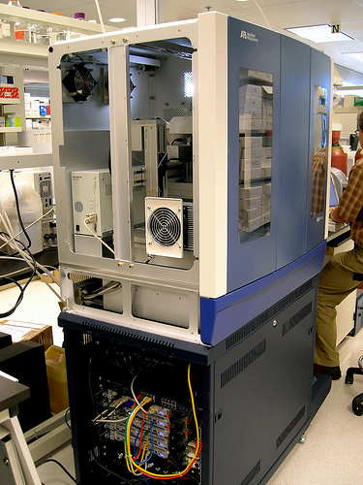
Automated Sequencing
Nowadays, DNA sequencing is automated, using computers.
Nucleotides are fluorescently labelled with dyes.
Everything occurs in only a single tube.
And the separation can occur in one lane during gel electrophoresis.
← Equipment used during the Human Genome Project.

Slide 15
Flash Video
http://smcg.ccg.unam.mx/enp-unam/03-EstructuraDelGenoma/animaciones/secuencia.swf

