Slide 1
Biodiversity
17.1 Species diversity
Need calculators ☺

Slide 2
Learning outcomes
Students should be able to understand the following:
Diversity may relate to the number of species present in a community.
An index of diversity describes the relationship between the number of species and the number of individuals in a community.
Calculation of an index of diversity from the formula
d = N (N – 1)
Σ n (n – 1)
where N = total number of organisms of all species
and n = total number of organisms of each species
Candidates should be able to
calculate the index of diversity from suitable data

Slide 3
Definitions
Biodiversity – the general term used to describe variety in the living world. It has 3 components:
Species diversity – the number of different species and the abundance of each species within a community.
Genetic diversity – the variety of genes possessed by individuals that make up any one species.
Ecosystem diversity – the range of different habitats within a particular area.

Slide 4
Species diversity
The higher the species diversity of plants and trees in an area, the higher the species diversity of insects , animals and birds. Why?
This is because there are more habitats and a larger more varied food source.
Species diversity can be measured using the ‘index of diversity’ – it takes into account different population sizes.

Slide 5
Index of diversity (d)
d = N ( N – 1 )
Σn ( n – 1 )
N = total number of organisms of all species
n = total number of one species
The higher the number the more diverse the area is.
If all the individuals are of the same species (i.e. no diversity) the index is 1.

Slide 6
Index of diversity (d)
d = N( N – 1 )
Σn( n – 1 )
Species found | Numbers found in habitat X | Numbers found in habitat Y
A | 10 | 3
B | 10 | 5
C | 10 | 2
D | 10 | 36
E | 10 | 4
No of species | 5 | 5
No of individuals | 50 | 50
If we want to calculate the index of diversity for two habitats we must first calculate the n( n – 1 ) for each species in each habitat.

Slide 7
Index of diversity (d)
d = N( N – 1 )
Σn( n – 1 )
Species found | Numbers found in habitat X | n(n-1) | Numbers found in habitat Y | n(n-1)
A | 10 | 10(9) = 90 | 3 | 3(2) = 6
B | 10 | 10(9) = 90 | 5 | 5(4) = 20
C | 10 | 10(9) = 90 | 2 | 2(1) = 2
D | 10 | 10(9) = 90 | 36 | 36(35) = 1260
E | 10 | 10(9) = 90 | 4 | 4(3) = 12
 | Σn(n-1) | 450 | Σn(n-1) | 1300
We can now calculate the species diversity for each habitat:
Habitat X d = 50(49) = 2450 = 5.44
450 450
Habitat Y d = 50(49) = 2450 = 1.88
1300 1300

Slide 8
Index of diversity (d) - Task
P227 Answer the summary questions
What is meant by species diversity?
Calculate the index of diversity, show your working.
Explain why it is more useful to calculate a species diversity index than just record the number of species present.
species | numbers in salt marsh
Salicornia maritima | 24
Halimione portulacoides | 20
Festuca rubra | 7
Aster tripolium | 3
Limonium humile | 3
Suaeda maritima | 1

Slide 9
Index of diversity (d) - Task
The number of different species and the proportion of each species within a given area/community.
d = 58(57) = 3306 = 3.35
986 986
It measures both the number of species and the number of individuals. It therefore takes account of species that are only present in small numbers.
species | numbers in salt marsh | n(n-1)
Salicornia maritima | 24 | 24(23) = 552
Halimione portulacoides | 20 | 20(19) = 380
Festuca rubra | 7 | 7(6) = 42
Aster tripolium | 3 | 3(2) = 6
Limonium humile | 3 | 3(2) = 6
Suaeda maritima | 1 | 1(0) = 0
 | Σn(n-1) | 986

Slide 10
Biodiversity
Biodiversity reflects how well an ecosystem functions.
The higher the species diversity the more stable the ecosystem and the less it is affected by climate change.
E.g. A community with a high species diversity is more likely to have at least one species able to tolerate a change in climate conditions (drought) .

Slide 11
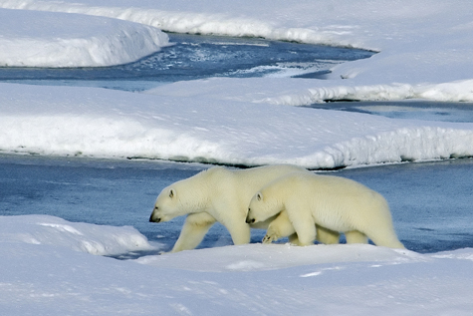
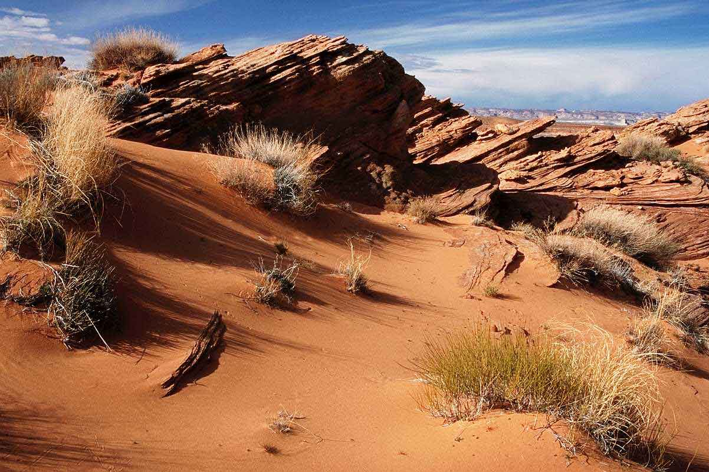
Biodiversity
In extreme environments the species diversity is normally low as only a few species will have the necessary adaptations to survive.
Here to ecosystem is unstable and dominated by climatic factors rather than by the organisms within the community.

Slide 12
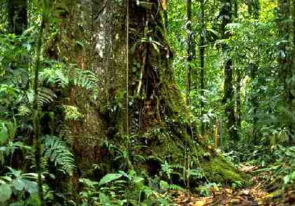
Biodiversity
In less harsh environments the species diversity is normally high.
Here the ecosystem is stable and dominated by living organisms rather than the climate.

Slide 13
Learning outcomes
Students should be able to understand the following:
Diversity may relate to the number of species present in a community.
An index of diversity describes the relationship between the number of species and the number of individuals in a community.
Calculation of an index of diversity from the formula
d = N (N – 1)
Σ n (n – 1)
where N = total number of organisms of all species
and n = total number of organisms of each species
Candidates should be able to
calculate the index of diversity from suitable data

