Slide 1
Biodiversity
17.2 Species diversity and human activities

Slide 2
Learning objectives
Students should understand the following:
The influence of deforestation and the impact of agriculture on species diversity.
Candidates should be able to
interpret data relating to the effects of human activity on species diversity and be able to evaluate associated benefits and risks
discuss the ways in which society uses science to inform the making of decisions relating to biodiversity.

Slide 3
Biodiversity
Man has had a considerable impact on the environment in his quest for enough food at a low cost for the ever expanding human population.
This impact has lead to a reduction in diversity.
We shall look at the impact of agriculture and deforestation:

Slide 4
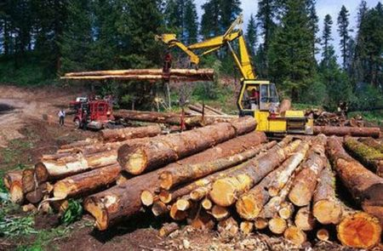
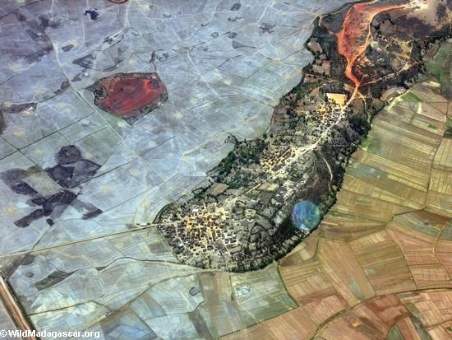
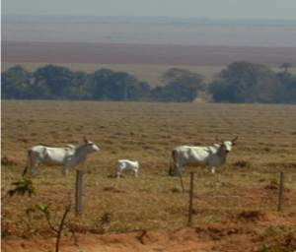
Impact of deforestation
Deforestation is the permanent clearing of forests to get wood and create land for agriculture, grazing, settlements, and reservoirs.

Slide 5
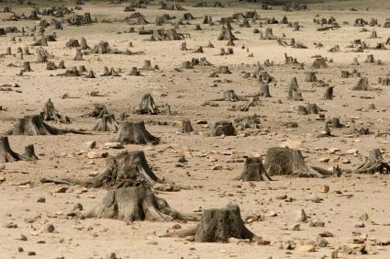
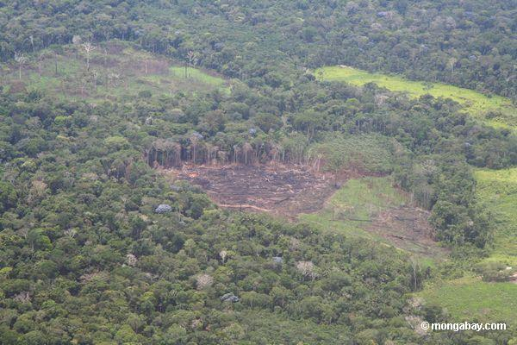
Impact of deforestation
The most serious consequence of deforestation is the loss of biodiversity.
Deforestation directly reduces the number of trees and sometimes the number of tree species.

Slide 6
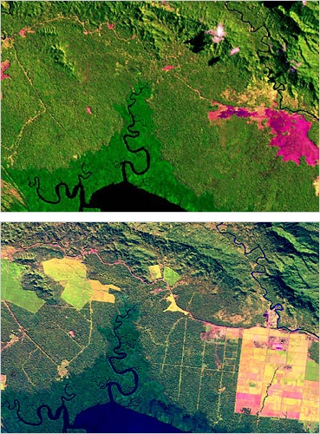
Impact of deforestation
Deforestation destroys habitats so some species lose their shelter and food source. This means that these species will die or be forced to migrate to another area.
The migration of species into increasingly smaller areas of remaining forests may temporarily increase species diversity in those areas.

Slide 7
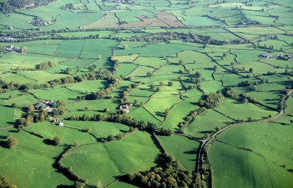
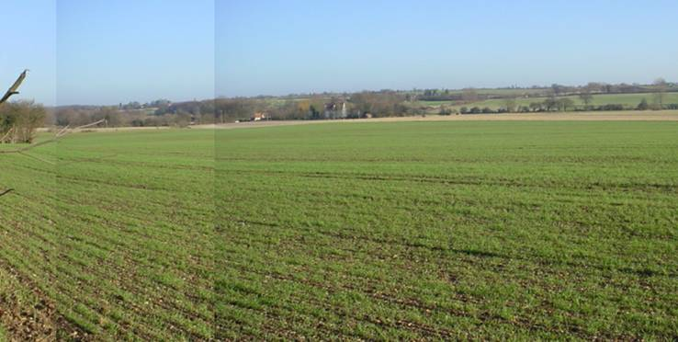
Impact of agriculture
Farmers try to maximise the amount of food that they can produce from a given area of land. Many of the methods they use reduce diversity:
Woodland clearance – to increase the area of farmland.
Hedgerow removal - to increase the area of farm land by turning lots of small fields into few larger fields.

Slide 8
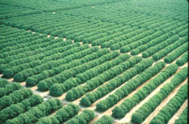
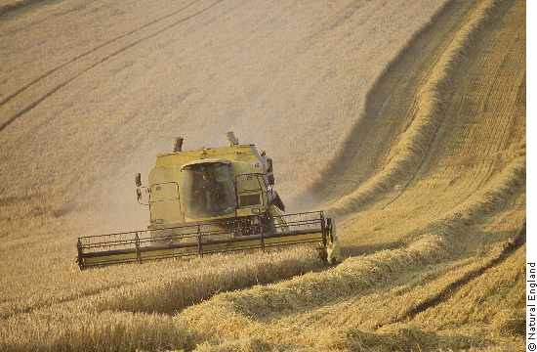
Impact of agriculture
Monoculture – farmers grow fields containing only one type of plant. A single type of plant will support fewer species.

Slide 9
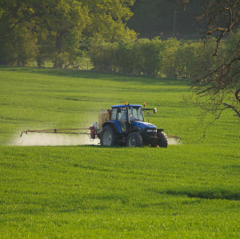
Impact of agriculture
Pesticides – chemicals that kill organisms (pest) that feed on the crop. They reduce diversity by directly killing pests. Also any species that feed on the pest will lose a food source.
Herbicides – chemicals that kill unwanted plants (weeds). These reduce plant diversity and could reduce the number of organisms that feed on the weeds.

Slide 10
TASK
P230 Application and How science works
Answer questions 1 -5
Human activity and loss of species in the UK

Slide 11
Learning objectives
Students should understand the following:
The influence of deforestation and the impact of agriculture on species diversity.
Candidates should be able to
interpret data relating to the effects of human activity on species diversity and be able to evaluate associated benefits and risks
discuss the ways in which society uses science to inform the making of decisions relating to biodiversity.

