Slide 1
2.8 Enzyme Inhibition
Competitive & Non-Competitive

Slide 2
Learning Objectives
To learn about what enzyme inhibition is.
To learn how competitive and non-competitive inhibitors affect the active site.
To understand the implications of inhibition of rates of reaction.

Slide 3
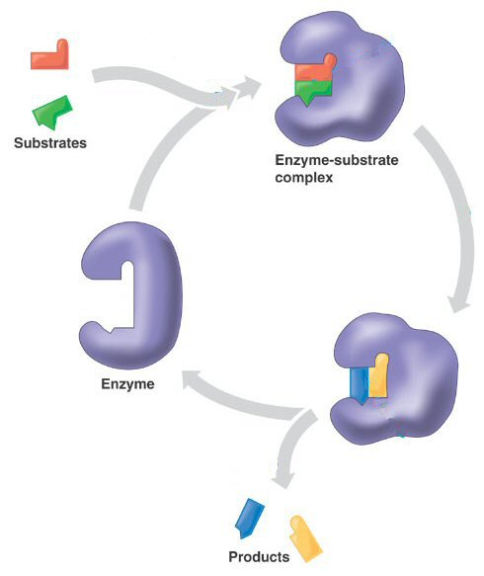
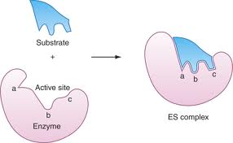
Recap of Enzyme Action
What are the two hypothesised methods of enzyme action?
Induced-Fit
Lock & Key

Slide 4
Enzyme Inhibitors
Enzyme inhibitors are molecules that have some sort of altering effect on the active site of an enzyme.
Inhibitors can cause a change to the active site, either directly or indirectly.
By doing so, enzyme inhibitors reduce the activity of an enzyme and therefore the rate of reaction in which it is involved.
+
=
Inhibitor
Molecule
Enzyme
with altered Active Site
Enzyme

Slide 5
Enzyme Inhibitors
Inhibitors can vary greatly in their action – and many are actually produced by humans as medicines and other drugs.
Sometimes an inhibitor can bind so strongly to the active site, that it can never be removed, rendering the enzyme useless.
Most inhibitors however, bind only temporarily, which is why they are known as reversible inhibitors.
There are two types:
Competitive Inhibitors
These bind directly to the active site of an enzyme.
Non-competitive Inhibitors
These bind to a position other than the active site.

Slide 6
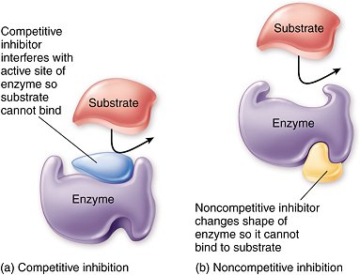
Competitive Inhibitors
Competitive inhibitors fit directly into the active site of the enzyme they will inhibit.
So what does this say about their shape?
Because of this shape similarity, it means that these inhibitor molecules are competing with the substrate for active sites.
So the concentration of inhibitor, and the concentration of substrate is what will have substantial effect on the enzymes activity.
What would happen if you increased the concentration of inhibitor?
What would happen if you increased the concentration of substrate?

Slide 7
Competitive Inhibitors
If the inhibitor is not permanently bound to the active site, when it leaves, another molecule will takes its place.
But the chances of which molecules this is, depends on the concentrations of both inhibitor and substrate.
It’s not all doom & gloom though...
Sooner or later, all of the substrate molecules will occupy an active site and will be catalysed.
It just depends on how much inhibitor is present.
The more there is, the longer it will take for each substrate molecules to ‘take its turn’ in the active site.

Slide 8
Non-competitive Inhibitors
Non-competitive inhibitors attach to a site other than the active site.
Their shape then, does not have to resemble the shape of the active site, as they never bind to it.
These inhibitors therefore, act indirectly.
Upon attachment, they alter the shape of the active site.
Enzyme-substrate complexes can no longer form.
Due to the inhibitors not binding to the active site, the inhibitor and substrate are not competing against each other!

Slide 9
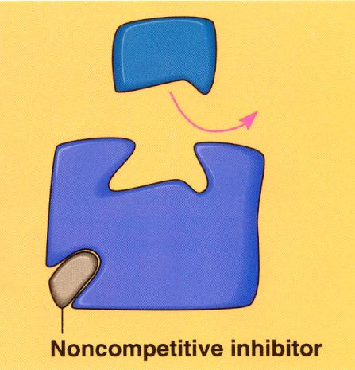
Non-competitive Inhibitors
Due to the fact that the inhibitor fits somewhere other than the active site, it makes no difference if you increase the concentration of substrate!

Slide 10
Rates of Reaction

Slide 11
Rates of Reaction
It should be obvious to you now that inhibitors will always have a detrimental effect on rate of reaction.
But competitive and non-competitive inhibitors affect rate of reaction in different ways.
These effects can be shown on a graph.
How do you think these graphs will appear?

Slide 12
Rate of Reaction
Substrate concentration
Rate of Reaction
Substrate concentration
Rate of Reaction
Substrate concentration

Slide 13
Rate of Reaction
Substrate concentration

