Slide 1
Use the slides in the PowerPoint to fill in the boxes on your worksheet.
You need to read the description on the sheet and then fill in the:
Name
Draw a simple picture
Write a short description of it’s function.

Slide 2
Organelles

Slide 3
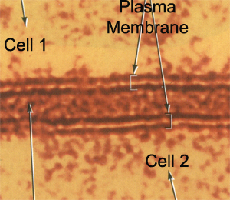
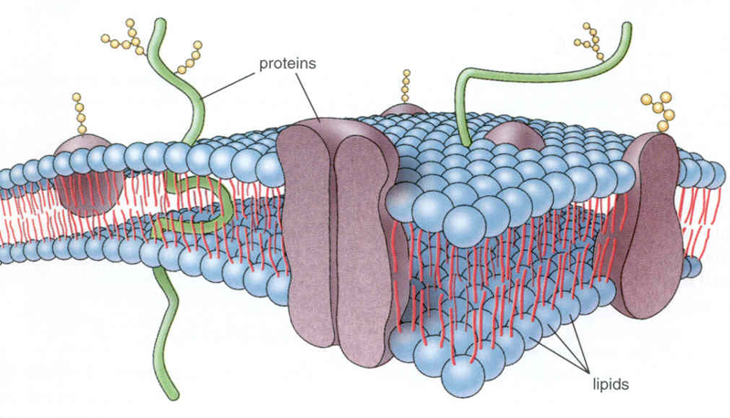
Plasma Membrane
The plasma membrane (or cell surface membrane) controls the entry & exit of substances into and out of the cell.
The plasma membrane is a phospholipid bilayer.
It has proteins embedded in it, which are able to move. So we call it a fluid mosaic.

Slide 4
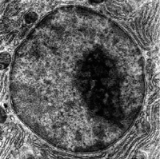
Nucleus
The nucleus is the largest organelle and is surrounded by it’s own membrane called the nuclear envelope.
The nucleus contains the DNA of the cell and is the site of DNA replication.
The nucleus contains a small dark structure called the nucleolus, which synthesises ribosomes.
The DNA in a nucleus usually exists as CHROMATIN.
The nucleus controls all the activities of the cell.

Slide 5
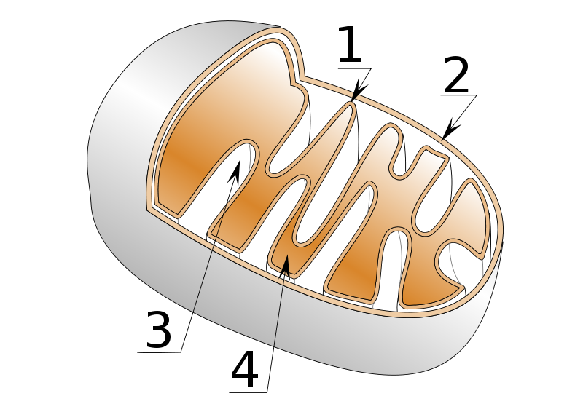
Mitochondria
Mitochondria are the sites of aerobic respiration.
They provide all of the energy a cell requires – so more active cells (muscles) will have greater numbers of mitochondria.
They too, have a double membrane – the inner one is folded to form cristae – where ATP is produced.

Slide 6
Endoplasmic Reticulum (ER)
The endoplasmic reticulum is a series of membrane folds that connect to the nuclear envelope.
The space between these folds is filled with fluid, which transports substances around within the cell.
There are 2 types of ER:
Smooth Endoplasmic Reticulum
This type of ER synthesis & processes lipids.
Rough Endoplasmic Reticulum
This type of ER is studded with ribosomes. It’s function is to process proteins produced by the ribosomes.

Slide 7
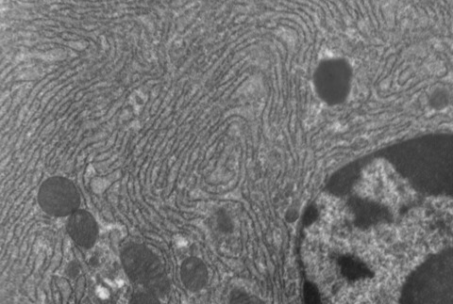
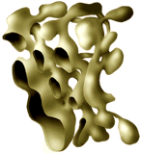
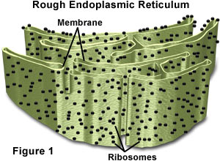

Slide 8
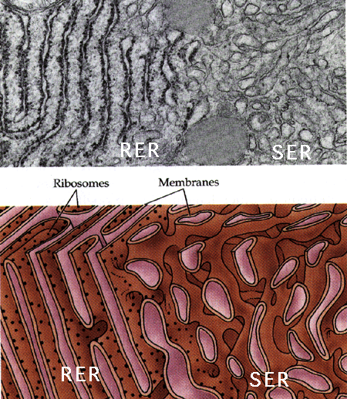

Slide 9
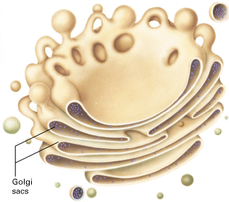
Golgi Body
The Golgi Body appears as flattened sacs that produce vesicles.
It is like the processing department of the cell.
All the substances produced by the smooth & rough endoplasmic reticulum are processed and packages by the Golgi body.

Slide 10
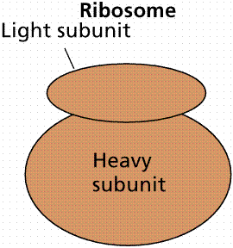
Ribosome
A ribosome are tiny organelles that either:
Float free in the cytoplasm
Attached to the endoplasmic reticulum (= RER)
Ribosome’s are the site where proteins are synthesised.

Slide 11
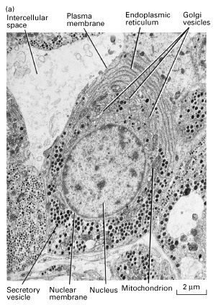
Lysosome
Lysosomes are small, round organelles.
They contain digestive enzymes which need to be kept separate from the rest of the cell by a membrane.
The digestive enzymes of the lysosome are used to digest invading cells or even destroy the cell itself when needed.

Slide 12
The organelles up until now, are present in both animal & plant cells....
...... The following organelles are found in plant cells only.

Slide 13
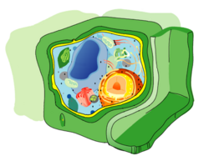
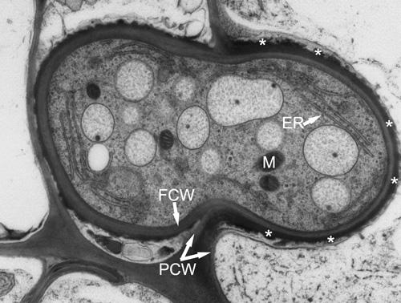
Cell Wall
Although plant cells have a plasma membrane, they also have a supporting structure called a CELL WALL.
The cell wall is made of cellulose which allows the cell wall to be flexible as well as strong.
The function of a cell wall is to support the plant cell and stop it from bursting.

Slide 14
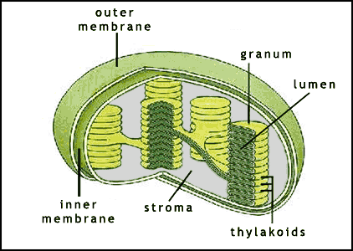
Chloroplasts
Chloroplasts are organelles surrounded by a double membrane.
The inner membrane is folded into thylakoid membranes, which are where PHOTOSYNTHESIS TAKES PLACE.
The chloroplasts contain a light-absorbing pigment called chlorophyll which give plants their green colour.

Slide 15
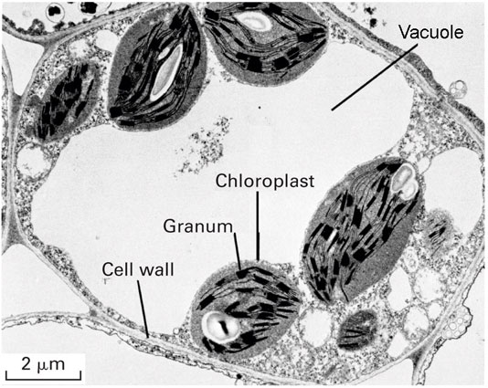
Vacuole
Mature plant cells have a large vacuole.
The vacuole contains liquid (water), pigments, waste etc.
It is important in keeping the cell turgid. When it is full, it provides support.

Slide 16
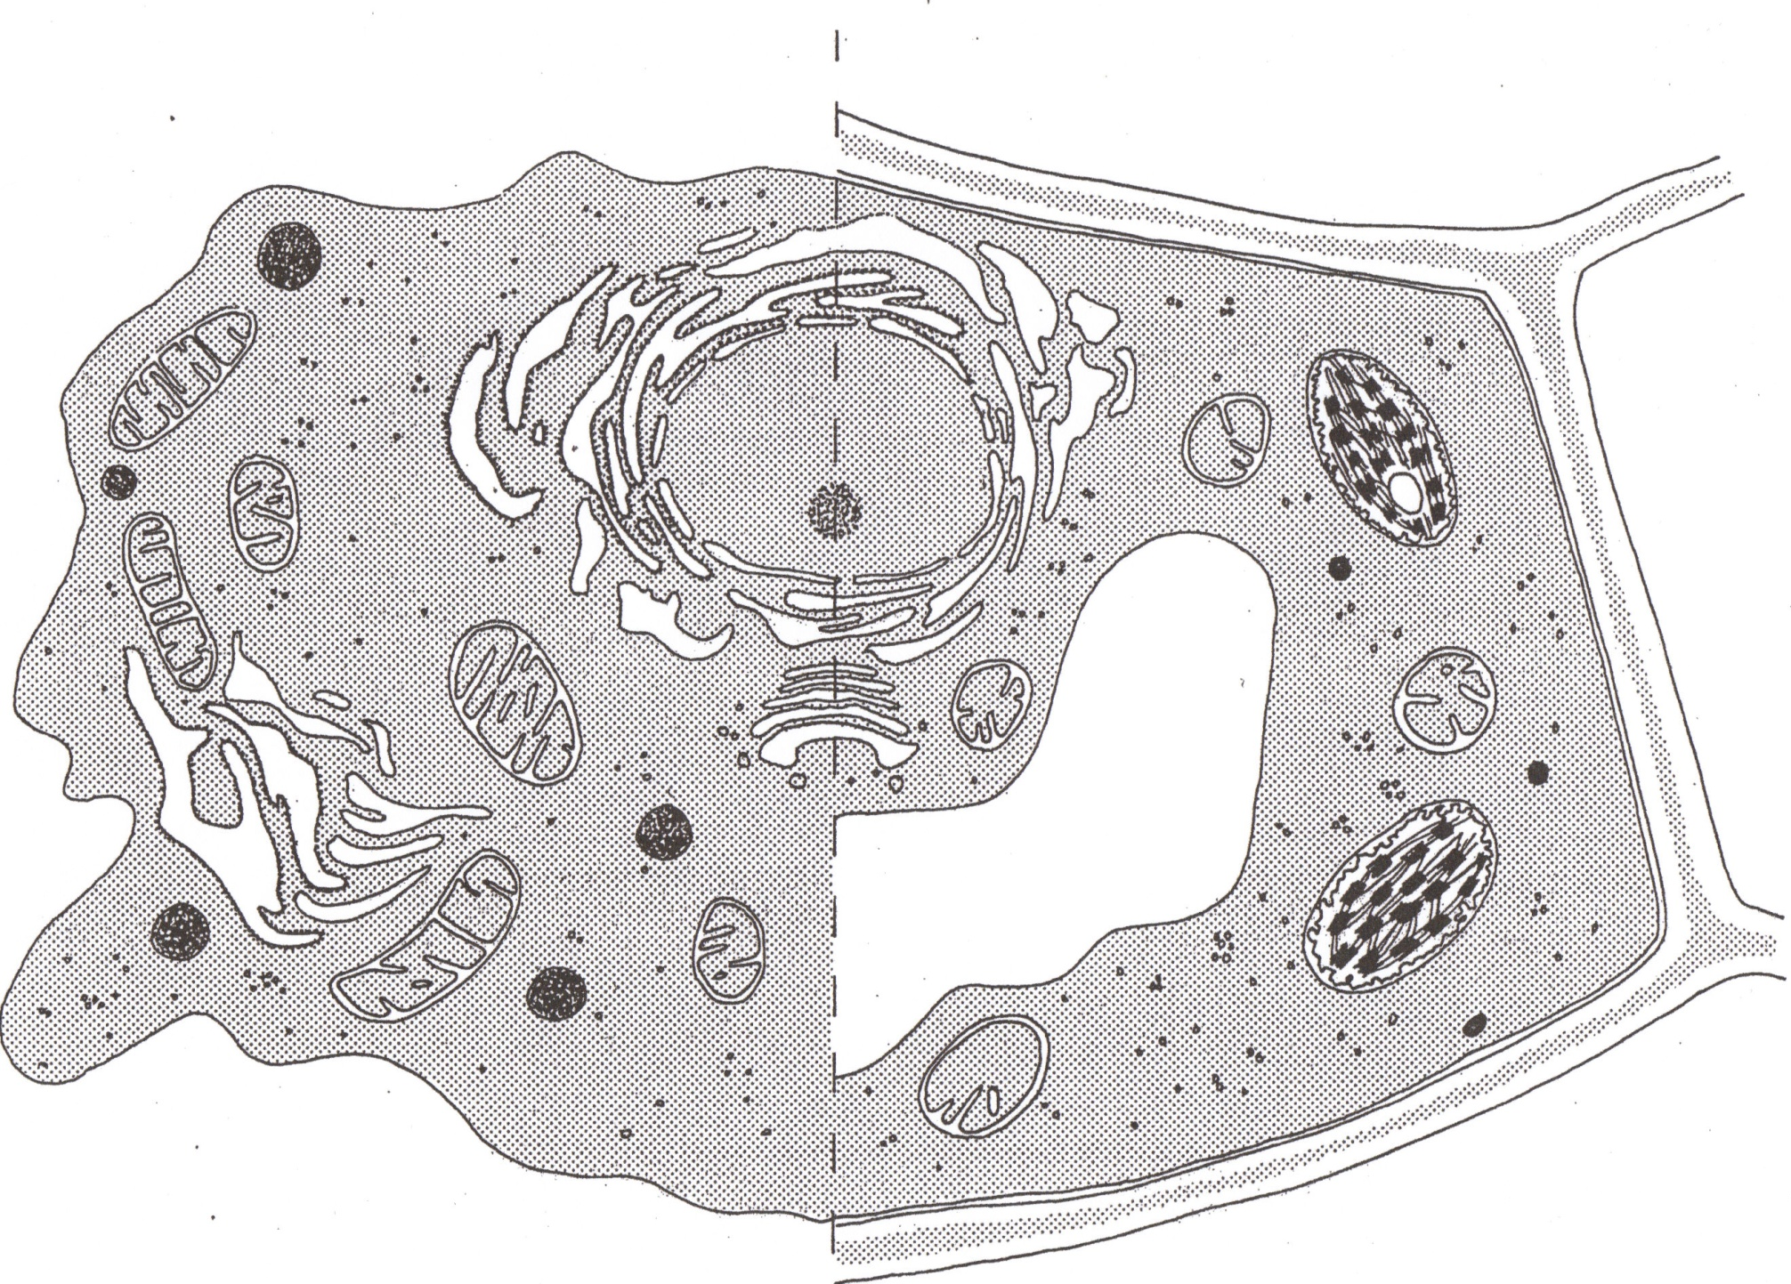
Animal Cell Plant Cell

