Slide 1
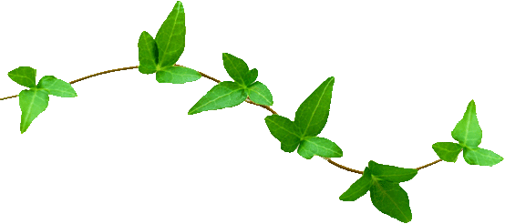
3.2 The Light-Dependent Reaction
Photosynthesis

Slide 2
Learning Objectives
To understand what it meant by oxidation and reduction in photosynthesis.
To understand how ATP is made during the light-dependent reaction.
To know the role of photolysis is in the light-dependent reaction.
To understand how chloroplasts are adapted to carry out the light-dependent reaction.

Slide 3
An Outline of Photosynthesis
The overall equation for photosynthesis is:
The equation is highly oversimplified and shows the overall result of what is actually a complex metabolic pathway.
There are three main stages involved in photosynthesis:
6CO₂ + 6H₂O → C₆H₁₂O₆ + 6O₂
1. Capturing of Light Energy
2. The Light-Dependent Reaction
3. The Light-Independent Reaction

Slide 4
Outline of the 3 Stages
Capturing of Light Energy
Light is absorbed by the pigment chlorophyll which is present in chloroplasts.
The Light-Dependent Reaction
In this stage, light energy is converted into chemical energy.
An ‘electron flow’ is created and cause the photolysis of water into protons, electrons and oxygen.
The stage ultimately produces reduced NADP, ATP and oxygen.
The Light-Independent Reaction
The protons (H⁺ ions) are used to reduce carbon dioxide to produce sugars and other organic molecules.

Slide 5
Light Capturing
Chlorophyll
Light-Dependent
Splitting of Water
H₂O
ATP
H
O₂
by-product
+
CO₂
C₆H₁₂O₆
_{glucose}
Reduction of CO₂
Light-Independent Reaction

Slide 6
Oxidation & reduction

Slide 7
Oxidation & Reduction
In the light-dependent stage of photosynthesis, the majority of reactions involve molecules being oxidised and reduced.
Oxidation and reduction can be explained in three ways:
Remember that oxidation and reduction always occur TOGETHER.
OXIDATION
Gain of OXYGEN
Loss of HYDROGEN
Loss of ELECTRONS
REDUCTION
Loss of OXYGEN
Gain of HYDROGEN
Gain of ELECTRONS

Slide 8
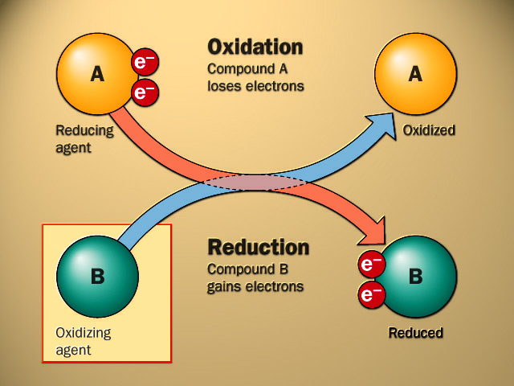

Slide 9
The light-dependent reaction

Slide 10
Outline of the Light-Dependent Reaction
This stage of photosynthesis occurs on the thylakoid membranes, unlike the light-independent reaction (which occurs in the stroma).
The reaction involves the capture of light, whose energy is used for two purposes:
Remember that the production of ATP in this way is called photophosphorylation.
To combine ADP and an P_{i} (inorganic phosphate) to form ATP.
To split water into H⁺ (protons) and OH⁻ ions. This is known as photolysis.

Slide 11
energy
ATP!
ADP
P_{i}
energy
e l e c t r o n e n e r g y l e v e l
reduced
NADP
NADP
e⁻
e⁻
H⁺
H₂O
e⁻
O₂
chlorophyll
by-product

Slide 12
LDR part 1 – Making ATP
A chlorophyll molecule absorbing light, boosts a pair of electrons to a higher energy level.
These excited electrons actually leave the chlorophyll molecule and are taken up by an electron carrier.
This is the first of a sequence of redox reactions.
Next, the electrons are passed along a series electron carriers, in a stage known as the electron-transport chain.
e⁻
e⁻
chlorophyll
oxidised
reduced
Energy is released each time the electrons pass from carrier to carrier.
e⁻
e⁻
D E C R E A S I N G E N E R G Y L E V E L

Slide 13
Continued…
The energy that is released as the electrons pass down the transfer chain, is used to synthesise ATP.
As the initial energy was derived from light, the formation of ATP in this manner is called photophosphorylation.
ADP + P_{i} → ATP
Note:
When the light struck the chlorophyll, two electrons were lost.
These need to be replaced or the chlorophyll can no longer absorb light energy.
They are replaced by the other set of reactions in the light dependent stage…

Slide 14
LDR part 2 – Photolysis of Water
As well as exciting electrons in chlorophyll, light energy is also able to split water molecules.
This ‘photolysis’ yields the following products:
The electrons produced are used to reduce the chlorophyll molecule – restoring the electrons it had lost.
The oxygen produced is a by-product which is either used in respiration, or leaves the cell.
The proton (hydrogen ion) is very important though…
H₂O
H⁺
e⁻
O₂

Slide 15
Continued…
The hydrogen ions produced by the photolysis of water are taken up by the electron carrier – NADP.
NADP is also the final acceptor of the pair of electrons released at the beginning of the light-dependent stage.
We know that gain of electrons or hydrogen is known as reduction.
As a result – reduced NADP has been formed.
Along with the ATP formed earlier, reduced NADP is vital for the next stage of photosynthesis – the light-independent stage.
e⁻
e⁻
reduced
NADP
NADP
H⁺

Slide 16
Light-Dependent Reaction
ATP!
reduced
NADP
Light-Independent Reaction

Slide 17
energy
ATP!
ADP
P_{i}
energy
e l e c t r o n e n e r g y l e v e l
reduced
NADP
NADP
e⁻
e⁻
H⁺
H₂O
e⁻
O₂
chlorophyll
by-product

Slide 18
Site of the ldr

Slide 19
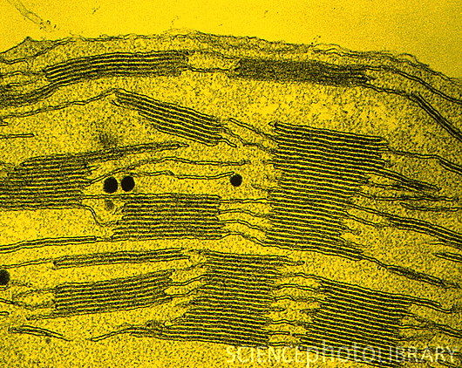
Site of the Light-Dependent Reaction
The light-dependent reaction takes place in the thylakoid membranes of chloroplasts.
The granal membranes have enzymes attached to them which help manufacture ATP.
Chloroplasts contain both DNA and ribosomes so that can easily manufacture proteins/enzymes required in the LDR.
The thylakoid membranes provide a large surface area for presence of chlorophyll, electron carriers and enzymes required for the light-dependent reaction.

Slide 20
Learning Objectives
To understand what it meant by oxidation and reduction in photosynthesis.
To understand how ATP is made during the light-dependent reaction.
To know the role of photolysis is in the light-dependent reaction.
To understand how chloroplasts are adapted to carry out the light-dependent reaction.

