Slide 1
wordsearch

Slide 2
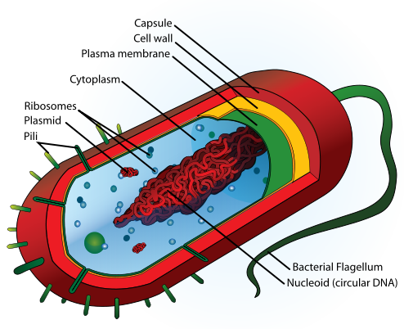
Eukaryotes, Prokaryotes and Measuring Cells

Slide 3
Lesson Objectives
To understand the difference between eukaryotic and prokaryotic cells.
To describe the features of a prokaryotic cell such as a bacterium.
To begin to understand the use of microscopes in biology.

Slide 4
Success Criteria
To be able to distinguish between pictures of eukaryotic and prokaryotic cells.
To be able to label a prokaryotic cell.
To be able to distinguish between light and electron microscope images.

Slide 5
Eukaryotic & Prokaryotic Cells
Although animal cells and plant cells are different in terms of the structures within them, they are both the same type of cell.
Animal and plant cells are both EUKARYOTIC CELLS. Animals and plants are therefore called eukaryotic organisms.
Other eukaryotic organisms include fungi and protozoa.

Slide 6
Eukaryotic Cells
Eukaryotic cells are those which have membrane-bound organelles.
The main feature that determines whether a cell is eukaryotic or not, is the presence of a membrane-bound nucleus.
This means that the DNA of a eukaryotic cell is enclosed and not free in the cytoplasm.
Eukaryotic cells are generally more ‘complicated’ than prokaryotic cells, with more structures in the cytoplasm.

Slide 7
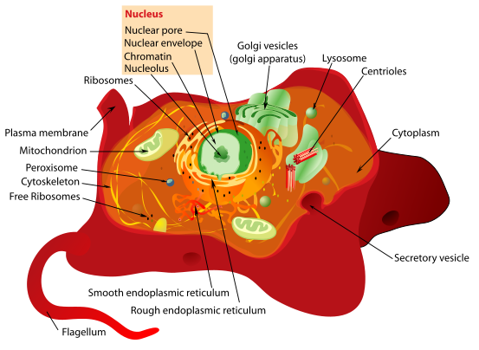

Slide 8
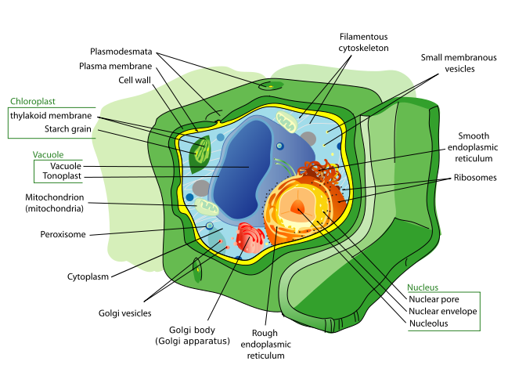

Slide 9
Prokaryotic Cells
Prokaryotic cells are less complicated than eukaryotic cells.
The defining feature of a prokaryotic cells is that it has NO NUCLEUS.
The DNA of a prokaryote floats free in the cytoplasm.
Prokaryotic cells are also a lot smaller than eukaryotic cells.
Prokaryotic organisms are unicellular. – Bacteria are prokaryotic organisms.

Slide 10
Main features of prokaryotic cells

Slide 12
Features they also have....
These are features that prokaryotes have as well as eukaryotes:
Plasma membrane.
Ribosomes.
Cytoplasm.
The next slides show features prokaryotes have.

Slide 13
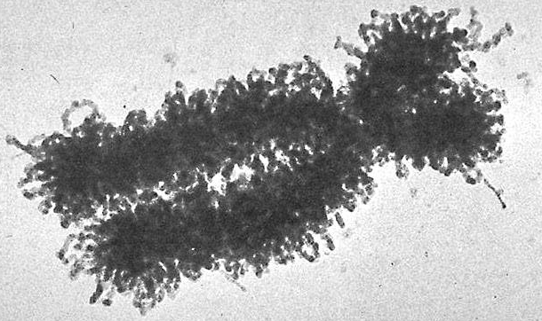
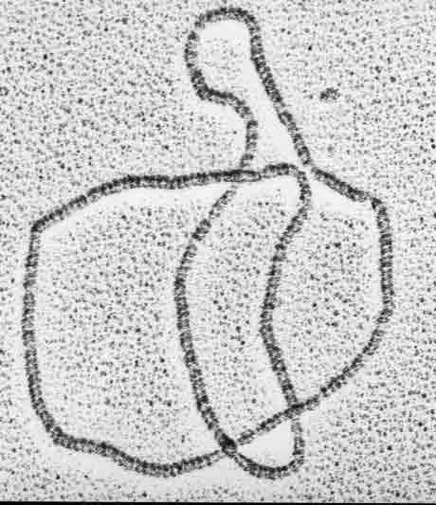
No Nucleus
Unlike eukaryotic cells, prokaryotic cells have no distinct nucleus. Instead, their DNA floats free in the cytoplasm.
Also, prokaryotes have a different type of DNA from eukaryotes. Eukaryotic DNA exists as linear strands.
The DNA in prokaryotes though,
is circular. It therefore has no
distinct ‘end’.

Slide 14
Cell Wall
Most prokaryotes have a cell wall, but it’s very different from the cell walls found around plant cells.
Plant cells have cell walls made from cellulose, but prokaryotes have cell walls made of peptidoglycan.
It has the same function as in
plants. i.e. It prevents the
cell from bursting if it takes in
too much water.

Slide 15
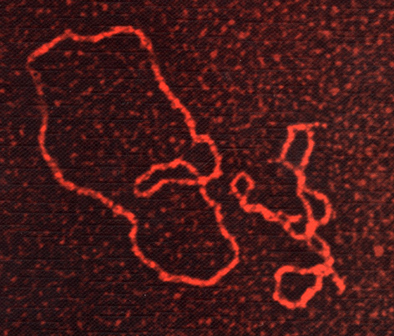
Extra DNA - Plasmids
Although prokaryotes have circular DNA which contains their genetic code, they also have extra DNA floating around in the cytoplasm.
These bits of DNA are called plasmids, which are tiny. They’re also circular.
These plasmids can code for special
Things like antibiotic resistance.
They can be passed from one pro-
karyote to another.

Slide 16
Slime Capsule
Some prokaryotes have a slime capsule around them, which is an extra layer on top of the cell wall.
This slime capsule can prevent a prokaryote from drying out.
But it’s main function is to make the
prokaryote slippery.
Some disease causing bacteria can’t
be engulfed by white blood cells
because of the slime capsule.

Slide 17
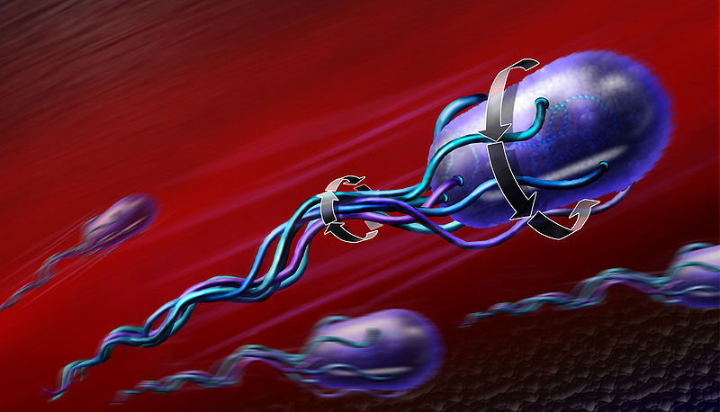
Flagellum
Some prokaryotes have long projection called a flagellum.
This is a hair-like structure that rotates to propel the prokaryote forwards.
Some bacteria have these. Bacteria that do, are called ‘flagellate bacteria.’
Flagella is the plural word for prokaryotes that have more than one flagellum.

Slide 18
Observing cells - microscopes

Slide 19
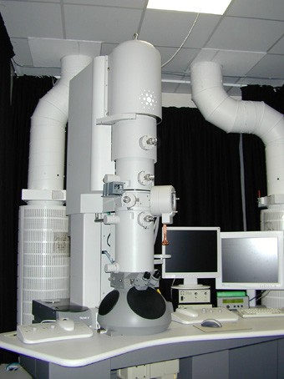
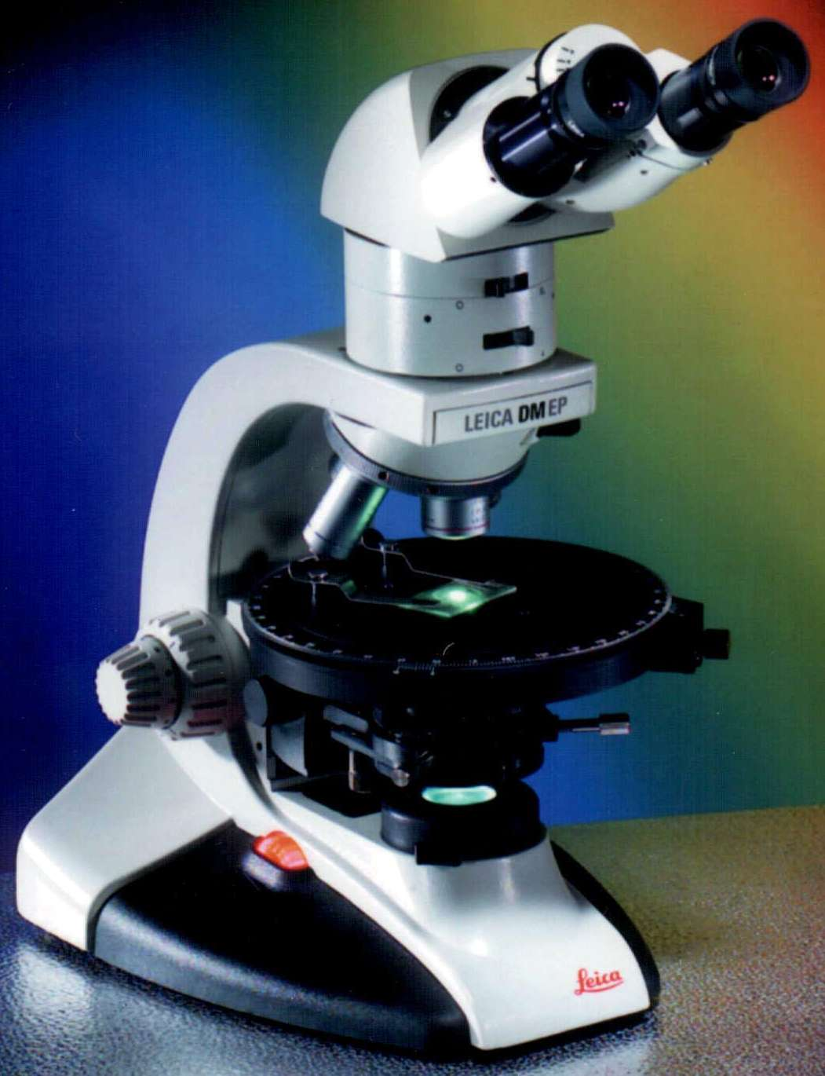
Microscopes
Individual cells are too small to be seen by the naked eye, so we require microscopes to be able to see them.
There’s different types of microscope that allow us to see differing amounts of detail.
Light microscope
←
Electron microscope
→

Slide 20
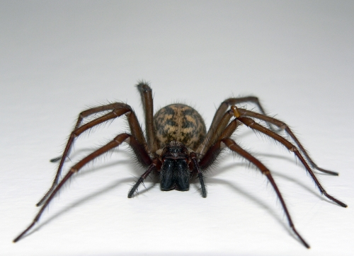
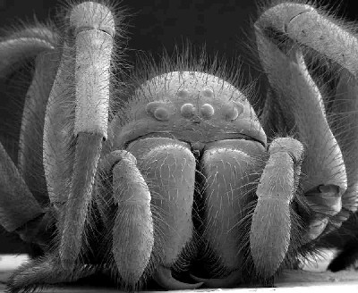
Magnification and Resolution
Magnification is how much bigger the image you see is, than the actual specimen itself.
Actual Size x 50
Magnification = Length of image
------------------------
Length of specimen

Slide 21
Resolution
Resolution is how detailed the image is. The technical definition you need to know is:
Resolution is how well a microscope distinguishes between two points that are close together
Light microscopes have a low resolving power compared to electron microscopes.
This is to do with the wavelengths of light and electrons.

Slide 22
Light Microscope
A light microscope uses lenses and light to view objects.
The maximum magnification of a light microscope is
x 1500.
A light microscope cannot resolve two separate objects that a less than 250nm apart.
250nm apart 200nm apart

Slide 23
Electron Microscope
There’s two types of electron microscope.
Transmission Electron Microscope (TEM)
Uses a beam of electrons, which have a much shorter wavelength than light. So TEMs can magnify objects up to 500,000 times. They have excellent resolving power.
Scanning Electron Microscope (SEM)
Scans electrons over the surface of the specimen, so you can get a 3D image. Slightly lower resolving power than TEM.

Slide 24
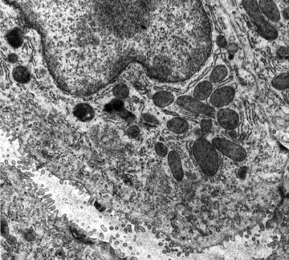
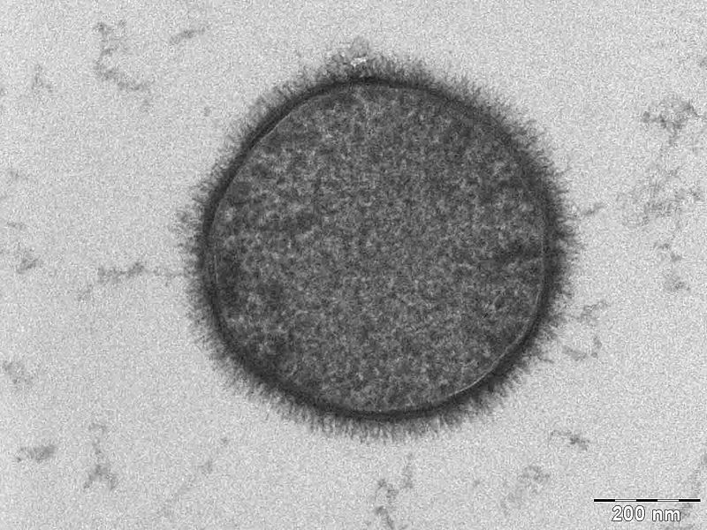
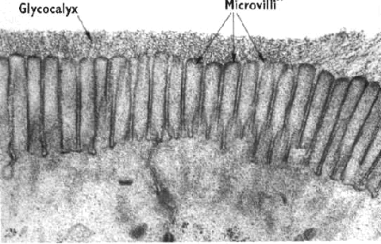

Slide 25
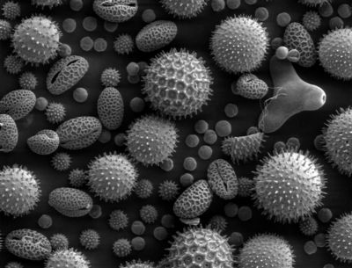
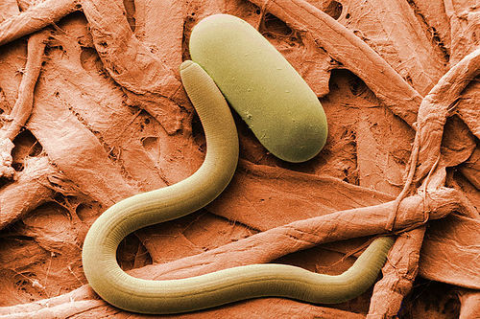
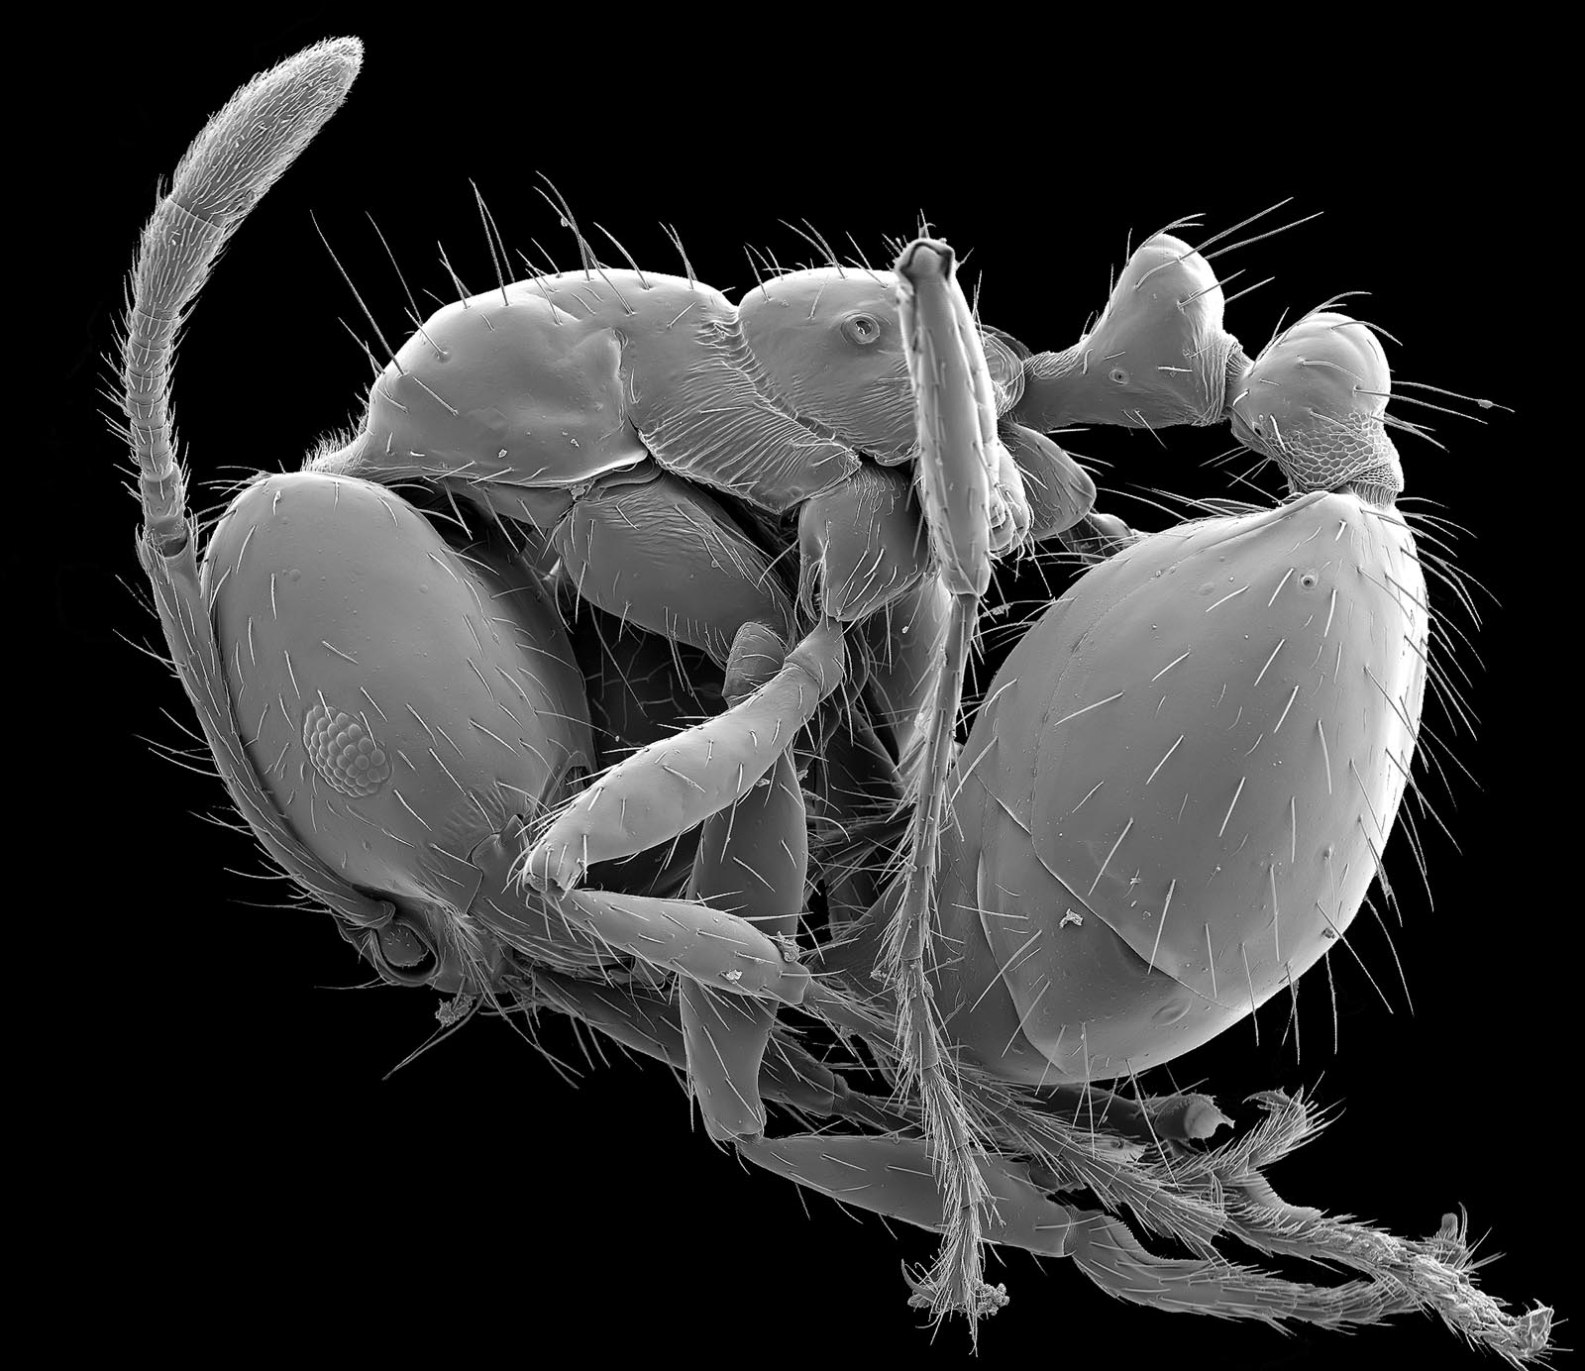
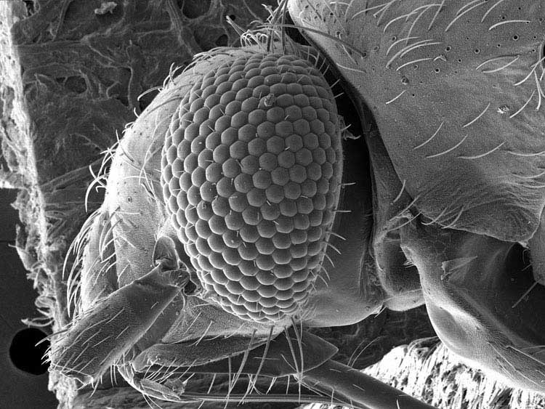

Slide 26
