Slide 1
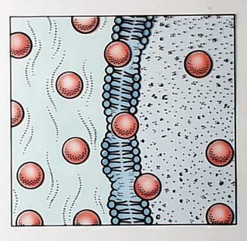
Exchanging Substances
Facilitated Diffusion, Osmosis and Active Transport

Slide 2
Learning Objectives
To recap the process of diffusion.
To understand the concepts of facilitated diffusion, active transport and osmosis.
To understand what is meant by water potential (Ψ).

Slide 3
Success Criteria
To be able to understand a diagram of a plasma membrane and the ways in which substances travel across them.
To be able to relate water potential to the way in which water moves in or out of cells.

Slide 4
Plasma Membrane
Plasma membranes form boundaries between cells and their environment.
But substances need to cross membranes because:
Nutrients need to get in.
Waste/hormones etc. need to get out.
OUTSIDE
INSIDE

Slide 5
Exchange Mechanisms
Plasma membranes are partially permeable – they let some things through, but not others.
The substances that can’t get through, need help crossing membranes.
The ways in which substances can cross membranes are:
Diffusion Facilitated Diffusion Osmosis
Active Transport

Slide 6
diffusion

Slide 7
Diffusion Recap
All particles that make up liquids and gases are in random motion – they’re moving around very fast.
Because of this, they move from:
a region of high concentration to a region of low concentration
High conc. Low conc.

Slide 8
Diffusion Recap
The molecules will diffuse both ways, but the net (overall) movement will be to the area of low concentration.
There is a concentration gradient
..... particles move down it
Diffusion is PASSIVE!
There is NO energy involved.
Diffusion occurs if the molecules involved can pass freely through a membrane. So they have to be small. If they’re not, facilitated diffusion is required!

Slide 9
Rates of Diffusion
The rate at which diffusion occurs is determined by several factors:
The size of the concentration gradient.
The larger the difference in concentration, the faster diffusion will occur.
The thickness of the exchange surface.
The thinner the exchange surface, the faster diffusion will occur.
The distance between the two areas.
A shorter distance = faster diffusion.
The size of the molecules.
Smaller molecules such as oxygen will diffuse quicker than large molecules like proteins.

Slide 10
Facilitated diffusion

Slide 11
Facilitated Diffusion
Facilitated diffusion uses the same principle as ordinary diffusion, except that protein carriers are involved.
Small molecules like O₂ and CO₂ can simply diffuse across a membrane without any help.
Larger molecules like amino acids and glucose can’t diffuse directly through the phospholipid bilayer.
They still move down a concentration gradient, but because they’re so big, they move through carrier proteins or channel proteins.
Facilitated diffusion is also passive (no energy).

Slide 12
CARRIER Proteins
OUTSIDE
INSIDE
Carrier proteins move large molecules in or out of the cell down a concentration gradient.
Molecules attach to the carrier protein.
The carrier changes shape.
It releases the molecule on the other side.

Slide 13
CHANNEL Proteins
OUTSIDE
INSIDE
Channel proteins form pores in the membrane for CHARGED PARTICLES to move down a concentration gradient.

Slide 14
Facilitated Diffusion
Facilitated diffusion is specific.
i.e. A certain type of molecule will have a corresponding carrier or channel
Glucose = glucose channel
Amino acids = amino acid channel

Slide 15
Active transport

Slide 16
Active Transport
Active transport is different from diffusion and facilitated diffusion because it uses ENERGY.
Unlike diffusion and facilitated diffusion, molecules move AGAINST a concentration gradient.
This happens in the intestines, where the concentration of nutrients is very high in the cells already.
Active transport uses carrier proteins too, but they work using ATP (energy).

Slide 17
Active Transport
OUTSIDE
ATP
INSIDE
Molecule attaches to carrier protein.
ATP molecule provides energy to go against gradient.
Carrier changes shape and molecule is released on the other side (side with higher concentration).

Slide 18
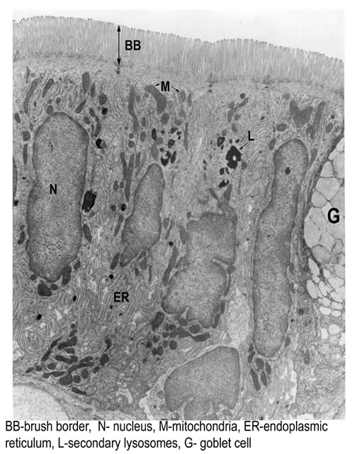
Cells like epithelial cells in the intestine have to carry out active transport.
They’re packed with mitochondria to provide the ATP (energy) needed for transporting nutrients against a concentration gradient.

Slide 19
Osmosis – transporting water

Slide 20
Osmosis
Osmosis is simply the diffusion of water molecules.
The definition for osmosis is:
The movement of water across a partially permeable membrane, from an area with a less negative water potential, to an area with a more negative water potential
...so we need to know what ‘water potential’ is...

Slide 21
Water Potential
Water is rarely pure – it is never composed of 100% H₂O molecules.
There are usually dissolved solutes in it such as minerals and ions.
Pure water would have a ‘water potential’ (Ψ) of zero.
But when there are dissolved solutes in water, there’s no longer 100% water molecules – so we say the water potential is more negative.
100% water
Ψ = zero
Ψ = more negative
Ψ = even more negative

Slide 22
Water Potential
Water potential is measured in kilopascals (kPa).
Water potential of pure water = 0 kPa
Water potential of water with a pinch of salt added = -70 kPa
Just remember that the more concentrated water is with solutes (substances), the more negative the water potential will be.

Slide 23
Ψ = -30 kPa
Ψ = -40 kPa
Ψ = -36 kPa

Slide 24
Ψ = -5 kPa
Ψ = -2 kPa
Ψ = -1 kPa
Ψ = -3 kPa
Ψ = -2 kPa
Ψ = -4 kPa
Draw the following diagrams, and show with arrows, which way you think osmosis will occur.

Slide 25
Cells are affected by the water potential of their surroundings
When you compare two water potentials, you can give special names to them in terms of how different they are:
Ψ = -2 kPa
Ψ = -2 kPa
Ψ = -10 kPa
Ψ = -10 kPa
Ψ = -2 kPa
Ψ = -2 kPa
Cell is in a HYPOTONIC SOLUTION
Cell is in a ISOTONIC SOLUTION
Cell is in a HYPERTONIC SOLUTION

Slide 26
PLENARY

Slide 27
Exam Q’s
Diffusion is a passive transport process. What does this mean?
How does the thickness of an exchange surface affect the rate of diffusion across it?
What happens if a cell is placed in a hypotonic solution?

Slide 28
Exam Q’s
Pieces of potato of equal mass were put into different concentrations of sucrose solution for three days. The difference in mass when they were taken out is shown in the table.
Why did the pieces in 1% and 2% sucrose gain mass?
Why did the mass of the piece in 3% sucrose stay the same?
What happens to a cell placed in a hypertonic solution?
Concentration of sucrose (%) | 1 | 2 | 3 | 4
Mass difference (g) | +0.4 | +0.2 | 0 | -0.2

Slide 29
PAGES 88-89

