Slide 1
Lungs and lung disease
4.1 Structure of the human gas-exchange system

Slide 2
Remember these guys?
Breathing - brainpop.swf

Slide 3
Learning objectives
Student should understand the following:
The gross structure and function of the human gas exchange system limited to the alveoli, bronchioles, bronchi, trachea and lungs.

Slide 4
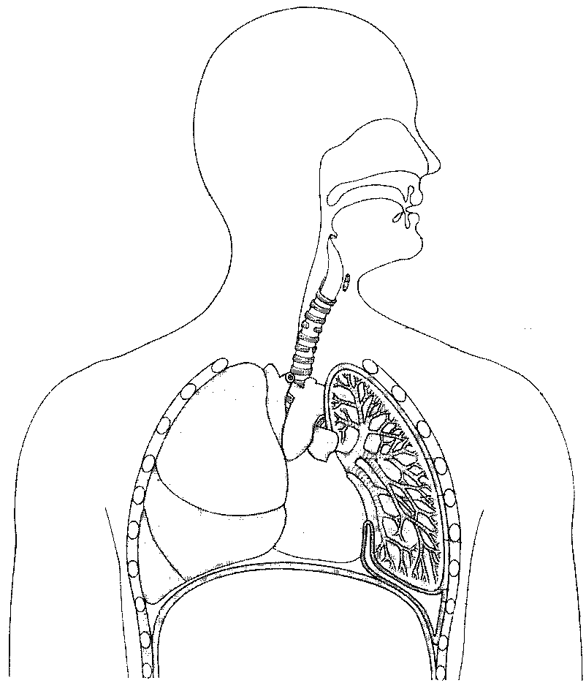

Slide 5
Starter :
Label this diagram
Oesophagus
Trachea
C shaped cartilage
Rib
Bronchus
Heart
Bronchiole
Alveolus
Diaphragm
Pleural cavity

Slide 6
Mammalian lungs
The lungs are the site of gas exchange in mammals.
Why are they located inside the body?
The air is not dense enough to support them
They would dry out
The lungs are supported by the ribcage which can be moved by the use of the intercostal muscles.

Slide 7
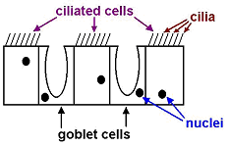
Trachea
The trachea is a flexible airway supported by rings of cartilage which prevent the trachea collapsing when the air pressure inside falls.
The walls are made up of muscle, lined with ciliated epithelium and goblet cells.
The goblet cells produce mucus which traps dirt and bacteria.
The cilia move the mucus up to the throat where it is swallowed.

Slide 8
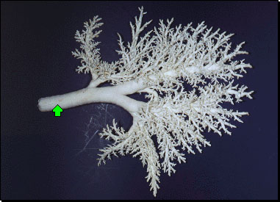
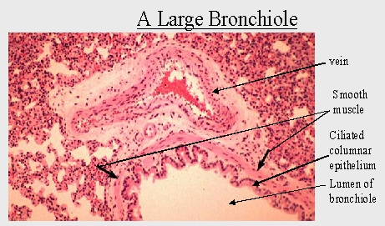
Bronchi – 2 divisions of the trachea. Larger bronchi are supported by cartilage.
Bronchioles – branching subdivisions of the bronchi. The walls are made of muscle lined with epithelial cells. The muscle enables them to control the flow of air in and out of the alveoli.

Slide 9
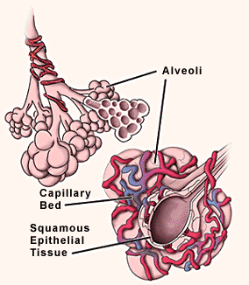
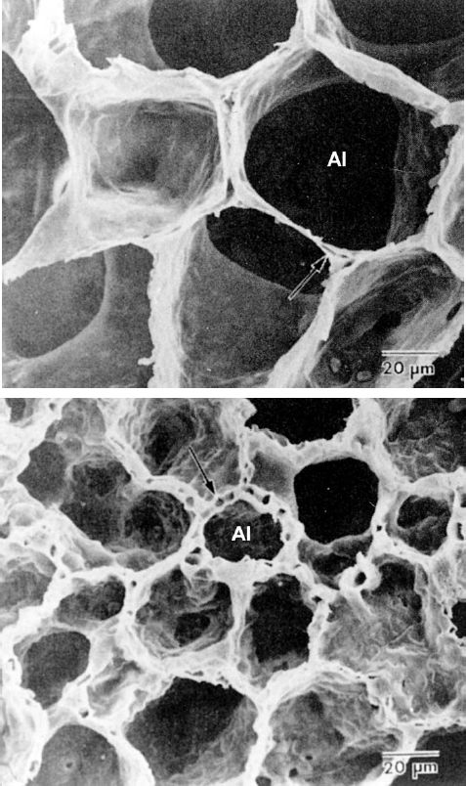
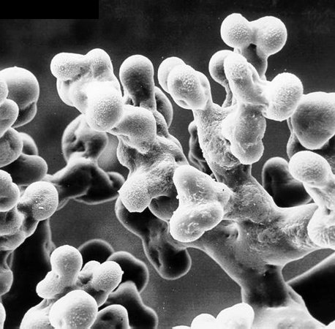
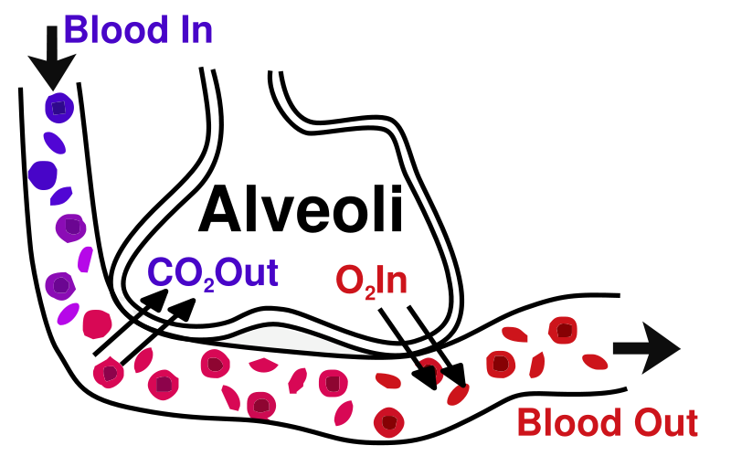
Alveoli
Minute air-sacs at the end of the bronchioles.
Contain collagen and elastic fibres.
Site of gas exchange

Slide 10
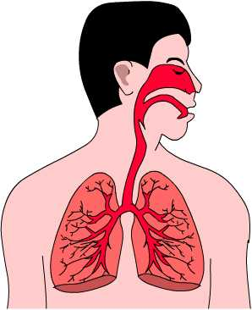
Problems with lung expansion
With air entering and leaving the lungs, they increase and decrease in size on a regular basis.
When organs in the body increase in size, they will touch other organs because of the lack of space.
This is a danger because living tissue is very delicate and when tissues rub against each other, friction could be generated.
This friction could damage the tissue and kill cells.
Therefore, a protective bag called the pleural membrane surrounds the lungs, which are likely to rub against other organs during the breathing process.

Slide 11
Learning objectives
Student should understand the following:
The gross structure and function of the human gas exchange system limited to the alveoli, bronchioles, bronchi, trachea and lungs.

