Slide 1
Respiration
4.4 Anaerobic Respiration
Lesson Context:
Studied aerobic respiration.
- Glycolysis
- Link Reaction
- Electron Transport Chain
38 molecules of ATP formed during aerobic respiration.
Oxygen acts as the final acceptor of electrons in the ETC.
Without oxygen – LR, K’sC and ETC cannot occur.

Slide 2
Learning Objectives
To understand that in the absence of oxygen, glycolysis is the only source of ATP.
To understand that during anaerobic respiration in animals, lactic acid is produced.
To understand that during anaerobic respiration in plants, ethanol and CO₂ are produced.
To understand that anaerobic respiration produces a much lower energy yield.

Slide 3
Fermentation
In animals: Lactic Acid
In plants: Ethanol + CO₂
Glycolysis
2 ATP (NET)
2 Red. NAD
2 Pyruvate
Anaerobic Respiration
Aerobic Respiration
Link Reaction
2 Red. NAD
2 Acetylcoenzyme A
Kreb’s Cycle
2 ATP
6 Red. NAD
2 Red. FAD
Electron T.C.
28 ATP
Water
10 NAD
2 FAD

Slide 4
Glycolysis Recap
In glycolysis there is a net gain of 2 ATP molecules.
In conditions of plentiful oxygen, the Reduced NAD produced in this stage would go on to the electron transport chain, and yield numbers of ATP.
If there is insufficient oxygen, the Kreb’s Cycle and ETC shut down.
This leads to a build up of pyruvate, which is converted into lactic acid (ethanol & CO₂ in plants.)
Glucose (6C)
2 ATP
2 ADP + P
Phosphorylated Glucose (6C)
2 x Triose Phosphate (3C)
4 ADP + P
2 NAD
4 ATP
2 Reduced NAD
2 x Pyruvate (3C)

Slide 5
Why do Kreb’s and ETC shut down?
At the end of the ETC, oxygen acts as the final electron acceptor.
Usually, an oxygen atom would be waiting to combine with the electrons and protons to form water.
If there is no oxygen available, it cannot accept the electrons from the last carrier protein.
H⁺
H⁺
NADH
NAD
e
FADH
FAD
here

Slide 6
A build-up of Reduced NAD and FAD occurs as they are not able to give away their electrons and protons.
No more oxidised NAD and FAD is being cycled back to the Kreb’s cycle, which shuts down.
ATP synthesis ceases.
H⁺
NADH
e
H⁺
FADH
NADH
NADH
NADH
FADH

Slide 7
Fermentation
In animals: Lactic Acid
In plants: Ethanol + CO₂
Glycolysis
2 ATP (NET)
2 Red. NAD
2 Pyruvate
Anaerobic Respiration
Aerobic Respiration
Link Reaction
2 Red. NAD
2 Acetylcoenzyme A
Kreb’s Cycle
2 ATP
6 Red. NAD
2 Red. FAD
Electron T.C.
28 ATP
Water
10 NAD
2 FAD

Slide 8
Fermentation
Remember the products of glycolysis:
Due to the shutdown of the subsequent stages of aerobic respiration, the Reduced NAD effectively has nowhere to go.
As a result, it immediately donates its hydrogen ions and electrons to pyruvate.
Pyruvate
2 x Red. NAD
2 x ATP
Pyruvate
Lactic Acid
Reduced NAD
NAD

Slide 9
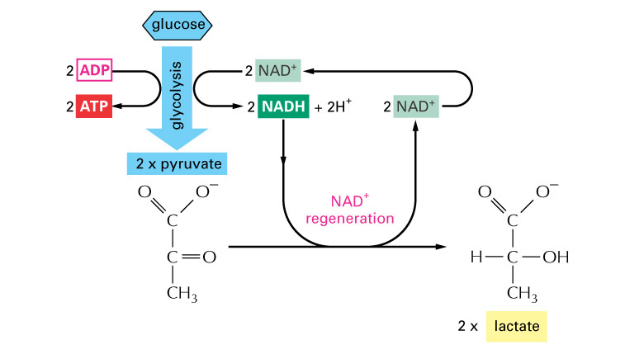
In animals, donation of hydrogen ions and electrons to pyruvate forms LACTIC ACID…

Slide 10
Fermentation in Animals
During strenuous exercise, not enough oxygen is delivered to muscle tissue.
Reduced NAD builds up as it is not able to deliver electrons and hydrogen ions to the ETC.
Even glycolysis would stop if no Reduced NAD is reoxidised.
Rather, each pyruvate molecule produced in glycolysis takes hydrogen ions from Reduced NAD – to form Lactic Acid.
Pyruvate + Reduced NAD → Lactic Acid + NAD

Slide 11
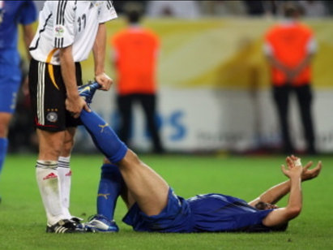
Lactic Acid and Muscle Fatigue
A build up of lactic acid will cause muscle cramp and fatigue.
Lactic acid will at some point need to be oxidised back to pyruvate.
This happens when oxygen is once again available.
The pyruvate can then continue through the stages of aerobic respiration, or be converted to glycogen for storage.

Slide 12
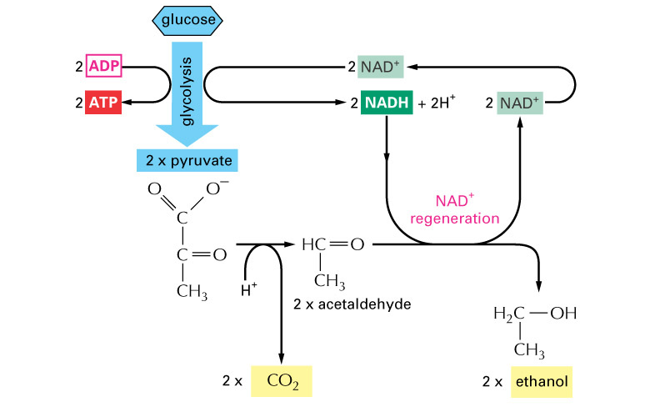
In plants, donation of hydrogen ions and electrons to pyruvate forms ETHANOL and CO₂…

Slide 13
Fermentation in Plants
Higher plant species, yeast and bacteria can respire anaerobically to produce ethanol.
The pyruvate molecule produced at the end of glycolysis loses a molecule of CO₂ and accepts hydrogen from Reduced NAD.
This form of anaerobic respiration in yeast has been used for thousands of years in the brewing industry.
Yeast is grown in anaerobic conditions in which it ferments carbohydrate sources such as grapes or barley seeds.
CO₂
Pyruvate
Ethanol
Reduced NAD
NAD

Slide 14
Key points

Slide 15
Key Points
Remember that energy from respiration is derived in two ways:
In anaerobic respiration, only glycolysis occurs - which yields 2 molecules of ATP.
Pyruvate is either converted to lactic acid or ethanol.
It is consequently unavailable for Krebs or ETC.
This means that the remaining 30 molecules of ATP are not produced.
Substrate-Level Phosphorylation
This happens during glycolysis and Krebs cycle
Oxidative Phosphorylation
This is where the bulk of ATP production occurs, during the ETC

Slide 16
Learning Objectives
To understand that in the absence of oxygen, glycolysis is the only source of ATP.
To understand that during anaerobic respiration in animals, lactic acid is produced.
To understand that during anaerobic respiration in plants, ethanol and CO₂ are produced.
To understand that anaerobic respiration produces a much lower energy yield.

