Slide 1
Lungs and lung disease
4.5 Lung disease – fibrosis, asthma and emphysema

Slide 2
Learning outcomes
Student should understand the following :
The effects of fibrosis, asthma and emphysema on lung function.
Candidates should be able to
explain the symptoms of diseases and conditions affecting the lungs in terms of gas exchange and respiration
interpret data relating to the effects of pollution and smoking on the incidence of lung disease
analyse and interpret data associated with specific risk factors and the incidence of lung disease
recognise correlations and causal relationships.

Slide 3
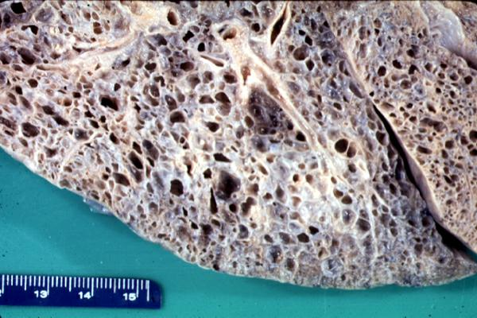
Pulmonary fibrosis
Arises when scars form on the epithelium of the lungs causing them to become irreversibly thickened.
Oxygen uptake is less efficient because
the volume of air that the lungs can contain is reduced
There is a greater diffusion pathway
Fibrosis also reduces the elasticity of the lungs and it is therefore more difficult to breathe out.

Slide 4
Effects of fibrosis on lung function
Shortness of breath, esp when exercising due to the amount of fibrous tissues in the lungs.
Less air is taken in by each breath
Increased diffusion pathway due to the thickened epithelium
Loss of elasticity makes ventilation difficult and thus makes it hard to maintain a diffusion gradient

Slide 5
Effects of fibrosis on lung function
Chronic, dry cough because the fibrous tissue creates an obstruction in the airways of the lungs. The body naturally reacts to clear the obstruction by coughing but as the tissue is immovable the cough is ‘dry’.
Pain and discomfort in the chest due to the pressure and damage from the fibrous tissue and coughing.
Weakness and fatigue from reduced oxygen uptake. The energy released by cellular respiration is reduced, leading to tiredness.
The exact cause is unclear, but evidence suggests that it is a reaction to microscopic lung injury, to which some individuals are genetically more susceptible.

Slide 6
Asthma
Affects up to 10% of the worlds population.
2000 deaths in UK each year.
Asthma tends to run in families – genetic element
Allergens include
Pollen, animal fur, faeces of house dust mite.
Can be triggered by
air pollutants(sulphur dioxide, nitrogen oxides and ozone), exercise, cold air, infection, anxiety and stress.
Number of cases rising due to
Increase in air pollution
Increase in stress
Increase in the chemicals in our food
Cleaner lifestyle

Slide 7
Asthma
The allergens cause the white blood cells lining the bronchi and bronchioles to release histamine. This has the following effects:
Inflammation of the lining of the airways
Cells of the epithelial lining secrete larger quantities of mucus
Fluid leaves the capillaries and enters the airways
The muscle surrounding the bronchioles contracts ands so constricts the airways
Overall there is a much greater resistance to the flow of air in and out of the alveoli and therefore it is difficult to maintain the diffusion gradient.

Slide 8
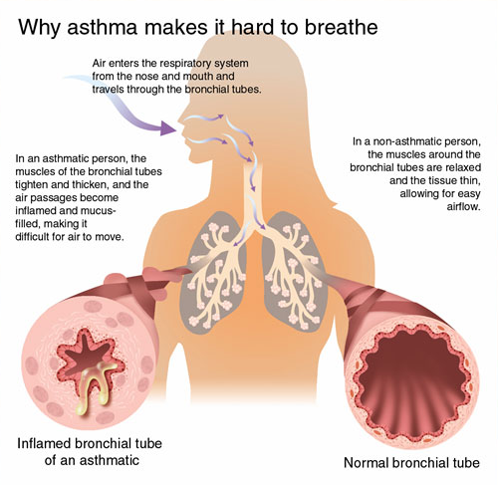

Slide 9
Symptoms
Difficulty in breathing due to
Constriction of bronchi and bronchioles
Inflamed lining
Presence of additional mucus and fluid
Wheezing caused by air passing through constricted bronchi and bronchioles
Tight feeling in chest, a consequence of not being able to ventilate the lungs properly
Coughing, a reflex response to the obstructed airways

Slide 10
Chronic bronchitis
Criteria: Having a productive cough for at least 3 months during 2 successive years
Symptoms: Productive cough, breathlessness
Smoking and air pollution paralyse the cilia in the bronchial tubes so mucus builds up in clumps that are coughed up (productive cough). The lining of the bronchial tubes becomes irritated and inflamed.
CAUSE : smoking and air pollution
TREATMENT: drug treatment, oxygen therapy, lung transplant

Slide 11
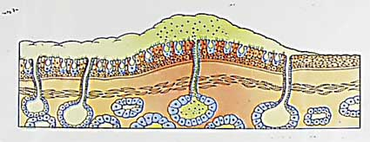
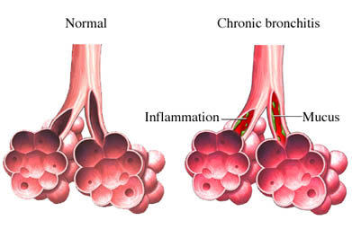
Chronic bronchitis

Slide 12
Emphysema
Criteria: Actually defined by pathology the walls of the alveoli are broken down
Symptoms: Coughing, shortness of breath, and wheezing, developing into extreme difficulty in breathing, bluish skin colour
Physical damage by repeated coughing and loss of elastin from walls of alveoli. Less surface area is available for the exchange of gases.
CAUSE: smoking and air pollution
Treatment: Emphysema is irreversible

Slide 13
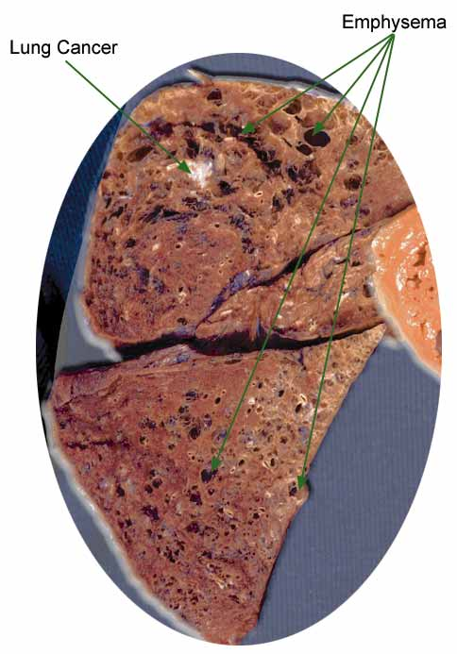
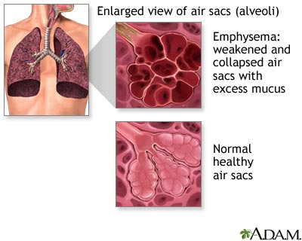
Emphysema

Slide 14
Healthy lung
Smoking and dust particles
recovery
more mucus production
irritation
infections
Bronchitis
Slow
recovery
Further irritation by coughing
cilia damaged by smoke so mucus is trapped in lung
alveoli damaged by coughing, giving reduced lung surface area
Further irritation by coughing
Emphysema
irreversible damage to alveoli
loss of elasticity
Ineffective gas exchange due to:
Reduced surface area of lung
Excess fluid in lung

Slide 15
Learning outcomes
Student should understand the following :
The effects of fibrosis, asthma and emphysema on lung function.
Candidates should be able to
explain the symptoms of diseases and conditions affecting the lungs in terms of gas exchange and respiration
interpret data relating to the effects of pollution and smoking on the incidence of lung disease
analyse and interpret data associated with specific risk factors and the incidence of lung disease
recognise correlations and causal relationships.

