Slide 1
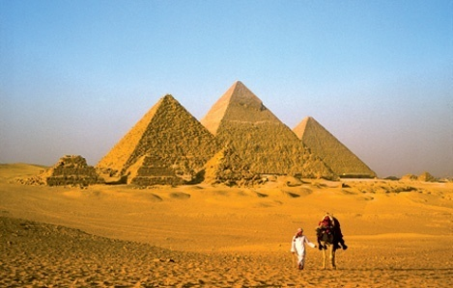
Energy and Ecosystems
5.3 Ecological Pyramids

Slide 2
Learning Objectives
All students should know...
...what the different types of ecological pyramid are.
...what are the relative merits and disadvantages of each pyramid are.
Specification reference: 3.4.5

Slide 3
Success Criteria
All students should be able to:
Construct pyramids of number, biomass and energy from a food chain or food web.
Correctly label pyramids.
Outline strengths and weaknesses of the different pyramids.
Answer exam style questions on pyramids.

Slide 4
Starter Activity: Card Sort Activity
Key term | Definition
Food chain | Organism that eats plants and animals
Producer | Organism that eats other organisms
Consumer | Living material that makes up organisms
Herbivore | Organism that only eats animals
Carnivore | A feeding level in a food chain
Omnivore | Organism that makes its own food
Biomass | Sequence showing feeding relationships
Trophic | Organism that only eats plants
Notes:
Teacher notes
This matching activity can be used at the start of a lesson to assess students’ existing knowledge of feeding relationships, or for revision purposes. It can be used to test understanding of terms introduced in KS3.

Slide 5
Starter Activity Answers
Key term | Definition
Omnivore | Organism that eats plants and animals
Consumer | Organism that eats other organisms
Biomass | Living material that makes up organisms
Carnivore | Organism that only eats animals
Trophic | A feeding level in a food chain
Producer | Organism that makes its own food
Food chain | Sequence showing feeding relationships
Herbivore | Organism that only eats plants
Notes:
Teacher notes
This matching activity can be used at the start of a lesson to assess students’ existing knowledge of feeding relationships, or for revision purposes. It can be used to test understanding of terms introduced in KS3.

Slide 6
Quick recap of last lesson!
The following organisms are found living in a patch of nettles. Use these organisms to construct a food web. Make sure arrow heads are drawn the correct way round!!!!
Two-spot ladybird
Nettle plant
Small nettle aphid
Fox
Rabbit
Parasitic wasp
Caterpillar (larva) of peacock butterfly

Slide 7
A food web showing some of the organisms living in a patch of nettles
Two-spot ladybird Fox Parasitic wasp
Small nettle aphid Rabbit Caterpillar (larva) of peacock
butterfly
Nettle plant

Slide 8
A food web showing some of the organisms living in a patch of nettles
Two-spot ladybird Fox Parasitic wasp
Small nettle aphid Rabbit Caterpillar (larva) of peacock
butterfly
Nettle plant

Slide 9
Ecological pyramids
Diagrams of food webs only show qualitative information. Pyramids of numbers, biomass and energy provide us with quantitative information i.e. The number, mass or amount of energy stored at each trophic level.
If you are asked to draw an ecological pyramid, always label it. Use the terms producer, primary consumer, secondary consumer rather than trophic levels 1, 2 and 3 etc.

Slide 10
The following activities involve making pyramids from chocolate blocks. You must not eat any chocolate until the end of the activity!

Slide 11
Pyramids of number
Pyramids of number allow us to compare the number of organisms present in each trophic level.
There are significant drawbacks to using pyramids of number:
No account is taken of size. Although pyramids of number are usually pyramid-shaped i.e. greater numbers of organisms at lower trophic levels, there are two important exceptions: Pyramids will be upside down or inverted if there are a lot of small animals feeding on a large plant e.g. aphids feeding on an oak tree. They are also inverted where an animal has a large number of small parasites feeding on it. One human, for example, can have a large number of head lice. The butterfly larva is being fed on by a large numbers of parasitic wasps.
The number of individuals can be so great that it is impossible to represent them accurately on the same scale as other species in the food chain.

Slide 12
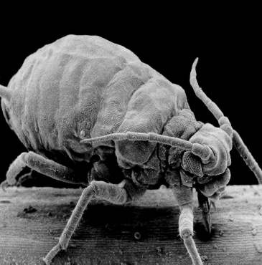
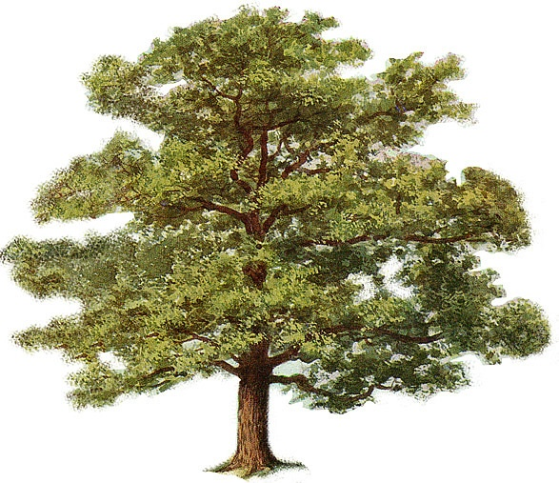
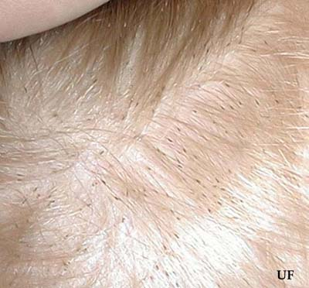
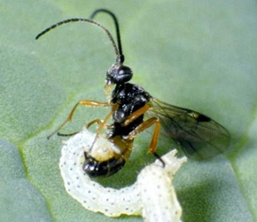
Pyramids of number
Pyramids of number allow us to compare the number of organisms present in each trophic level.
Although pyramids of number are usually pyramid-shaped i.e. Greater numbers of organisms at lower trophic levels, there are two important exceptions:
Pyramids will be upside down or inverted if there are a lot of small animals feeding on a large plant e.g. aphids feeding on an oak tree.
They are also inverted where an animal has a large number of small parasites feeding on it. On human, for example, can have a large number of head lice. The butterfly larva is being fed on by a large numbers of parasitic wasps.

Slide 13
Use chocolate blocks to construct ‘Pyramids of Numbers’ for the following food chains and then sketch these in your books.
Nettle Plant → Rabbit → Fox
Nettle plant → Small nettle aphid → Two-spot ladybird
Nettle plant → Caterpillar of peacock butterfly → Parasitic wasp

Slide 14
Ecological Pyramids
 | Fox Rabbit Nettle Plant | Two-spot ladybird Small nettle aphid Nettle plant | Parasitic wasp Caterpillar of peacock butterfly Nettle plant
Pyramids of numbers compares the number of organisms at each trophic level
Pyramids of biomass compares the mass of biological material at each trophic level
Pyramid of energy passing through each trophic level over a period of time

Slide 15
Pyramids of Biomass
Biomass is a measure of the total amount of living material in a particular place.
Pyramids of biomass allow us to compare the mass of organisms present in each trophic level at a particular time. Pyramids based on biomass are a more reliable, quantitative description of a food chain as they get over the problems of organisms differing in size. Units of biomass are usually gm⁻² where an area is being sampled, e.g. on grassland or a seashore. Where a volume is being sampled, e.g. a pond or an ocean, units are gm⁻³.
There can be drawbacks to using pyramids of biomass to describe a food chain:
Fresh mass is quite easy to assess, but the presence of varying amounts of water makes it unreliable. The use of dry mass measurement overcomes this problem but, because the organisms must be killed, it is usually only made on a small sample and this sample may not be representative.
Pyramids of numbers and pyramids of biomass only show the organisms present at a particular time, seasonal differences are not apparent. This can sometimes lead to pyramids of biomass being inverted. Also, when the producer is a small organism which multiplies very rapidly, the total biomass of the producers present at any one time may be less than the total biomass of the primary consumers. This is particularly significant when the biomass of some marine ecosystems is measured. Over the course of a whole year, the mass of phytoplankton (plants) must exceed that of zooplankton (animals), but at certain times of the year this is not seen. E.g. In early spring around the British Isles, zooplankton consume phytoplankton so rapidly that the biomass of zooplankton is greater than that of phytoplankton.

Slide 16
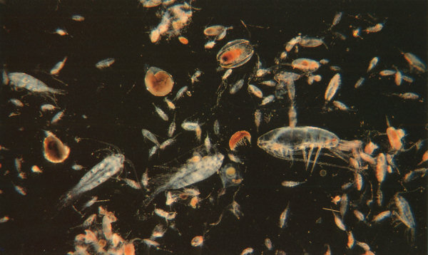
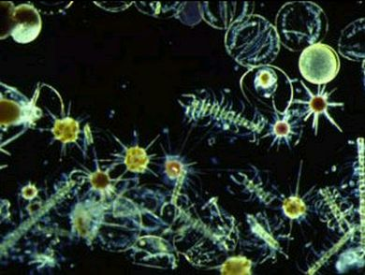

Slide 17
Use chocolate blocks to construct ‘Pyramids of Biomass’ for the following food chains and sketch these in your exercise books.
Nettle Plant → Rabbit → Fox
Nettle plant → Small nettle aphid → Two-spot ladybird
Nettle plant → Caterpillar of peacock butterfly → Parasitic wasp

Slide 18
Ecological Pyramids
 | Fox Rabbit Nettle Plant | Two-spot ladybird Small nettle aphid Nettle plant | Parasitic wasp Caterpillar of peacock butterfly Nettle plant
Pyramids of numbers compares the number of organisms at each trophic level
Pyramids of biomass compares the mass of biological material at each trophic level
Pyramid of energy passing through each trophic level over a period of time

Slide 19
Pyramids of energy
Pyramids of energy allow us to compare the amount of energy passing through each trophic level over a period of time. They differ from the other two types of ecological pyramid which measure the number and biomass of organisms present in each trophic level at a particular time.
Pyramids of energy are the most accurate representation of the energy flow through a food chain. They are always pyramid-shaped. There are no exceptions to this rule.
Data is collected in a given area (e.g. One square metre) for a set period of time, usually a year.
The results are more reliable than those of biomass, because 2 organisms of the same dry mass may store different amounts of energy. E.g. One gram of fat stores twice as much energy as one gram of carbohydrate. An organism with more fat will therefore have more stored energy than one with less fat, even though their biomass may be equal.
Units of energy flow are kJm⁻²year⁻¹
Drawbacks to these pyramids include:
Collecting data for pyramids of energy can be difficult and complex.

Slide 20
Ecological Pyramids
 | Fox Rabbit Nettle Plant | Two-spot ladybird Small nettle aphid Nettle plant | Parasitic wasp Caterpillar of peacock butterfly Nettle plant
Pyramids of numbers compares the number of organisms at each trophic level
Pyramids of biomass compares the mass of biological material at each trophic level
Pyramid of energy passing through each trophic level over a period of time

Slide 21
Plenary: Summary questions
State 2 advantages of using a pyramid of biomass rather than a pyramid of numbers when representing quantitative information on a food chain (2 marks).
Explain how a pyramid of biomass for a marine ecosystem may sometimes show producers (phytoplankton) with a smaller biomass than primary consumers (zoo plankton) (1 mark).
Name suitable units for the measurement of biomass (2 marks).

Slide 22
Peer Assessment: Answers
In a pyramid of numbers: no account is taken of size (1 mark) /the pyramid of individuals of one species may be so great that it is impossible to represent them on the same scale as other species in the food chain (1 mark).
At certain times of year (e.g. Spring) zooplankton consume phytoplankton so rapidly that their biomass temporarily exceeds that of phytoplankton (1 mark).
Grams per square metre (gm⁻²) (1 mark)/ grams per cubic metre (gm⁻³) (1 mark)

Slide 23
Grade Boundaries
5 marks: A
4 marks: B
3 marks: C
2 marks: D
1 mark: E

Slide 24
Learning Objectives
All students should know...
...what the different types of ecological pyramid are.
...what are the relative merits and disadvantages of each pyramid are.
Specification reference: 3.4.5

Slide 25
Success Criteria
All students should be able to:
Construct pyramids of number, biomass and energy from a food chain or food web.
Correctly label their pyramids.
Outline strengths and weaknesses of the different pyramids.
Answer exam style questions on pyramids.

