Slide 1
The heart and heart disease
5.3 Heart disease –
Risk factors

Slide 2
Learning outcomes
Student should understand the following:
Risk factors associated with coronary heart disease: diet, blood cholesterol, cigarette smoking and high blood pressure.
Candidates should be able to describe and explain data relating to the relationship between specific risk factors and the incidence of coronary heart disease.

Slide 3
Risk factors associated with CHD
Smoking
High blood pressure
High blood cholesterol
Diet

Slide 4
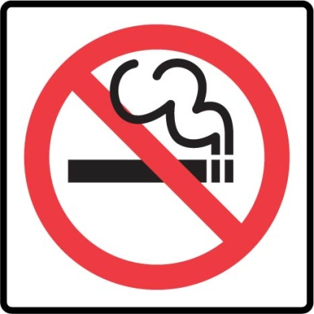
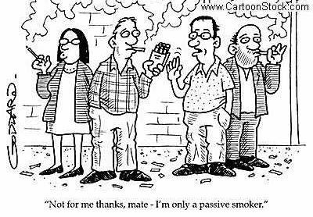
Smoking
Smokers are between 2 and 6 times more likely to suffer from CHD than non-smokers.
The 2 main components of tobacco smoke that increase the likelihood of heart disease are:
Carbon monoxide
Nicotine

Slide 5
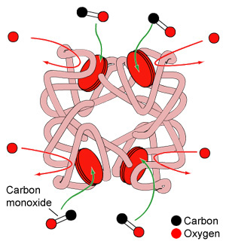
Smoking
Carbon monoxide :
Reduces the oxygen carrying capacity of the blood by combining easily and irreversibly with haemoglobin.
Therefore the heart must work harder to supply the equivalent amount of oxygen and this raises blood pressure.
The reduced O2 carrying capacity may also mean that there may be insufficient oxygen to supply the heart muscle during exercise.

Slide 6
Smoking
Nicotine:
Stimulates the production of the hormone adrenaline which increases heart rate and raises blood pressure.
Also makes red blood cells more ‘sticky’ and this leads to a higher risk of thrombosis.
Executives from major tobacco firms being sworn in at a congressional hearing (April 1994) where they testified that they believed that nicotine was not addictive.

Slide 7
High blood pressure
High blood pressure can be genetic and this you cannot control.
Certain lifestyle factors you can control:
Excessive prolonged stress
Certain diets esp including high salt content
Lack of exercise
Coronary Heart Disease 2.swf

Slide 8
High blood pressure
High blood pressure increases the risk of CHD for the following reasons:
The heart must work harder to pump blood into the arteries and is therefore more prone to failure.
High blood pressure in the arteries means they are more likely to develop aneurysm and burst, causing haemorrhage.
To resist the higher pressure the walls of the arteries may become thickened and harden, restricting blood flow.

Slide 9
Blood cholesterol
Cholesterol is an essential component of membranes, it is carried in the plasma as lipoproteins. There are 2 main types:
High density lipoproteins (HDLs) – remove cholesterol from tissues and transport it to the liver for excretion.
Low density lipoproteins (LDLs) – transport cholesterol from the liver to the tissues, including the artery walls. Here they can lead to an atheroma.
LDL and HDL.swf

Slide 10
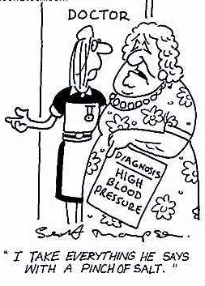
Diet
Diet can affect the risk of heart disease both directly and indirectly.
High levels of salt raise blood pressure
High levels of saturated fat increase LDL levels and hence blood cholesterol concentration.
Food that act as antioxidants (Vitamin C) and dietary fibre reduce the risk of heart disease.

Slide 11
Learning outcomes
Student should understand the following:
Risk factors associated with coronary heart disease: diet, blood cholesterol, cigarette smoking and high blood pressure.
Candidates should be able to describe and explain data relating to the relationship between specific risk factors and the incidence of coronary heart disease.

